Slide 1

Maximus PR

Slide 2
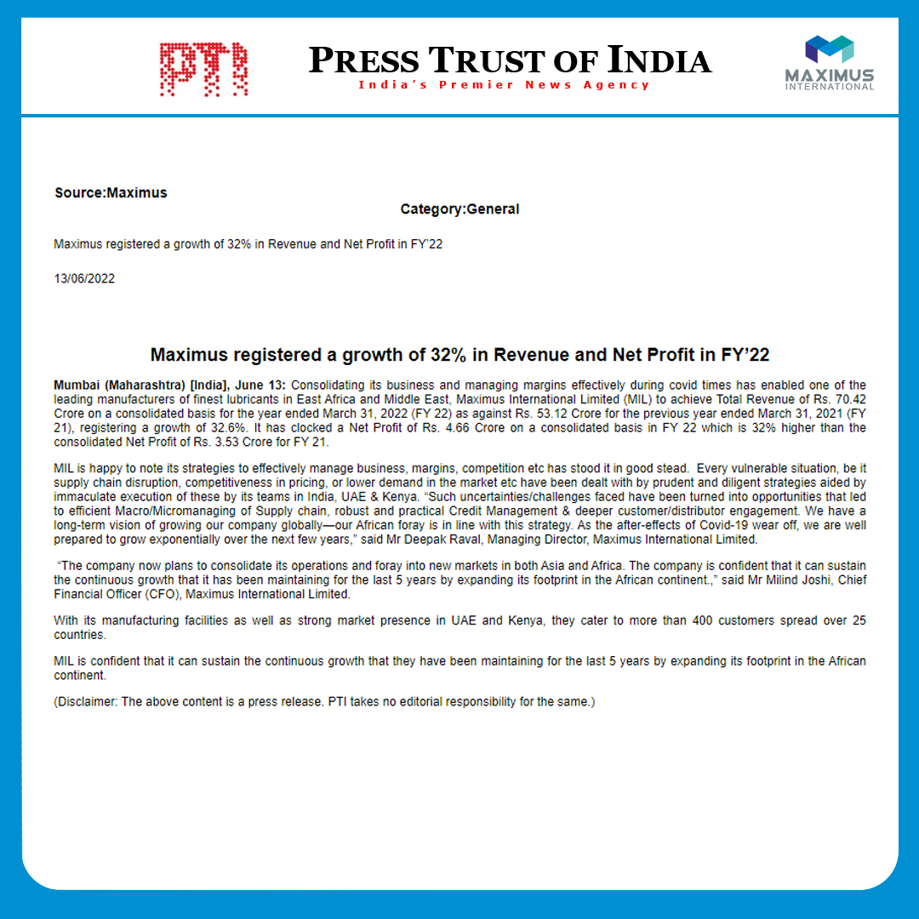
Notes:
http://www.ptinews.com/pressrelease/55539_press-subMaximus-registered-a-growth-of-32--in-Revenue-and-Net-Profit-in-FY-22

Slide 3
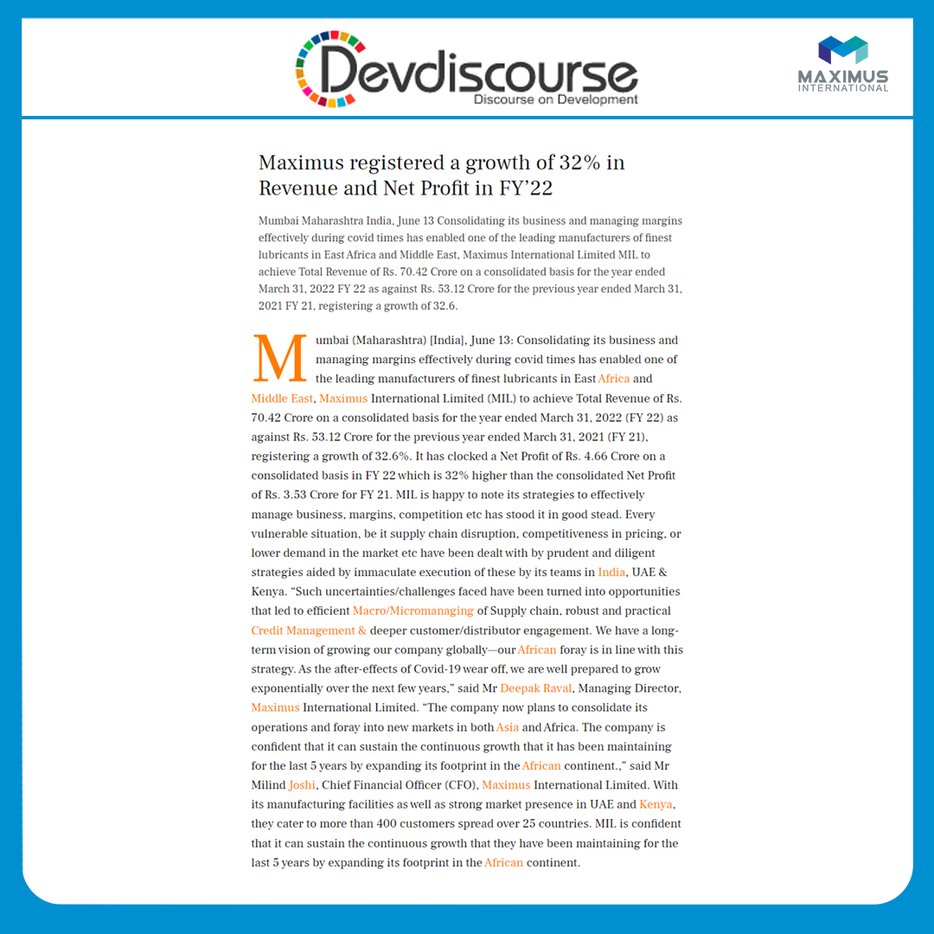
Notes:
https://www.devdiscourse.com/article/business/2071234-maximus-registered-a-growth-of-32-in-revenue-and-net-profit-in-fy22

Slide 4
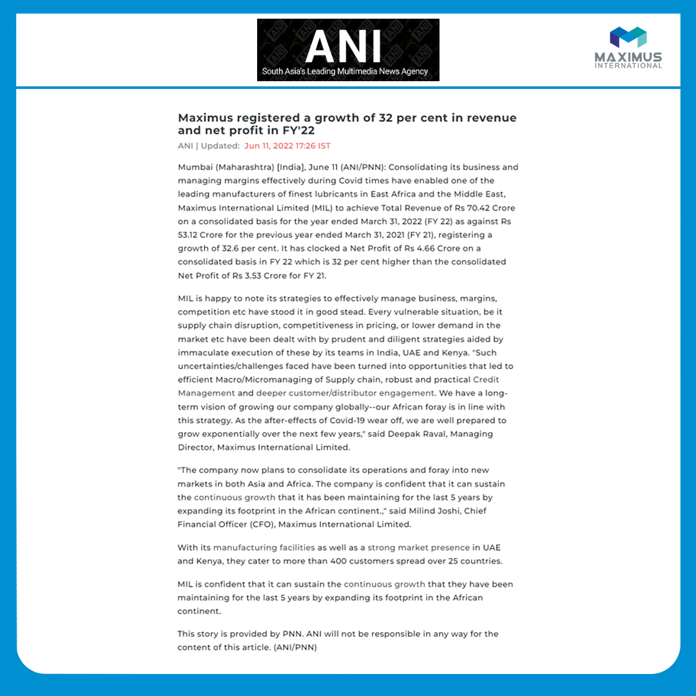
Notes:
https://www.aninews.in/news/business/business/maximus-registered-a-growth-of-32-per-cent-in-revenue-and-net-profit-in-fy2220220611172639/

Slide 5

Notes:
https://www.business-standard.com/content/press-releases-ani/maximus-registered-a-growth-of-32-per-cent-in-revenue-and-net-profit-in-fy-22-122061100758_1.html#:~:text=It%20has%20clocked%20a%20Net,stood%20it%20in%20good%20stead

Slide 6
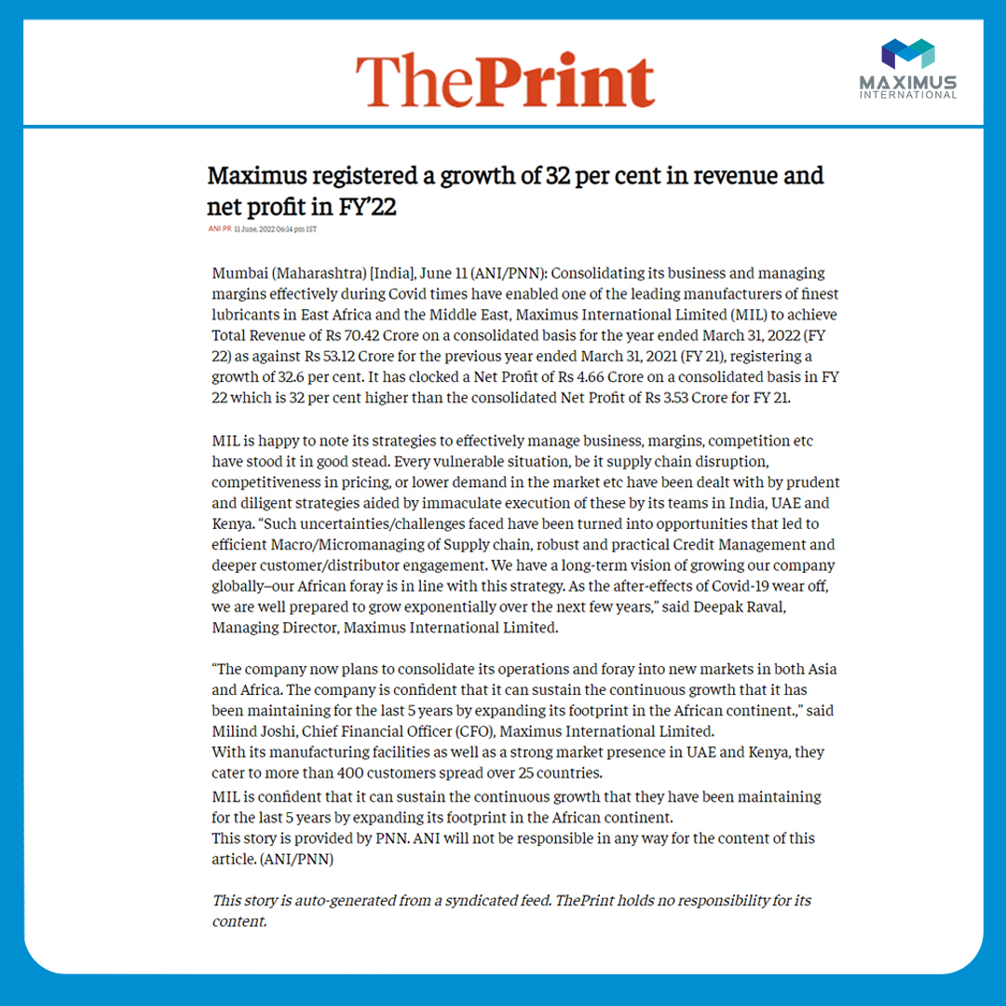
Notes:
https://theprint.in/ani-press-releases/maximus-registered-a-growth-of-32-per-cent-in-revenue-and-net-profit-in-fy22/992901/

Slide 7
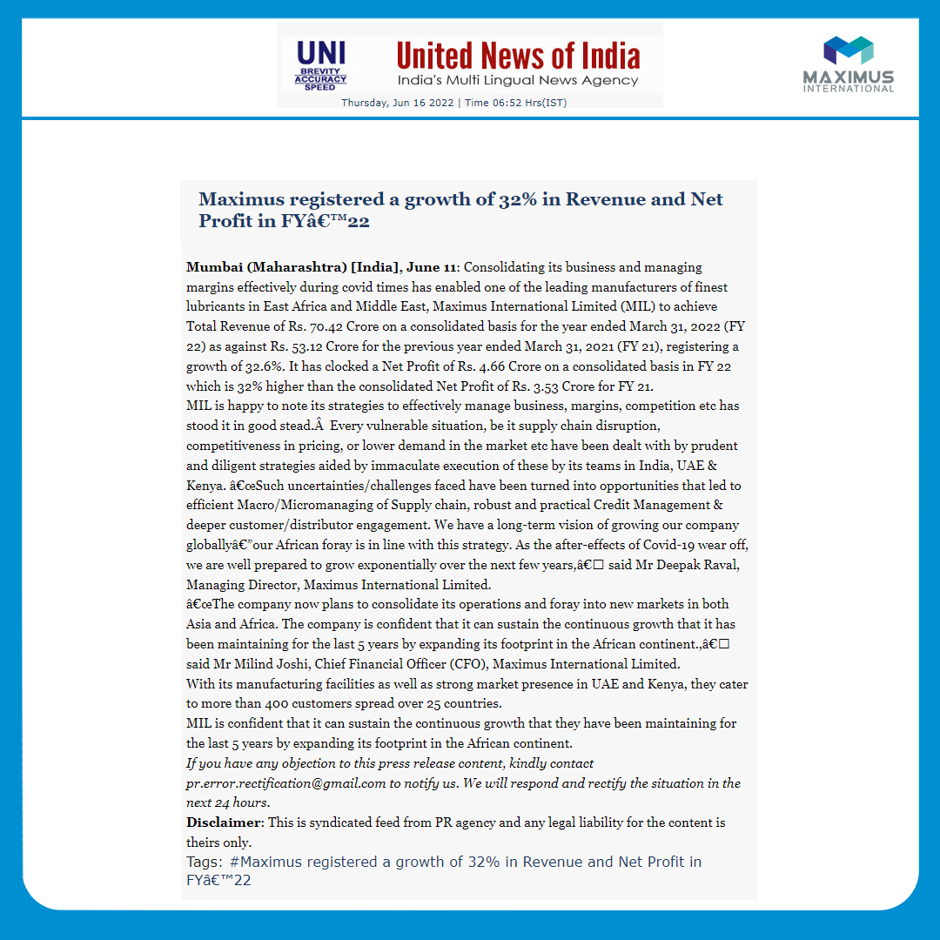
Notes:
http://www.uniindia.com/maximus-registered-a-growth-of-32-in-revenue-and-net-profit-in-fy%C3%A2-22/pnn/news/2755177.html

Slide 8
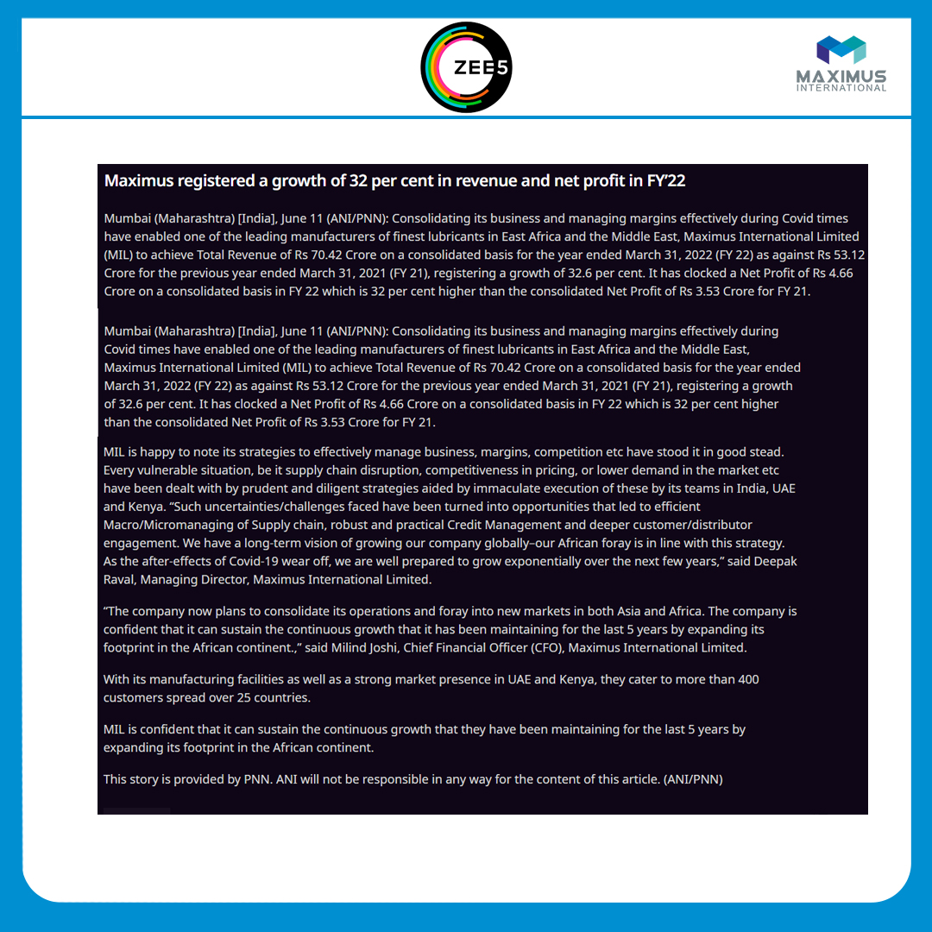
Notes:
https://www.zee5.com/articles/maximus-registered-a-growth-of-32-per-cent-in-revenue-and-net-profit-in-fy22

Slide 9

Notes:
https://www.zee5.com/articles/maximus-registered-a-growth-of-32-per-cent-in-revenue-and-net-profit-in-fy22

Slide 10
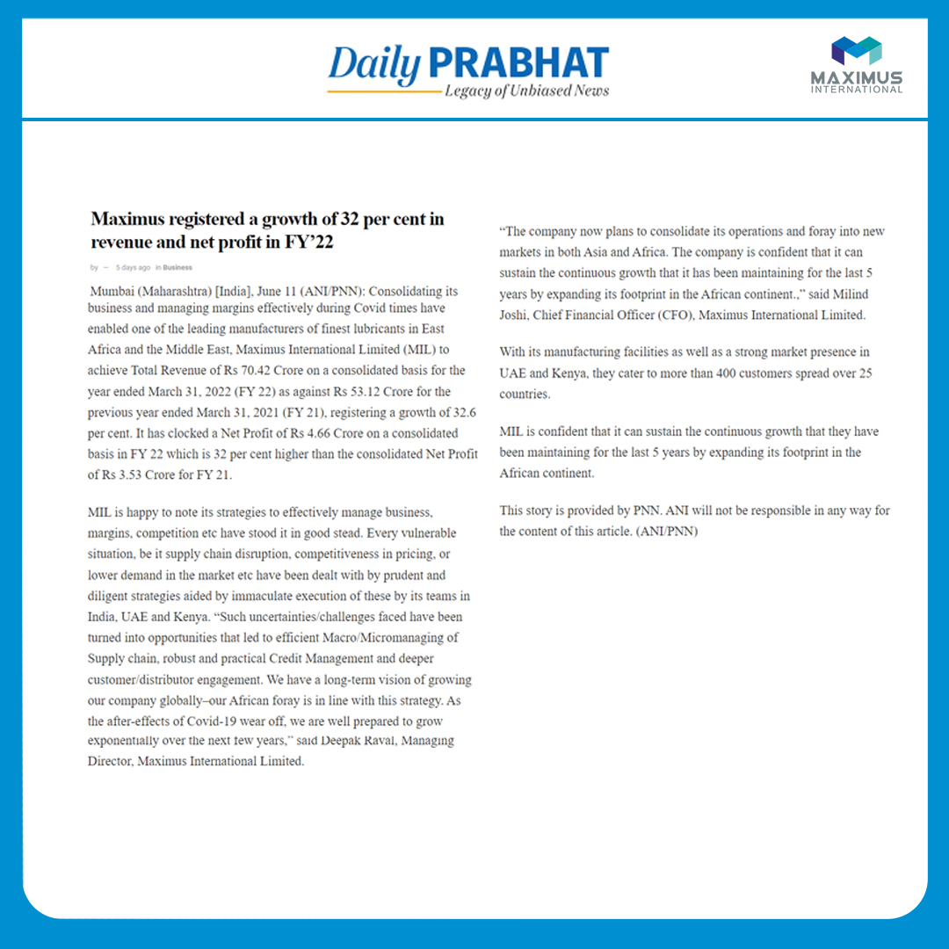
Notes:
https://www.business-standard.com/content/press-releases-ani/maximus-registered-a-growth-of-32-per-cent-in-revenue-and-net-profit-in-fy-22-122061100758_1.html#:~:text=It%20has%20clocked%20a%20Net,stood%20it%20in%20good%20stead

Slide 11
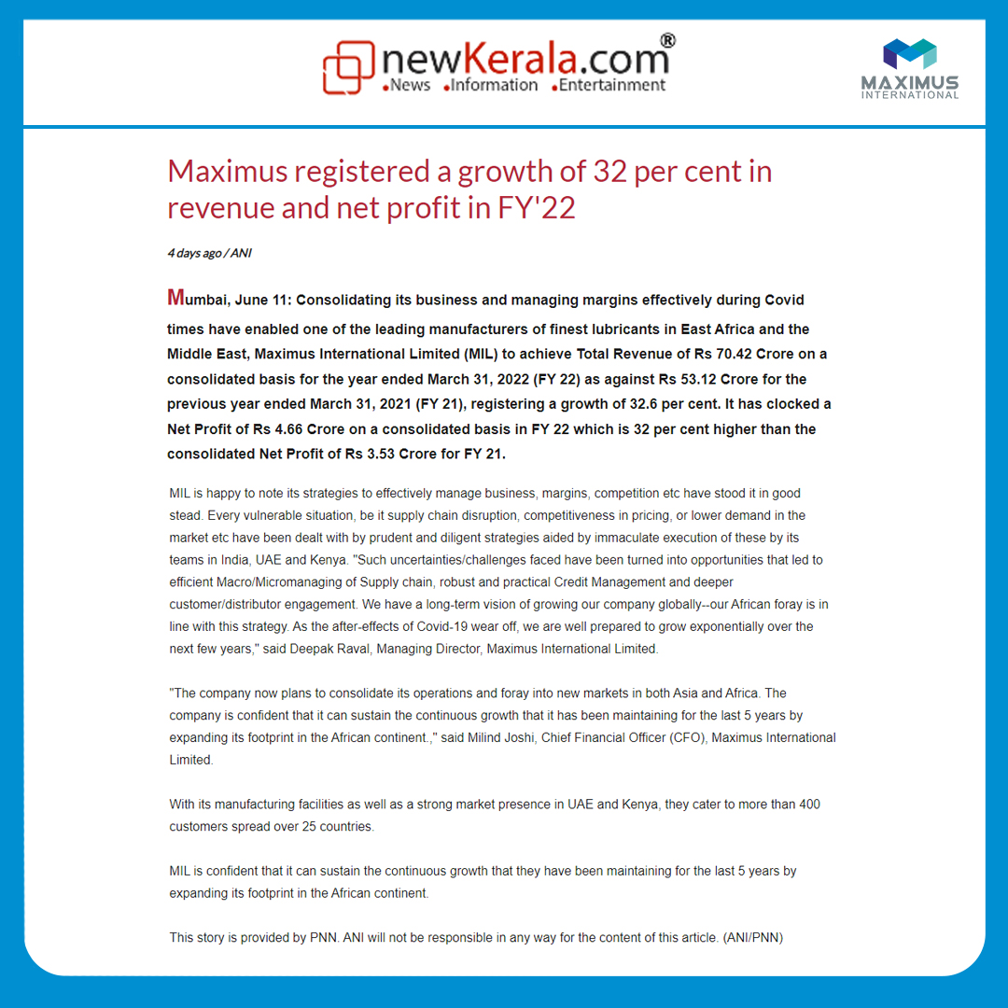
Notes:
https://www.newkerala.com/news/2022/77727.htm

Slide 12

Notes:
https://m.dailyhunt.in/news/india/english/daily+prabhat-epaper-dlyprbte/maximus+registered+a+growth+of+32+per+cent+in+revenue+and+net+profit+in+fy22-newsid-n394525892?s=a&uu=0xa75317646e3f2bc8&ss=pd

Slide 13
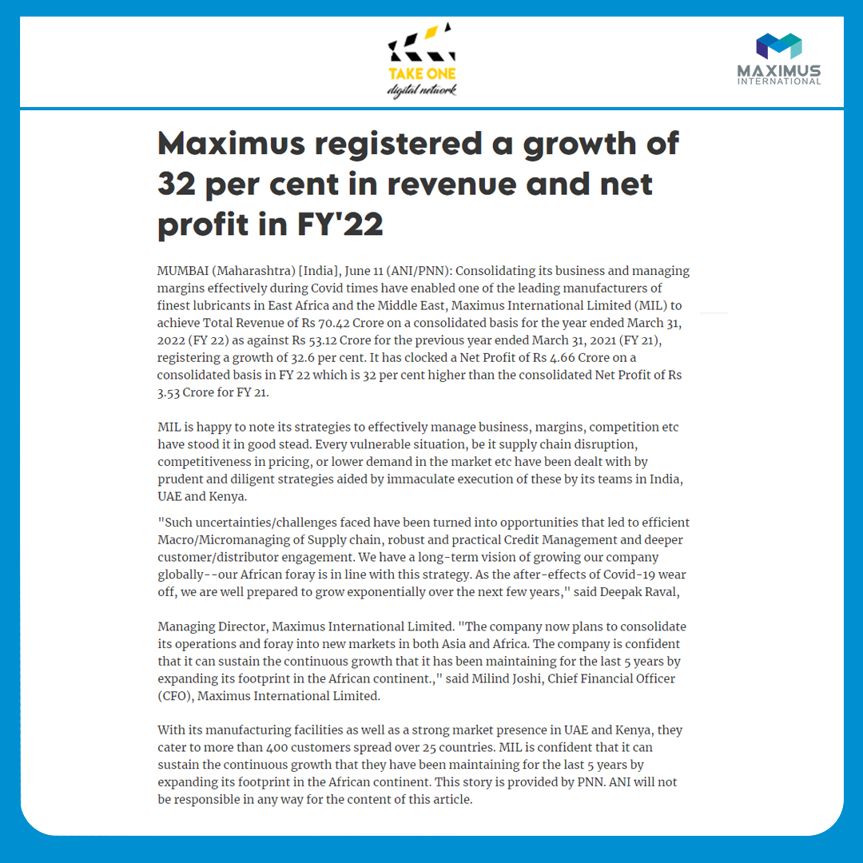
Notes:
https://www.takeonedigitalnetwork.com/post/maximus-registered-a-growth-of-32-per-cent-in-revenue-and-net-profit-in-fy-22

Slide 14

Notes:
https://www.illustrateddailynews.com/maximus-registered-a-growth-of-32-per-cent-in-revenue-and-net-profit-in-fy22/

Slide 15
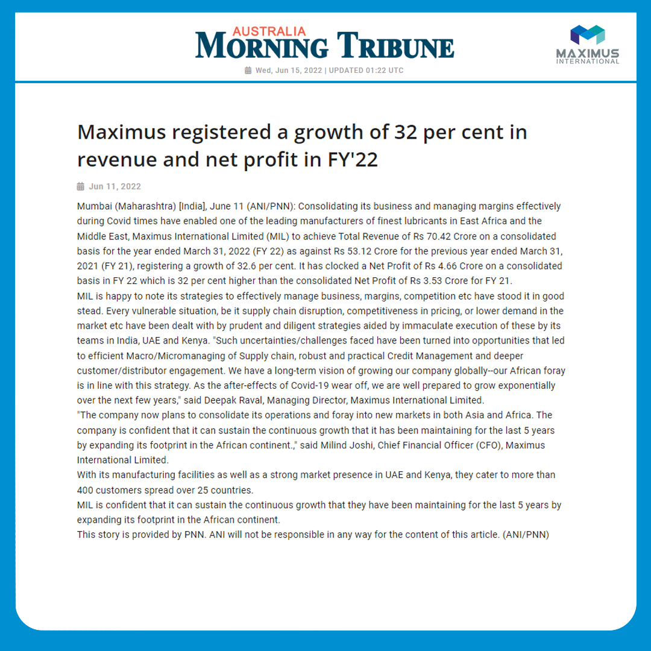
Notes:
https://www.australiamorningtribune.com/news/maximus-registered-a-growth-of-32-per-cent-in-revenue-and-net-profit-in-fy2220220611172635/

Slide 16
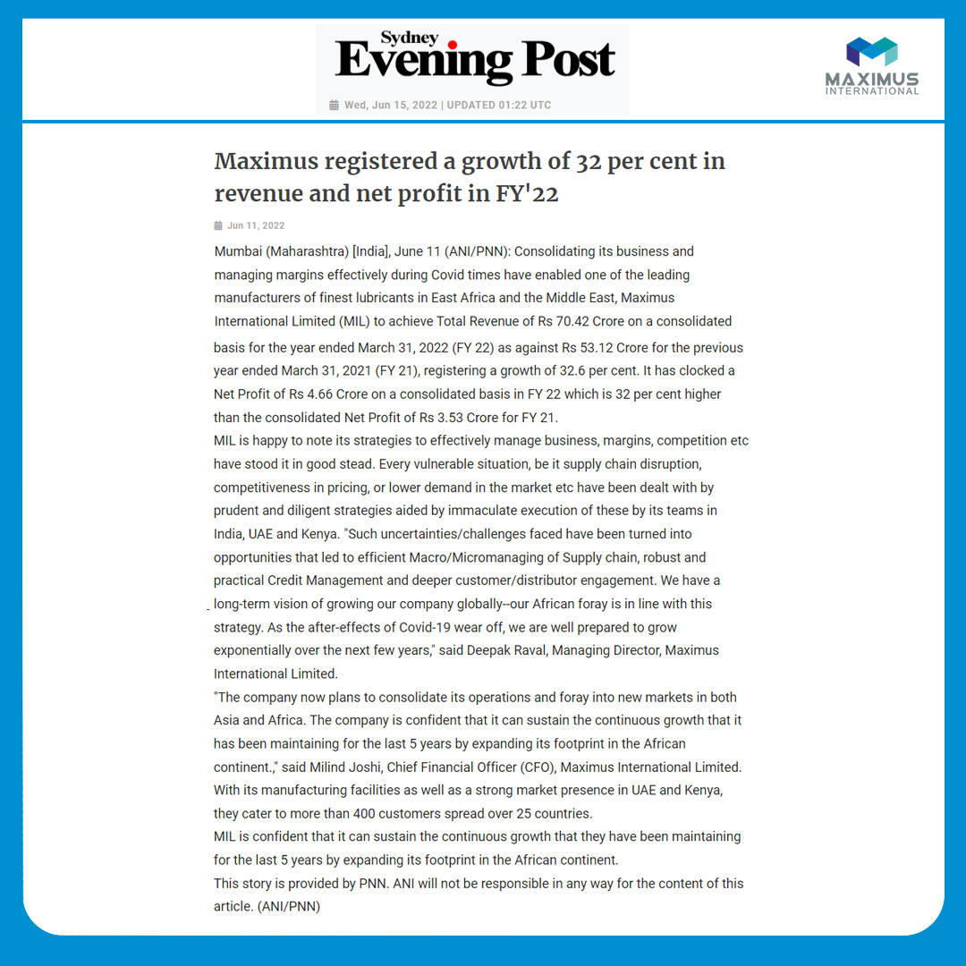
Notes:
https://www.sydneyeveningpost.com/news/maximus-registered-a-growth-of-32-per-cent-in-revenue-and-net-profit-in-fy2220220611172635/

Slide 17
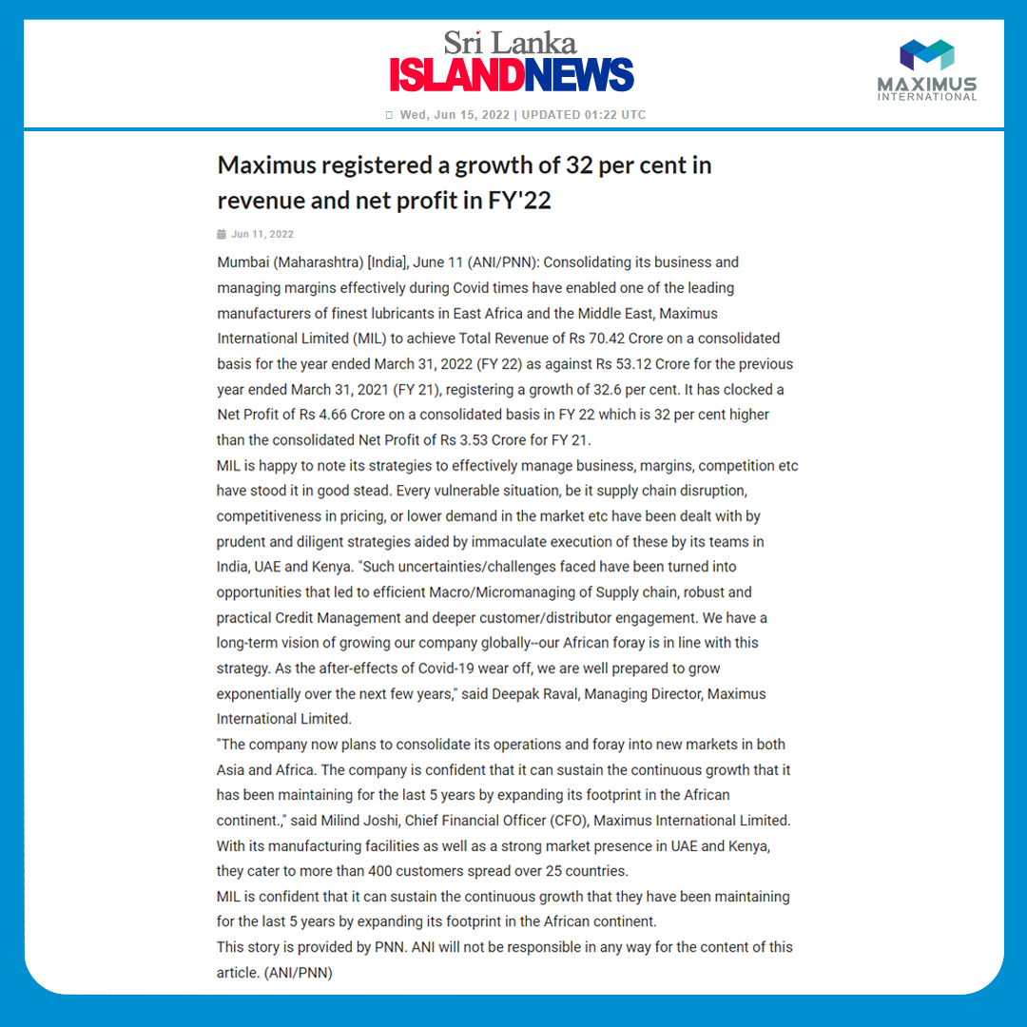
Notes:
https://www.srilankaislandnews.com/news/maximus-registered-a-growth-of-32-per-cent-in-revenue-and-net-profit-in-fy2220220611172635/

Slide 18
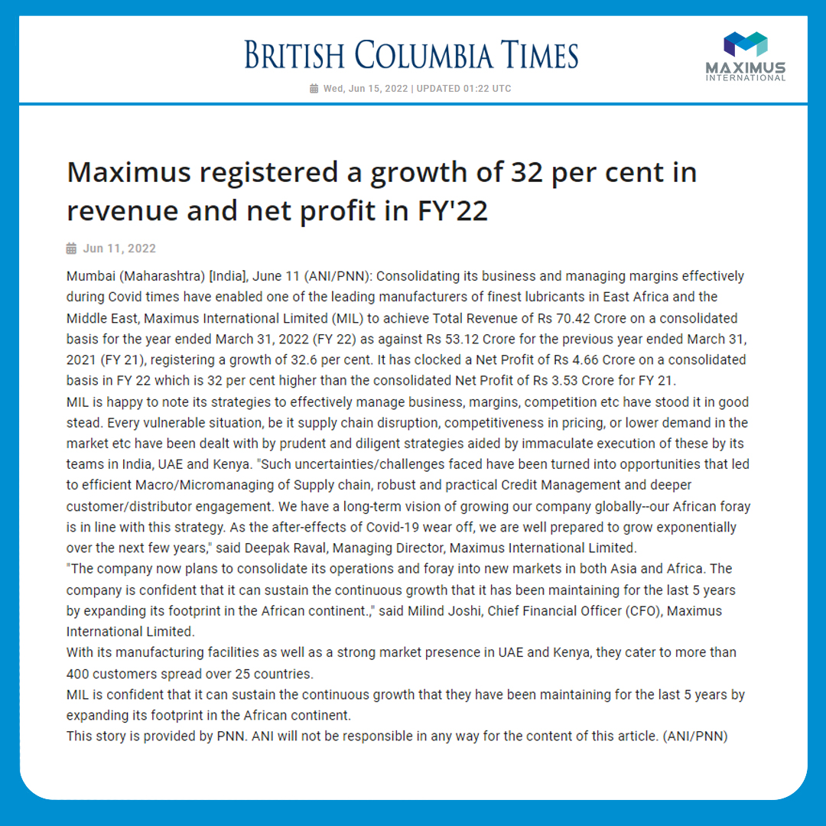
Notes:
https://www.britishcolumbiatimes.com/news/maximus-registered-a-growth-of-32-per-cent-in-revenue-and-net-profit-in-fy2220220611172635/

Slide 19
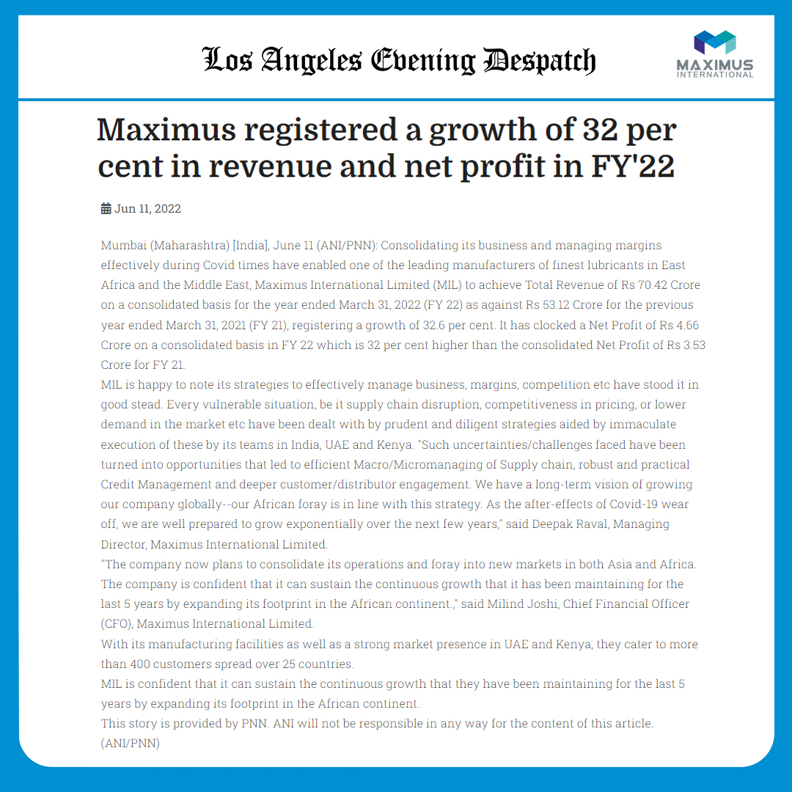
Notes:
https://www.losangeleseveningdespatch.com/news/maximus-registered-a-growth-of-32-per-cent-in-revenue-and-net-profit-in-fy2220220611172635/

Slide 20
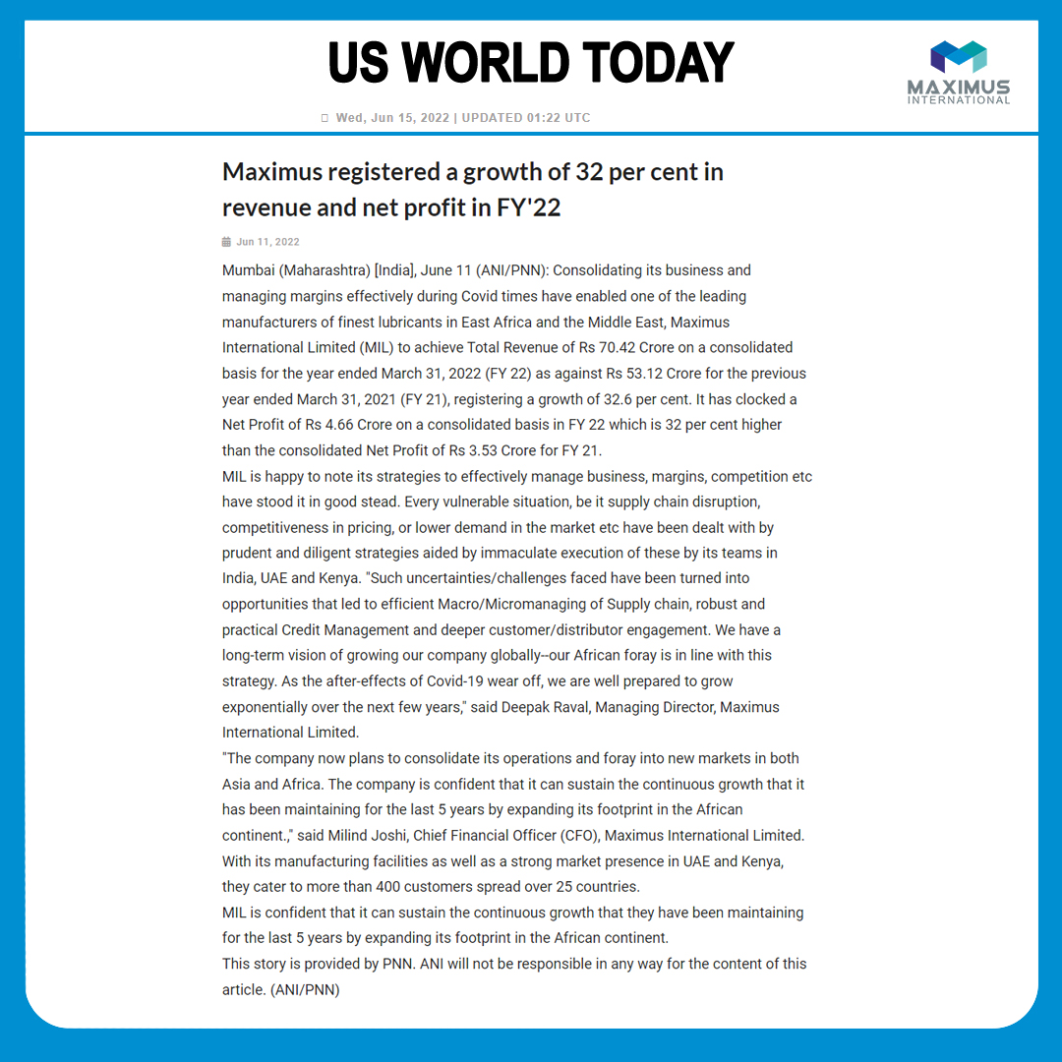
Notes:
https://www.usworldtoday.com/news/maximus-registered-a-growth-of-32-per-cent-in-revenue-and-net-profit-in-fy2220220611172635/

Slide 21
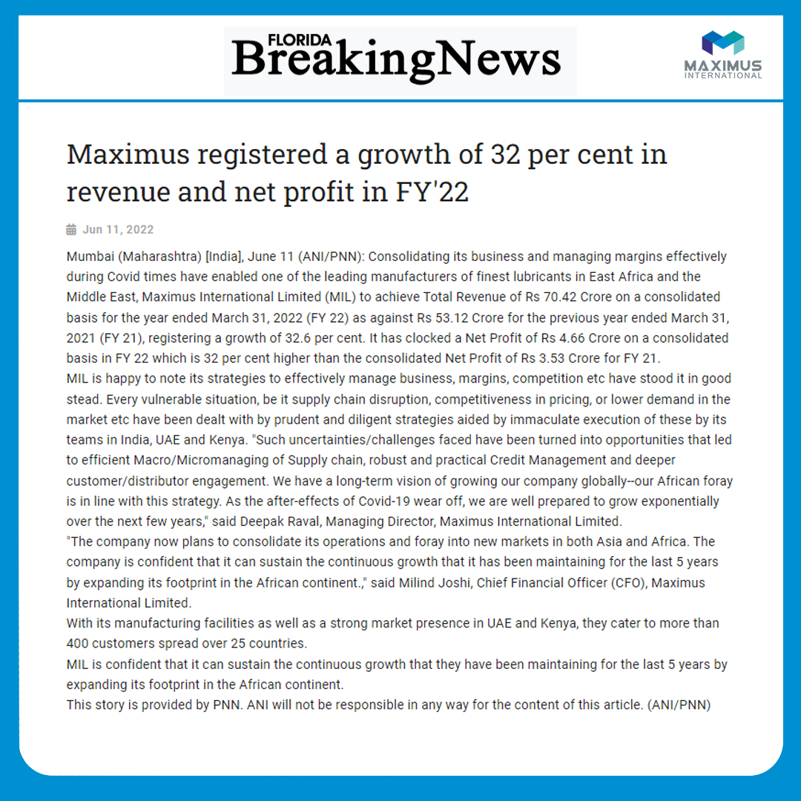
Notes:
https://www.floridabreakingnews.com/news/maximus-registered-a-growth-of-32-per-cent-in-revenue-and-net-profit-in-fy2220220611172635/

Slide 22

Notes:
https://www.richmondeveningnews.com/news/maximus-registered-a-growth-of-32-per-cent-in-revenue-and-net-profit-in-fy2220220611172635/

Slide 23
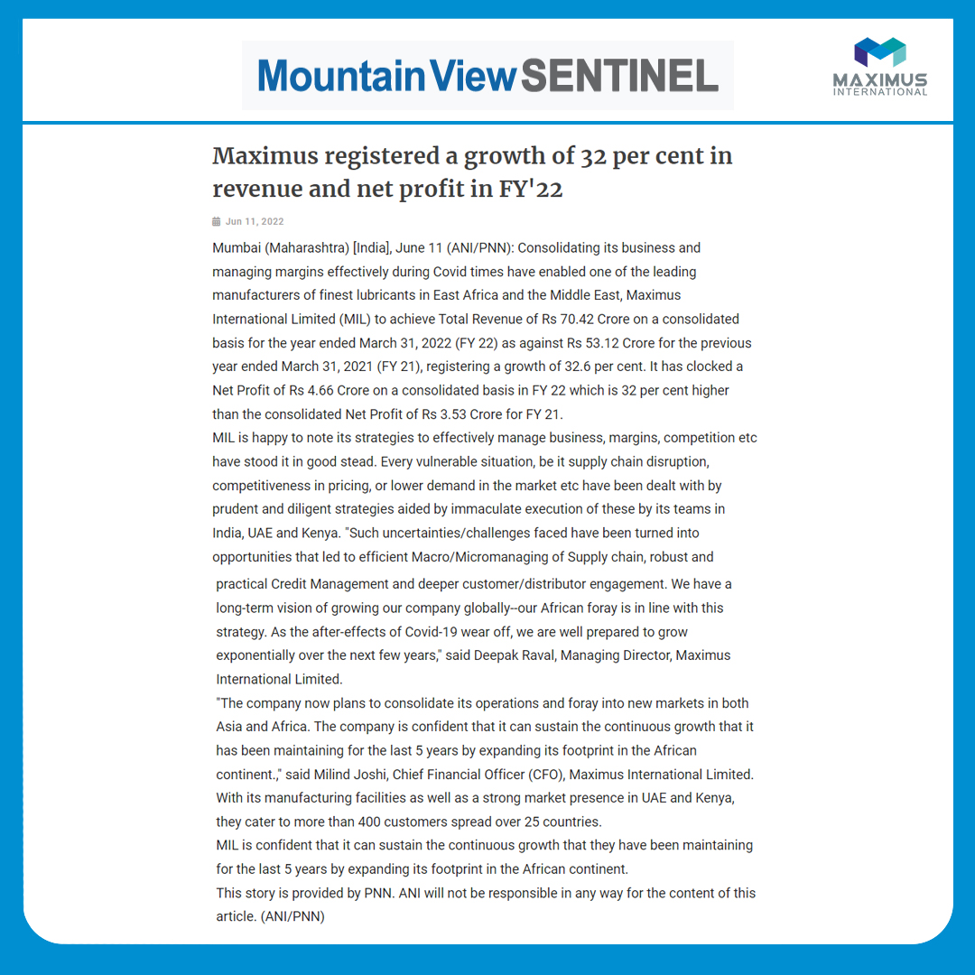
Notes:
https://www.mountainviewsentinel.com/news/maximus-registered-a-growth-of-32-per-cent-in-revenue-and-net-profit-in-fy2220220611172635/

Slide 24
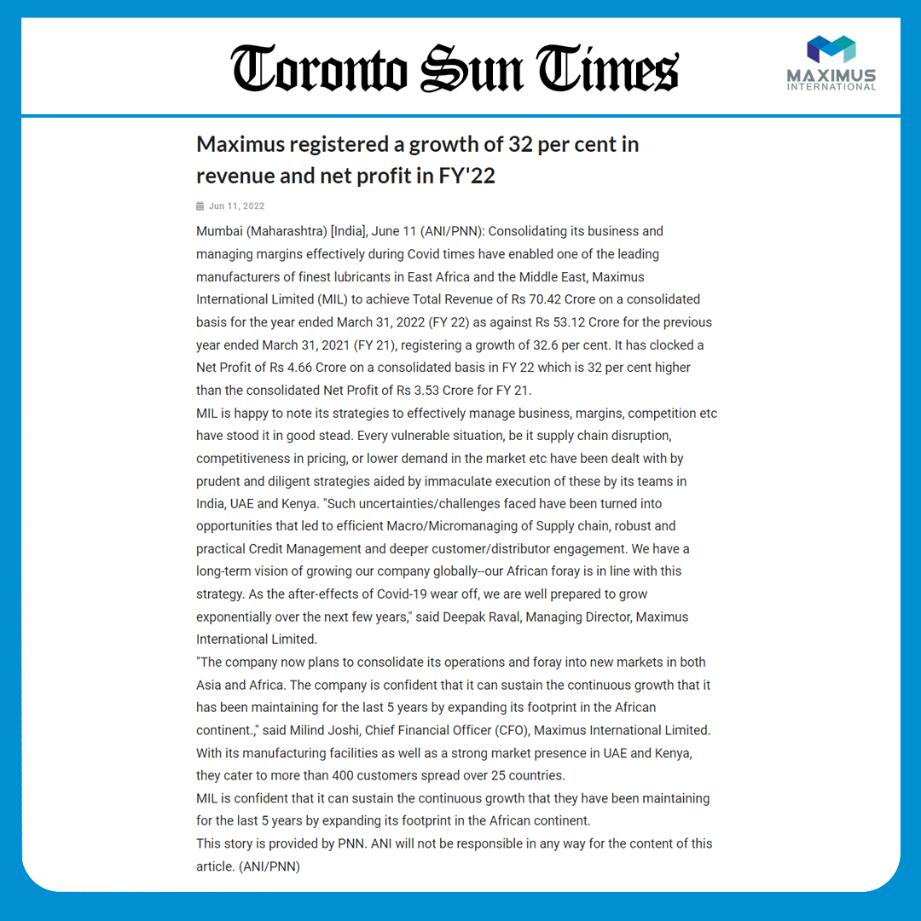
Notes:
https://www.torontosuntimes.com/news/maximus-registered-a-growth-of-32-per-cent-in-revenue-and-net-profit-in-fy2220220611172635/

Slide 25
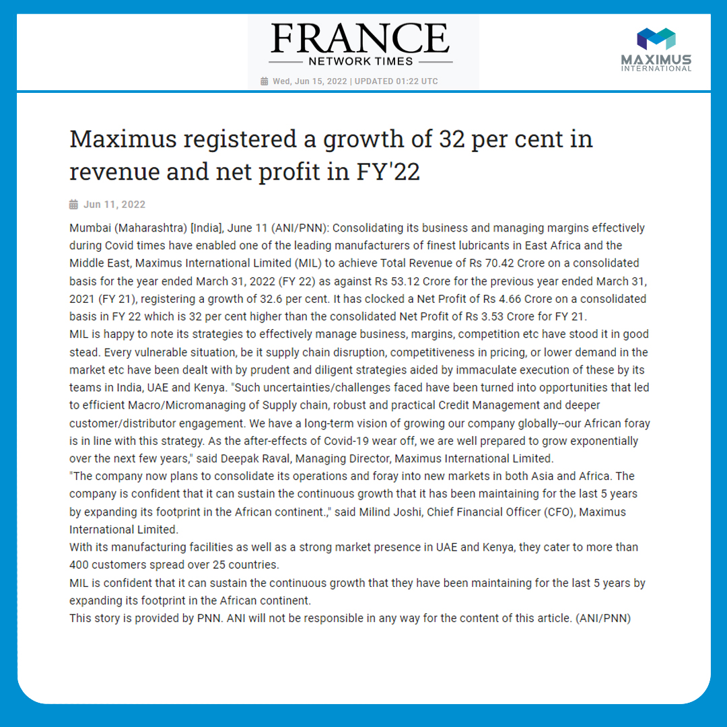
Notes:
https://www.francenetworktimes.com/news/maximus-registered-a-growth-of-32-per-cent-in-revenue-and-net-profit-in-fy2220220611172635/

Slide 26
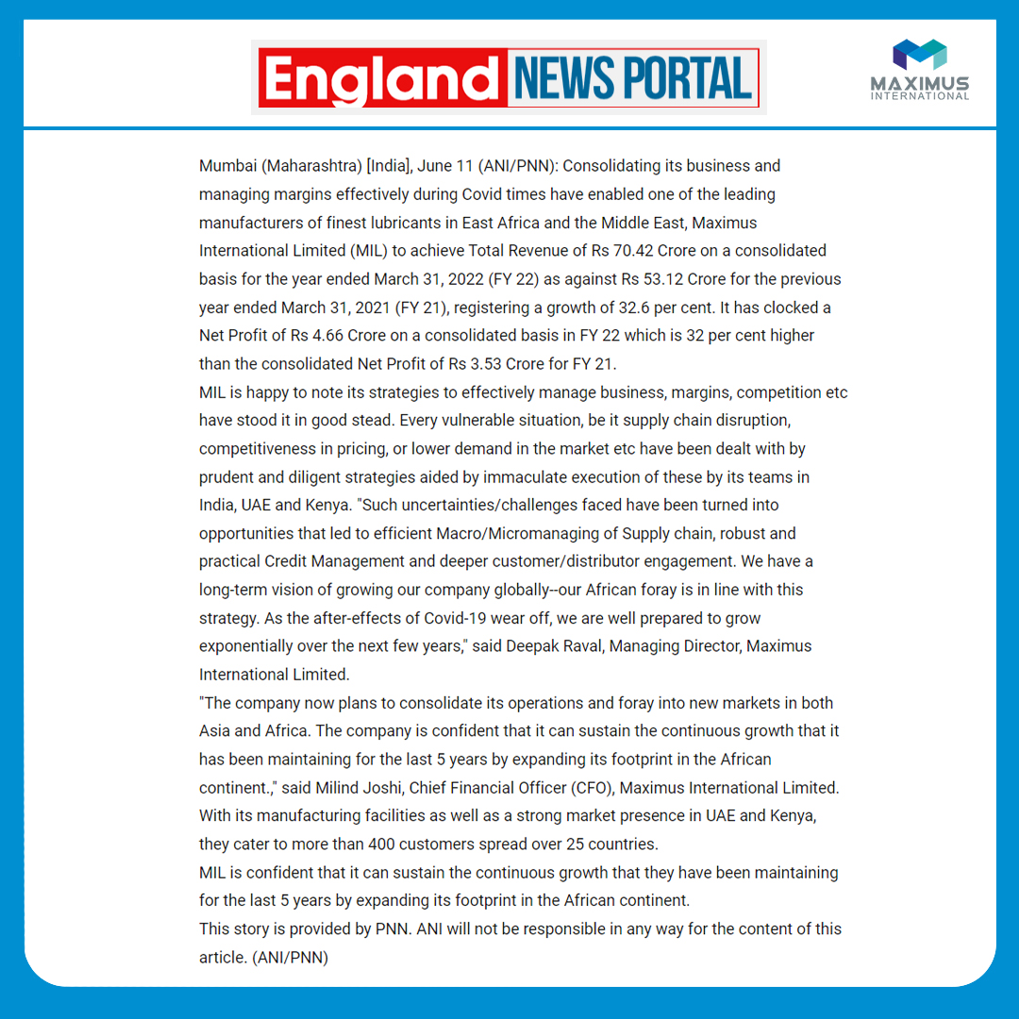
Notes:
https://www.englandnewsportal.com/news/maximus-registered-a-growth-of-32-per-cent-in-revenue-and-net-profit-in-fy2220220611172635/

Slide 27
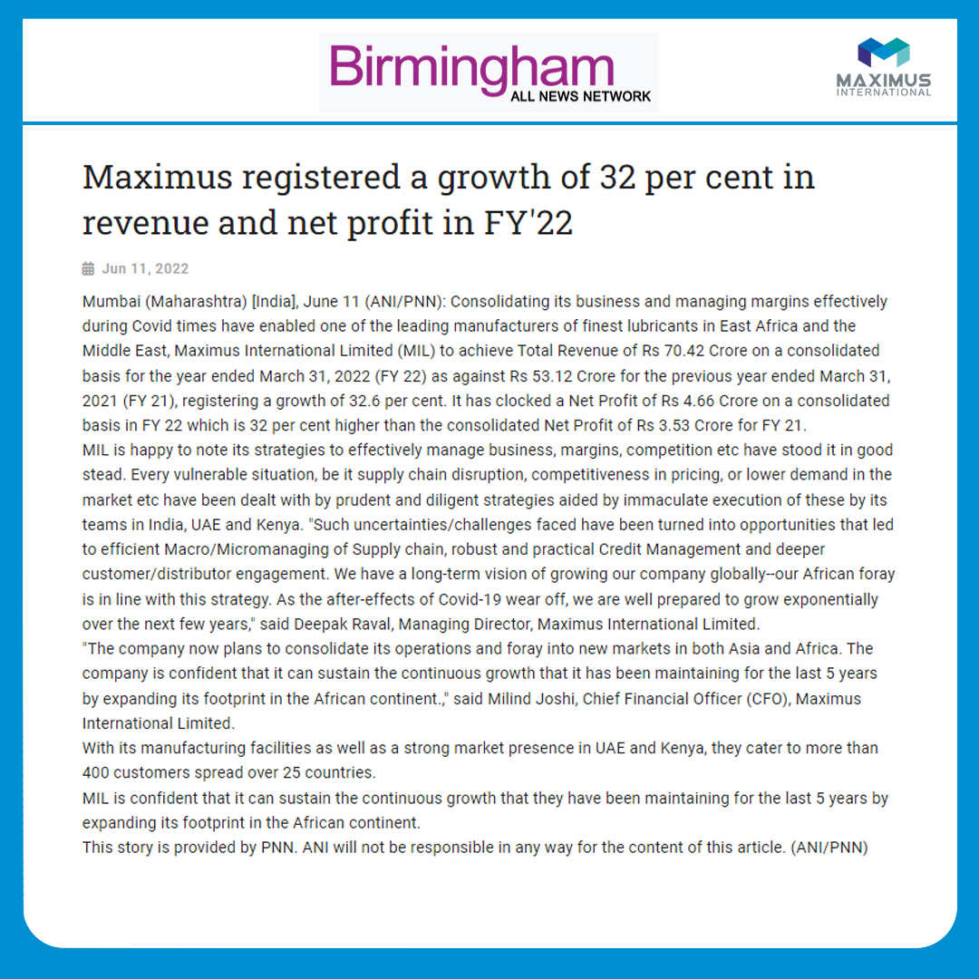
Notes:
https://www.birminghamallnewsnetwork.com/news/maximus-registered-a-growth-of-32-per-cent-in-revenue-and-net-profit-in-fy2220220611172635/

Slide 28
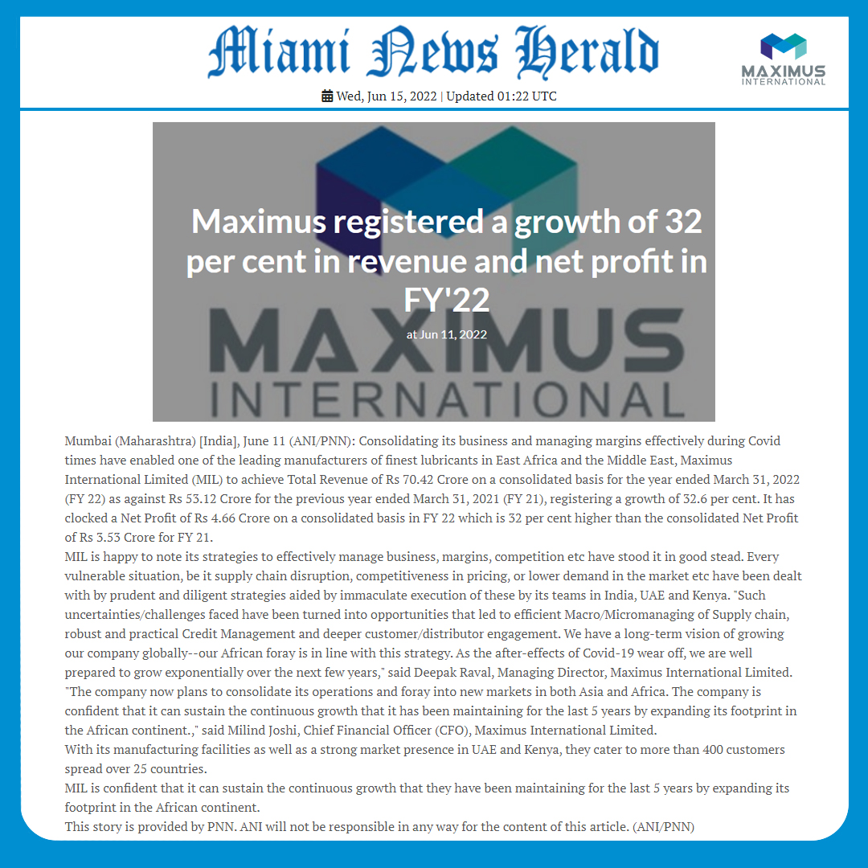
Notes:
https://www.miaminewsherald.com/news/maximus-registered-a-growth-of-32-per-cent-in-revenue-and-net-profit-in-fy2220220611172635/

Slide 29
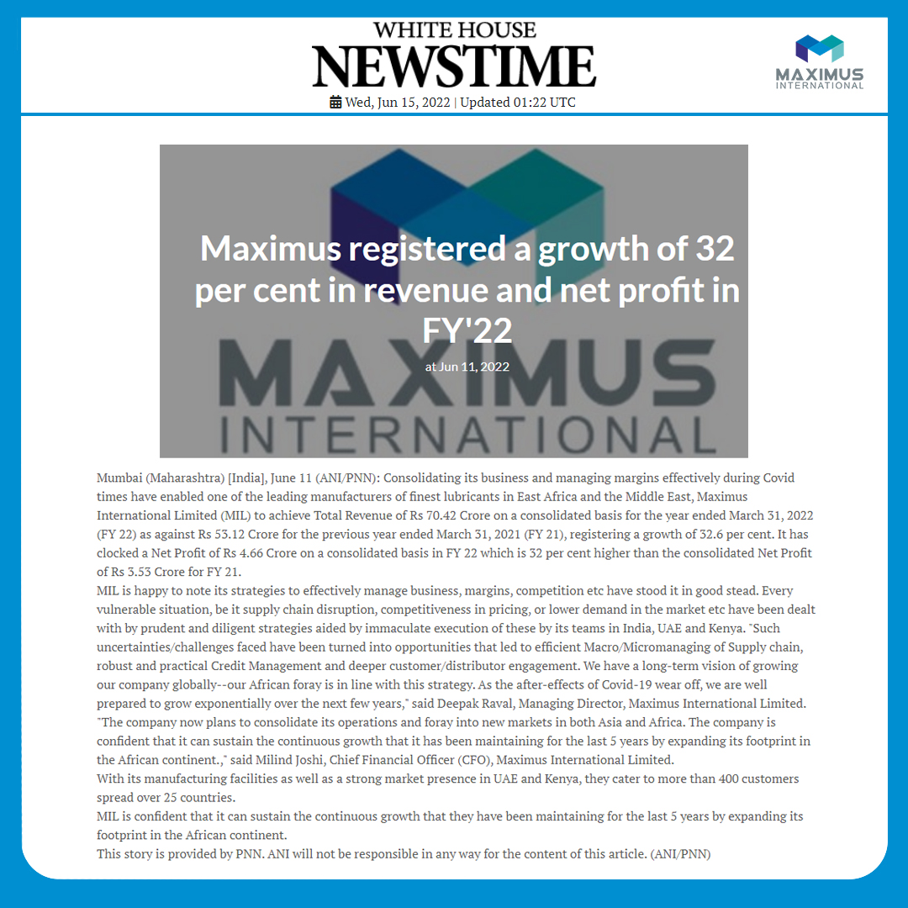
Notes:
https://www.whitehousenewstime.com/news/maximus-registered-a-growth-of-32-per-cent-in-revenue-and-net-profit-in-fy2220220611172635/

Slide 30
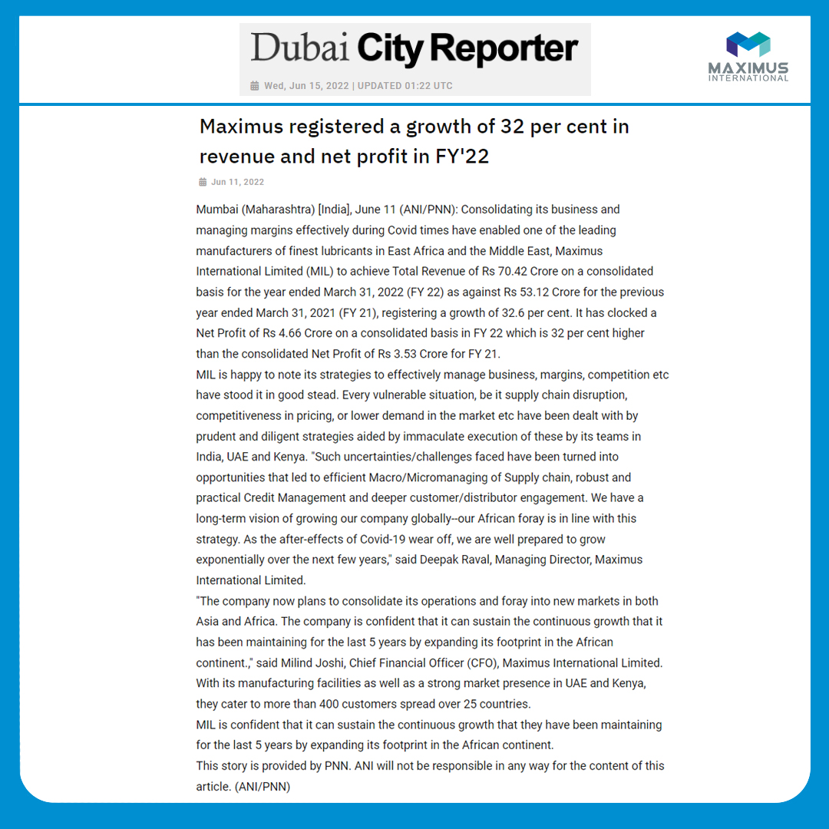
Notes:
https://www.dubaicityreporter.com/news/maximus-registered-a-growth-of-32-per-cent-in-revenue-and-net-profit-in-fy2220220611172635/

Slide 31
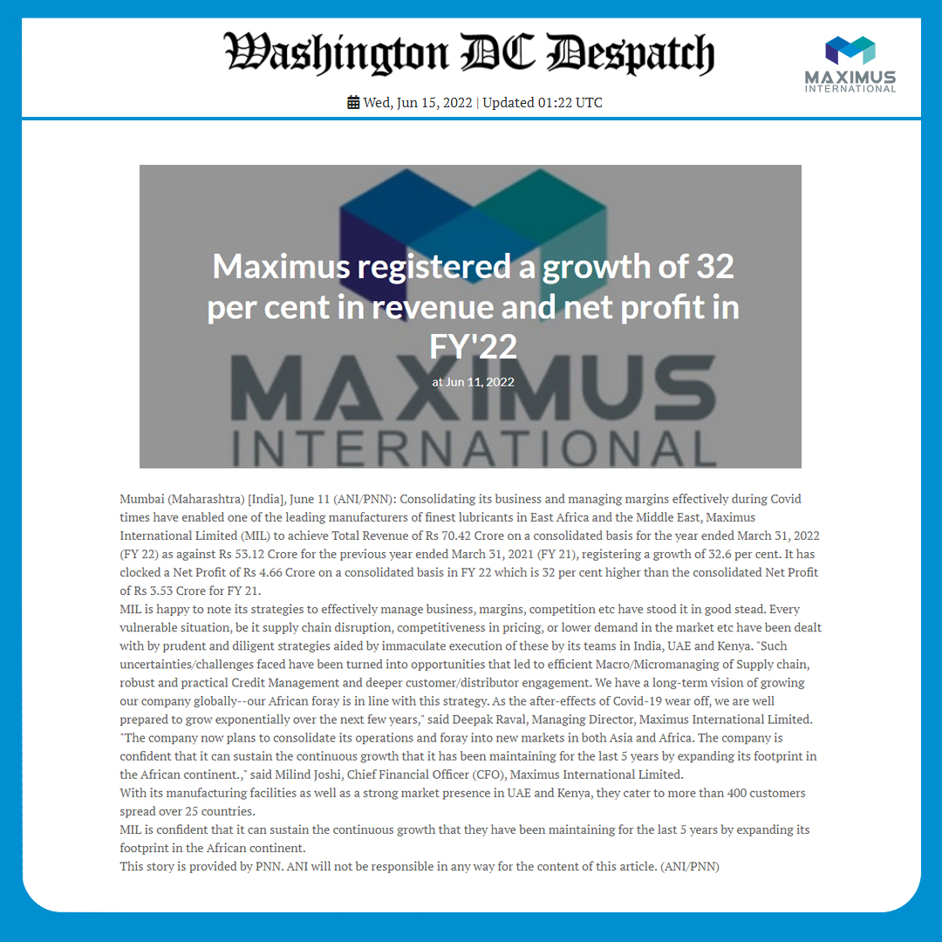
Notes:
https://www.washingtondcdespatch.com/news/maximus-registered-a-growth-of-32-per-cent-in-revenue-and-net-profit-in-fy2220220611172635/

Slide 32
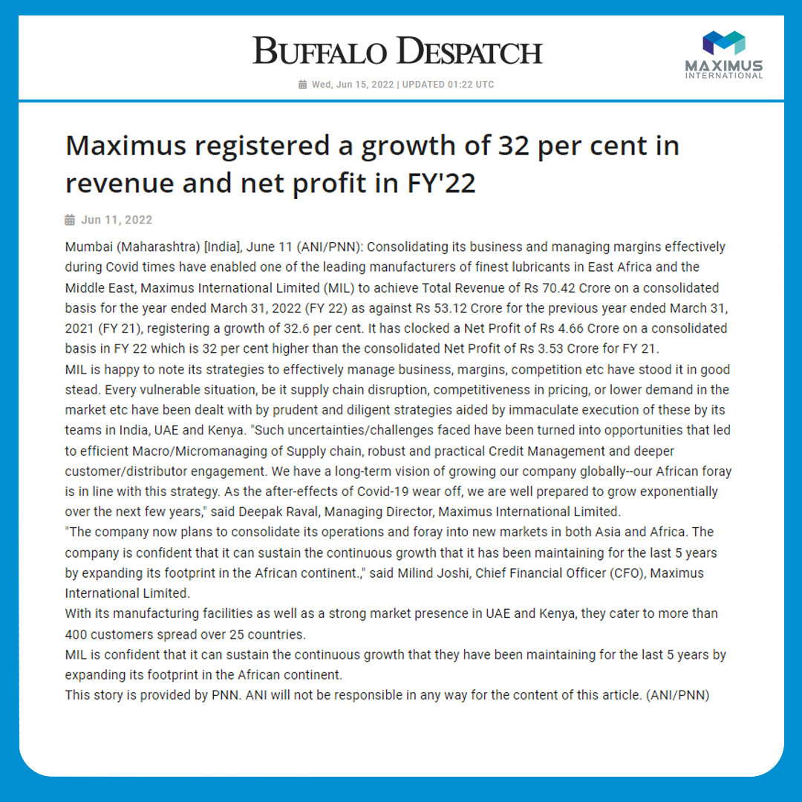
Notes:
https://www.buffalodespatch.com/news/maximus-registered-a-growth-of-32-per-cent-in-revenue-and-net-profit-in-fy2220220611172635/

Slide 33
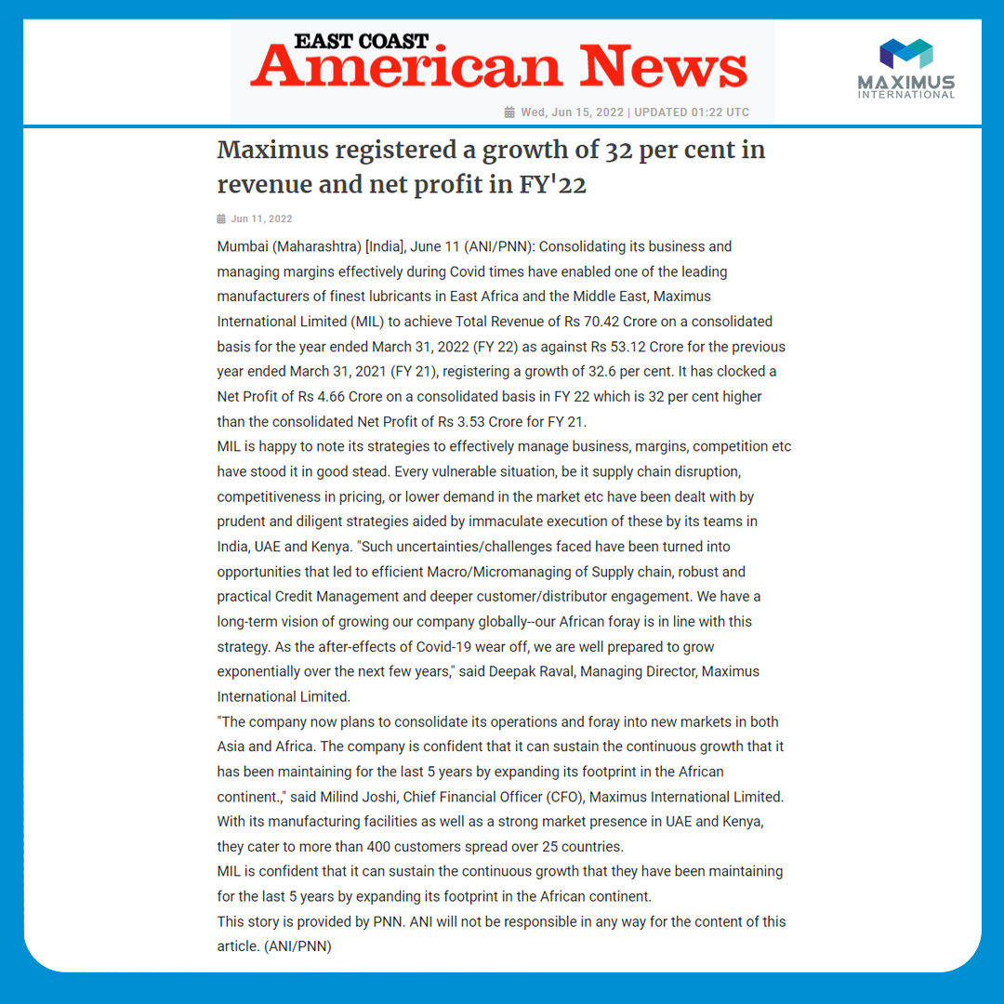
Notes:
https://www.eastcoastamericannews.com/news/maximus-registered-a-growth-of-32-per-cent-in-revenue-and-net-profit-in-fy2220220611172635/

Slide 34
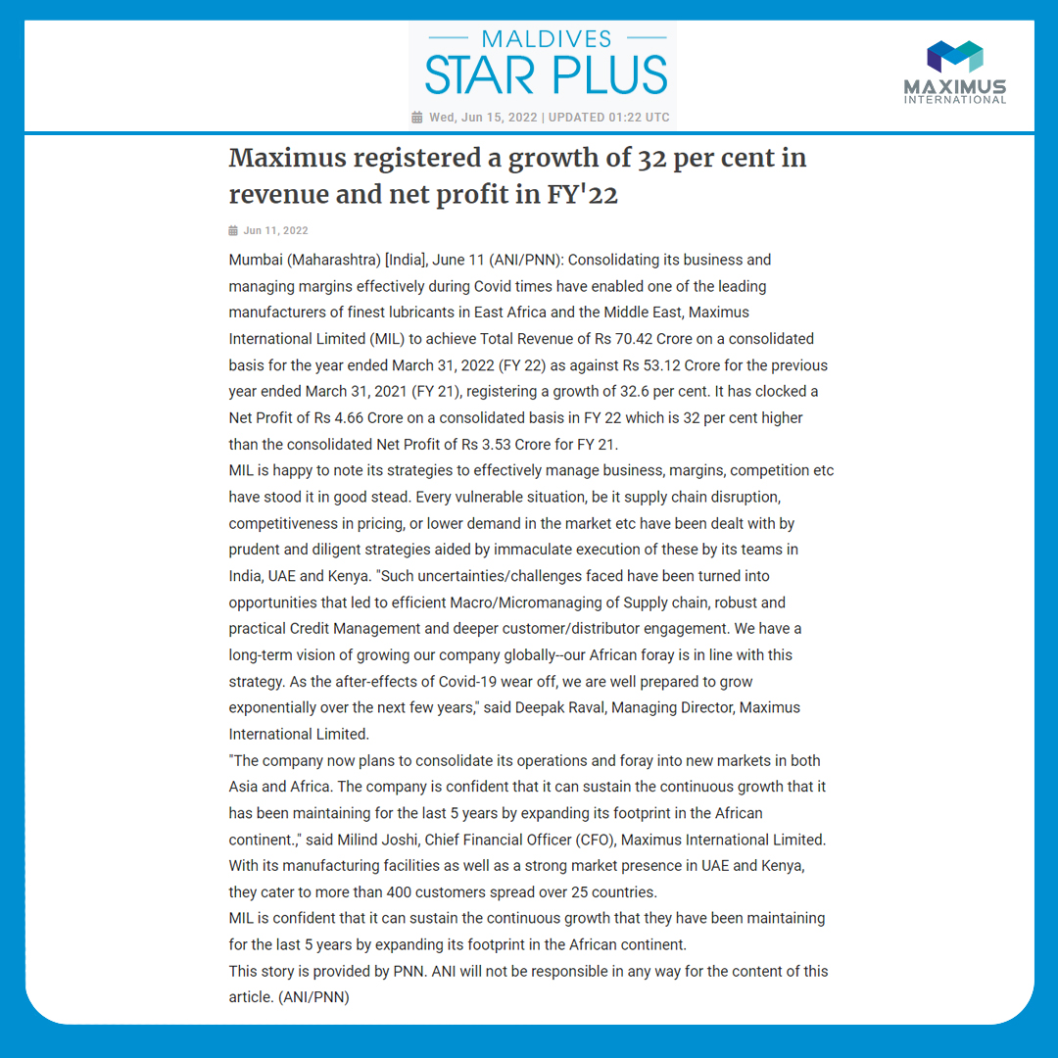
Notes:
https://www.maldivesstarplus.com/news/maximus-registered-a-growth-of-32-per-cent-in-revenue-and-net-profit-in-fy2220220611172635/

Slide 35
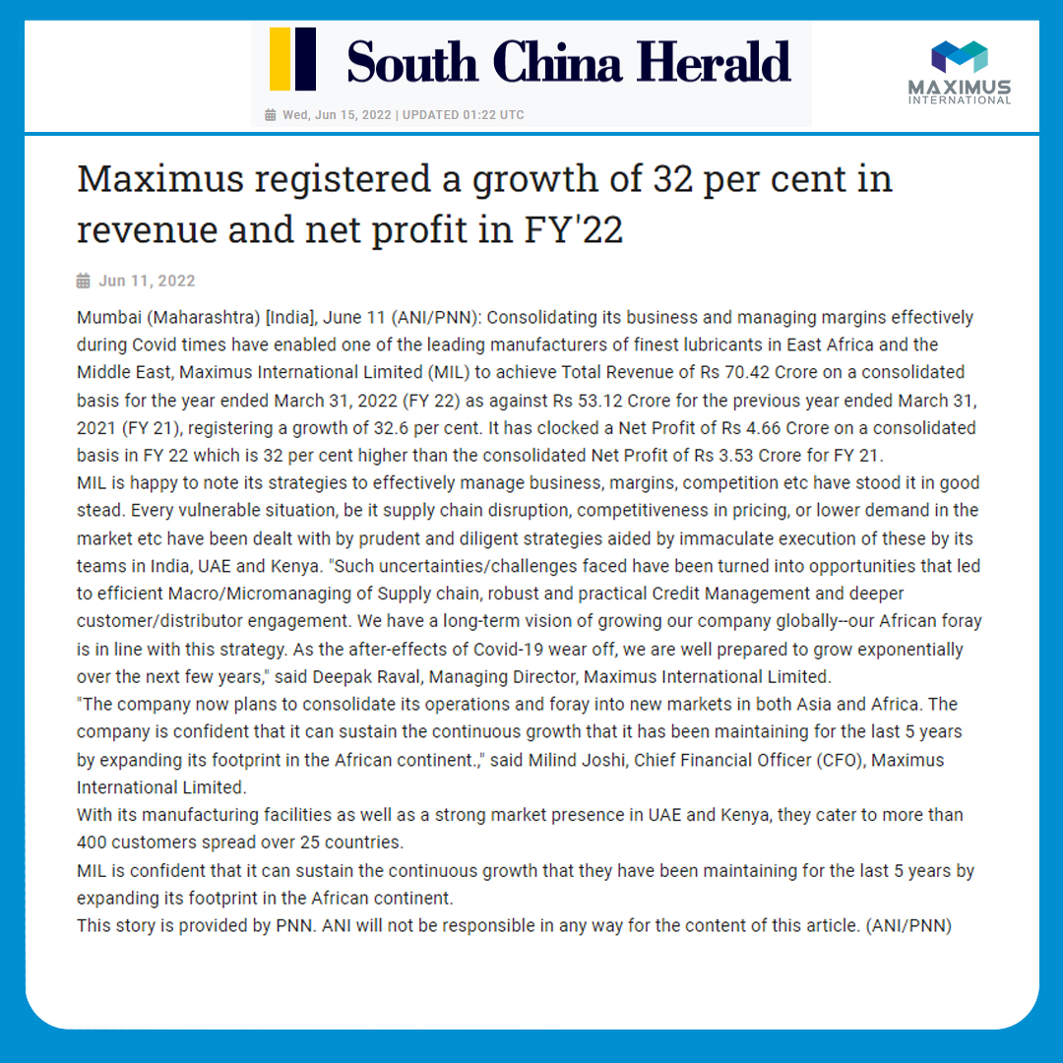
Notes:
https://www.southchinaherald.news/news/maximus-registered-a-growth-of-32-per-cent-in-revenue-and-net-profit-in-fy2220220611172635/

Slide 36
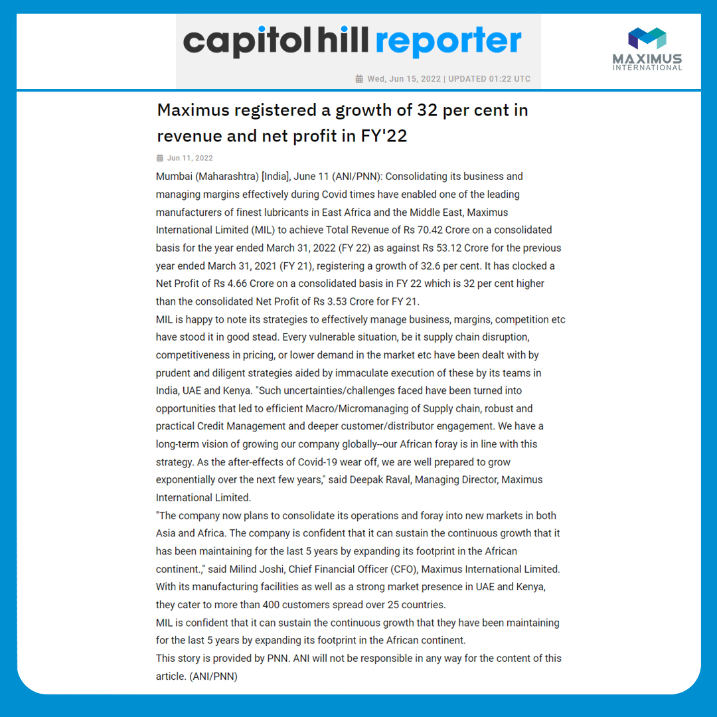
Notes:
https://www.capitolhillreporter.com/news/maximus-registered-a-growth-of-32-per-cent-in-revenue-and-net-profit-in-fy2220220611172635/

Slide 37
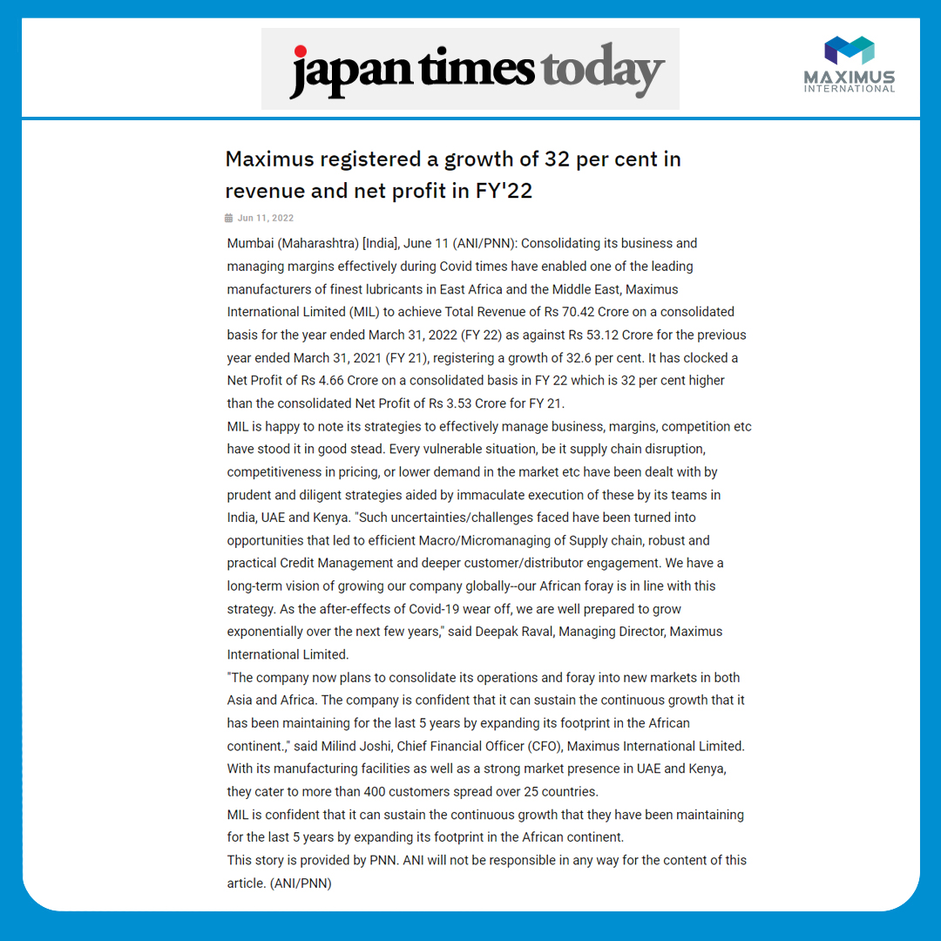
Notes:
https://www.japantimestoday.com/news/maximus-registered-a-growth-of-32-per-cent-in-revenue-and-net-profit-in-fy2220220611172635/

Slide 38
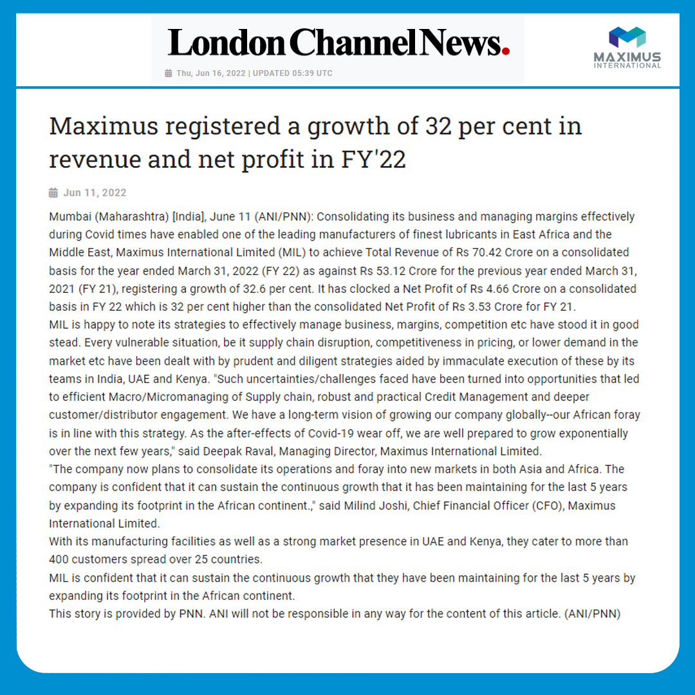
Notes:
https://www.londonchannelnews.com/news/maximus-registered-a-growth-of-32-per-cent-in-revenue-and-net-profit-in-fy2220220611172635/

Slide 39
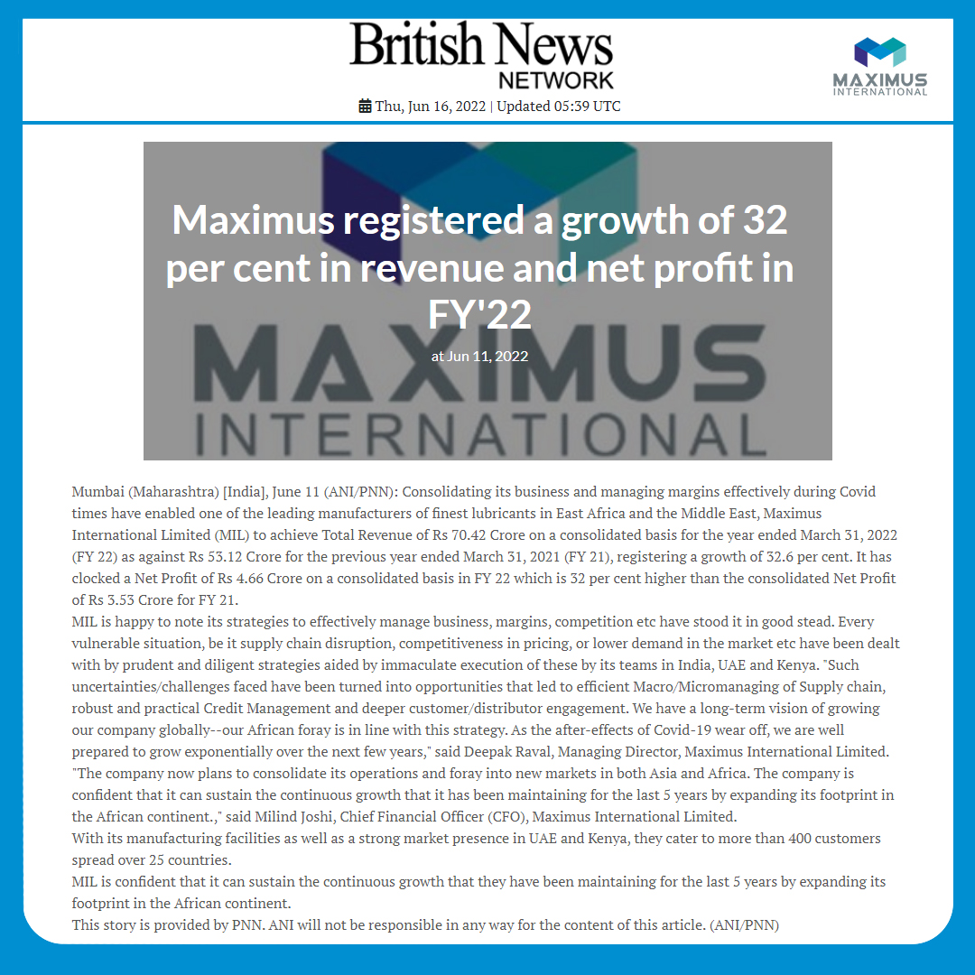
Notes:
https://www.britishnewsnetwork.com/news/maximus-registered-a-growth-of-32-per-cent-in-revenue-and-net-profit-in-fy2220220611172635/

Slide 40
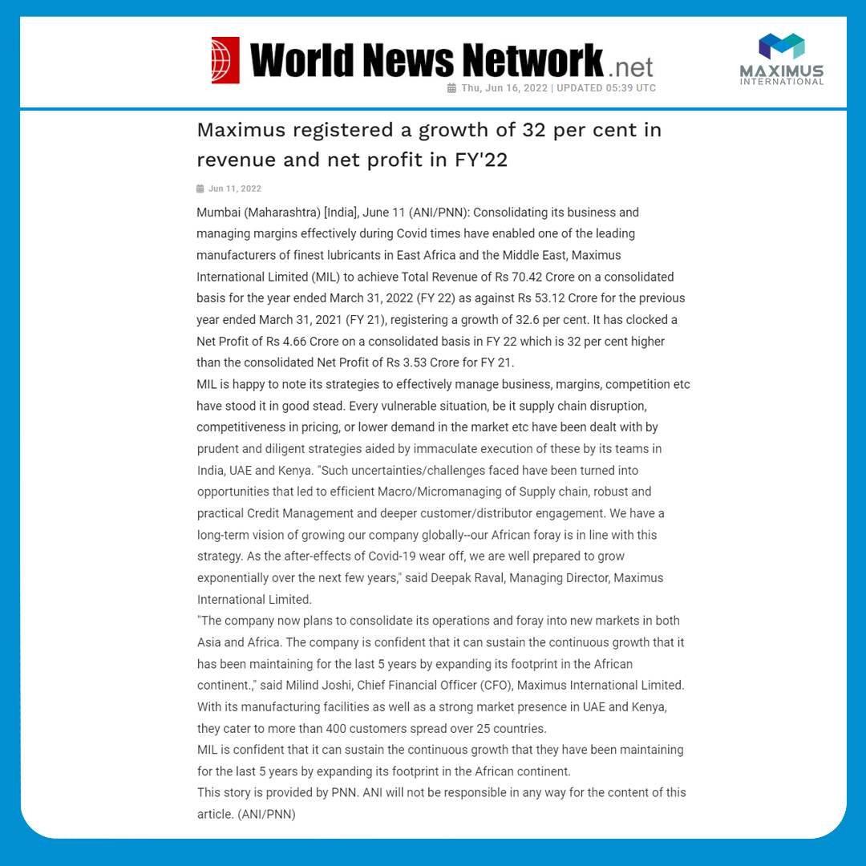
Notes:
https://www.worldnewsnetwork.net/news/maximus-registered-a-growth-of-32-per-cent-in-revenue-and-net-profit-in-fy2220220611172635/

Slide 41
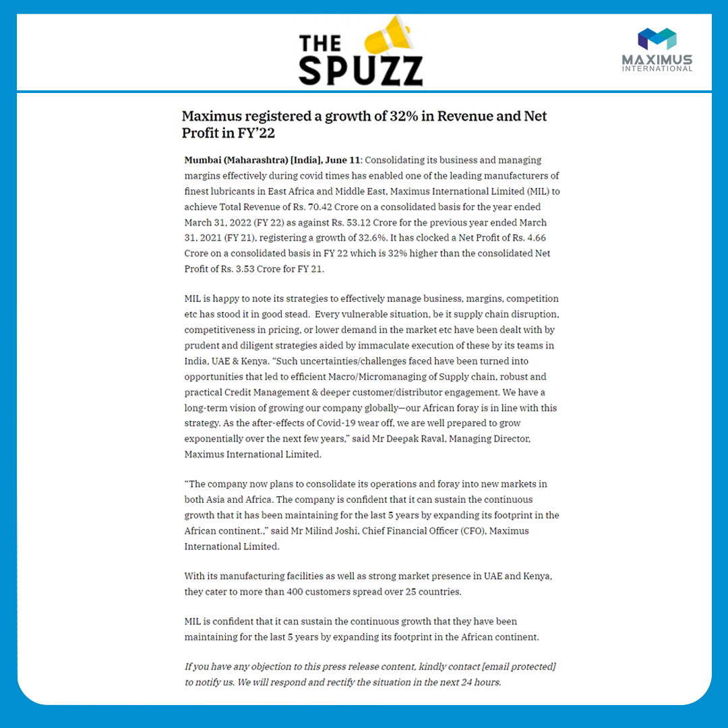
Notes:
https://www.thespuzz.com/maximus-registered-a-growth-of-32-in-revenue-and-net-profit-in-fy22/

Slide 42
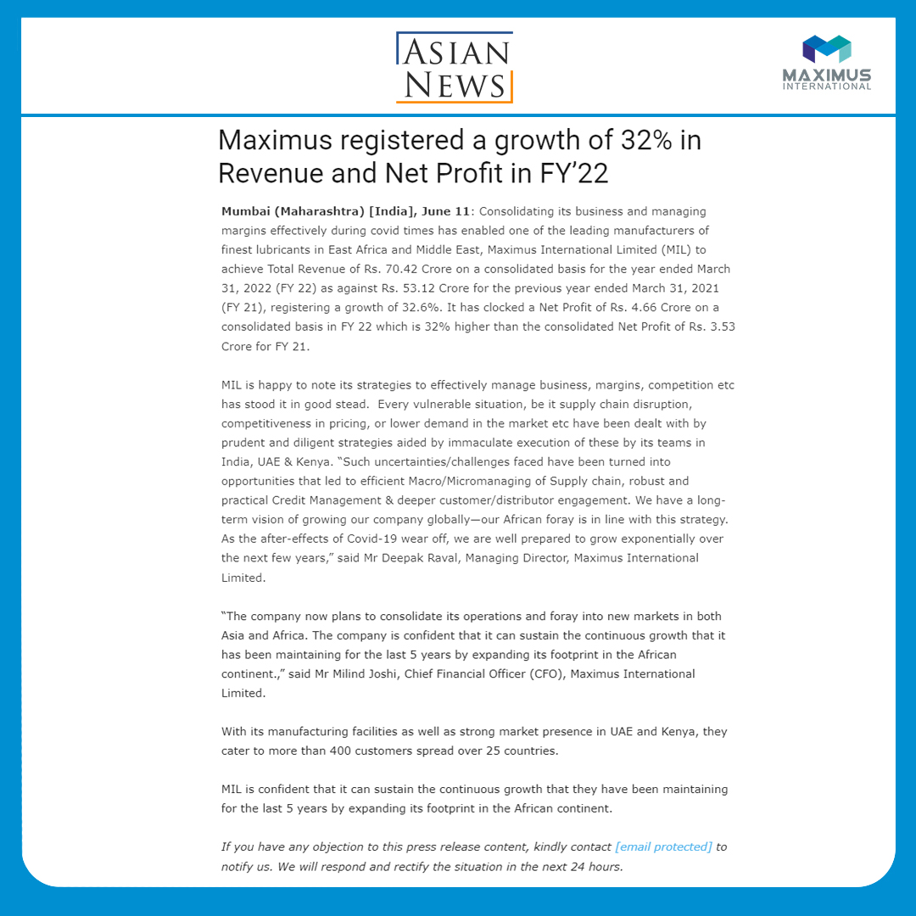
Notes:
https://asiannews.in/maximus-registered-a-growth-of-32-in-revenue-and-net-profit-in-fy22/

Slide 43
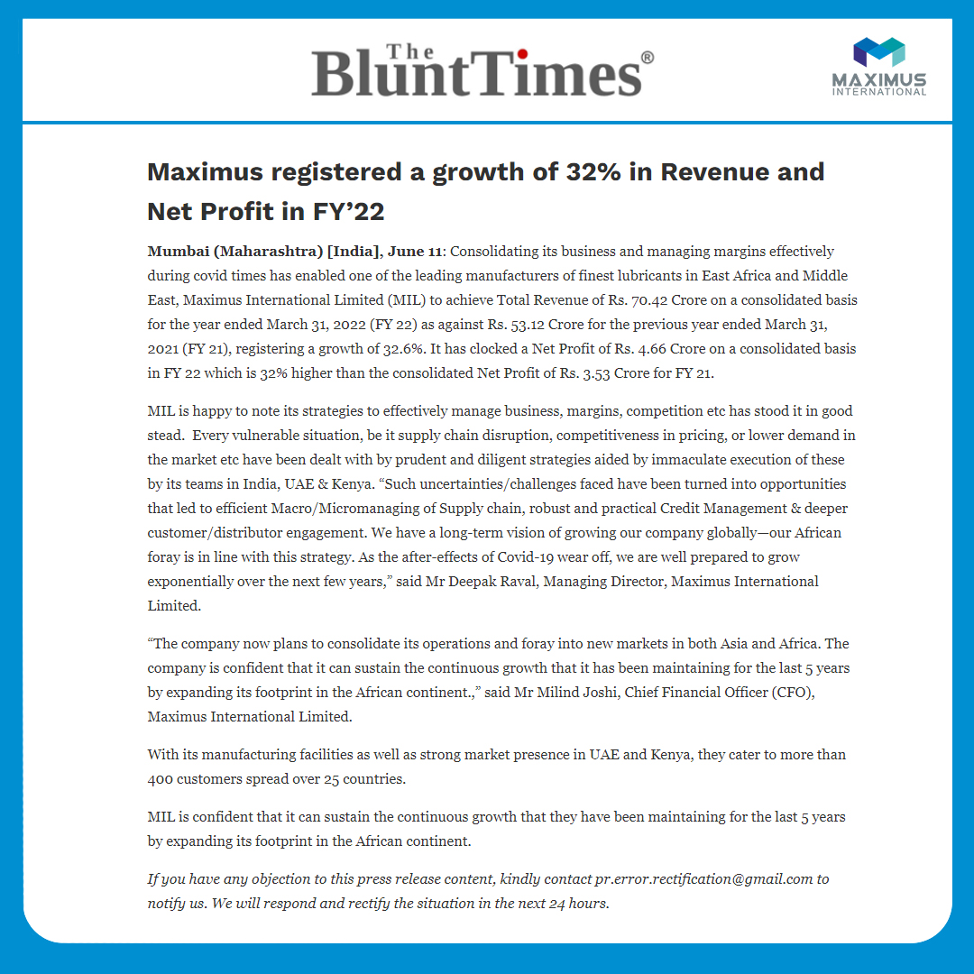
Notes:
https://theblunttimes.in/business-vibes/maximus-registered-a-growth-of-32-in-revenue-and-net-profit/cid7808243.htm

Slide 44
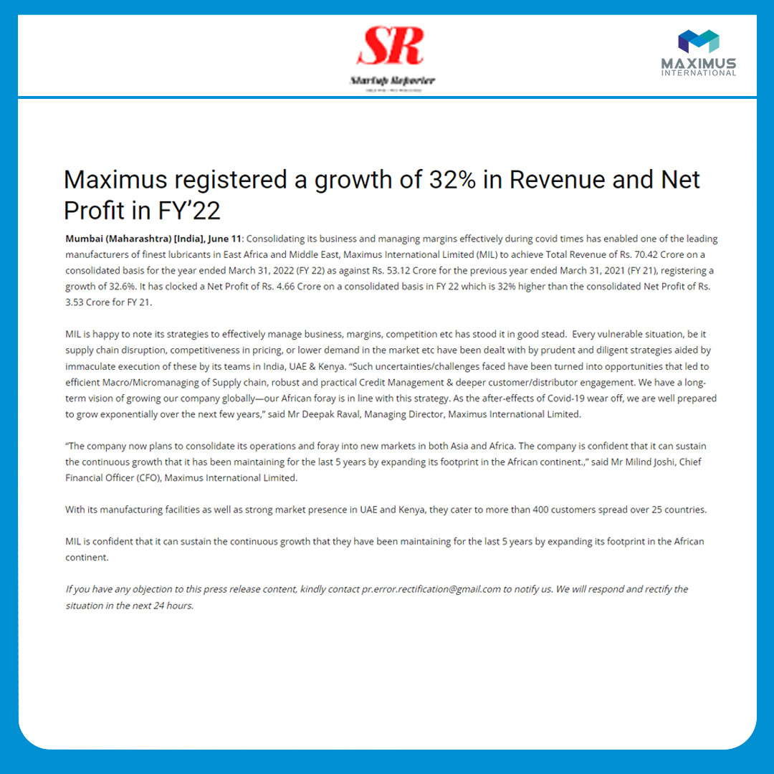
Notes:
https://startupreporter.in/maximus-registered-a-growth-of-32-in-revenue-and-net-profit-in-fy22/

Slide 45
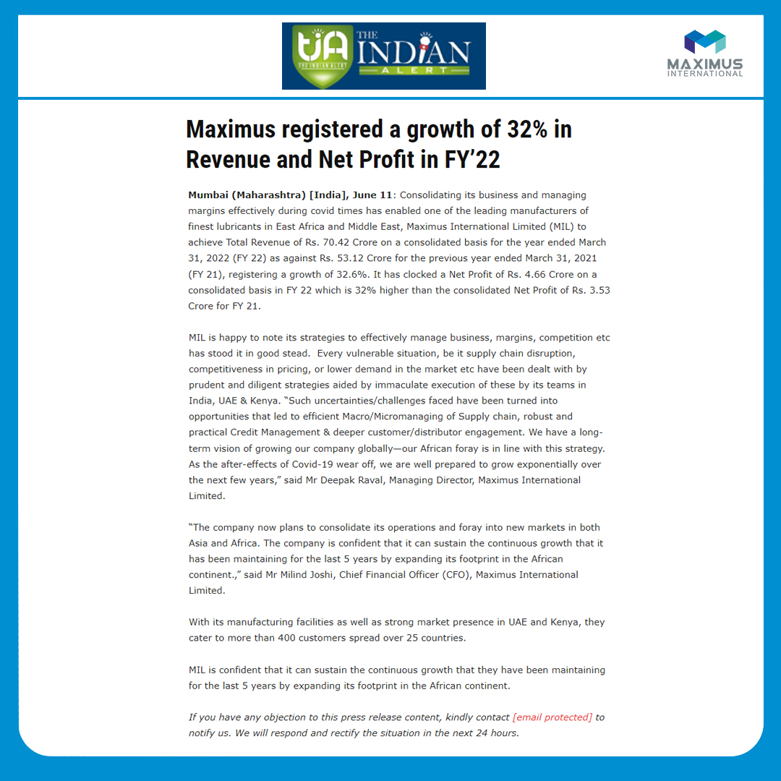
Notes:
https://theindianalert.com/maximus-registered-a-growth-of-32-in-revenue-and-net-profit-in-fy22/

Slide 46
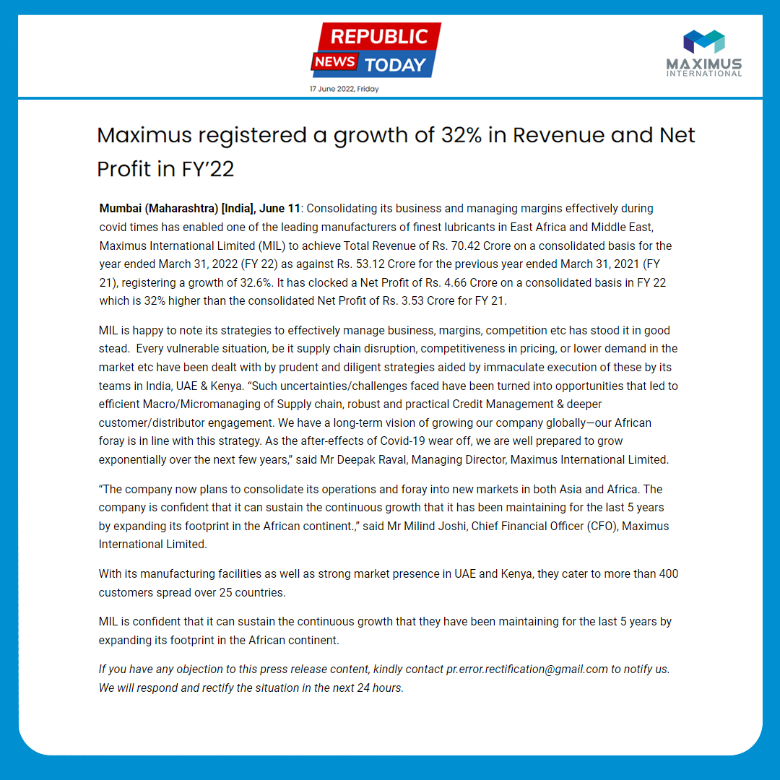
Notes:
https://republicnewstoday.com/index.php/2022/06/11/maximus-registered-a-growth-of-32-in-revenue-and-net-profit-in-fy22/

Slide 47
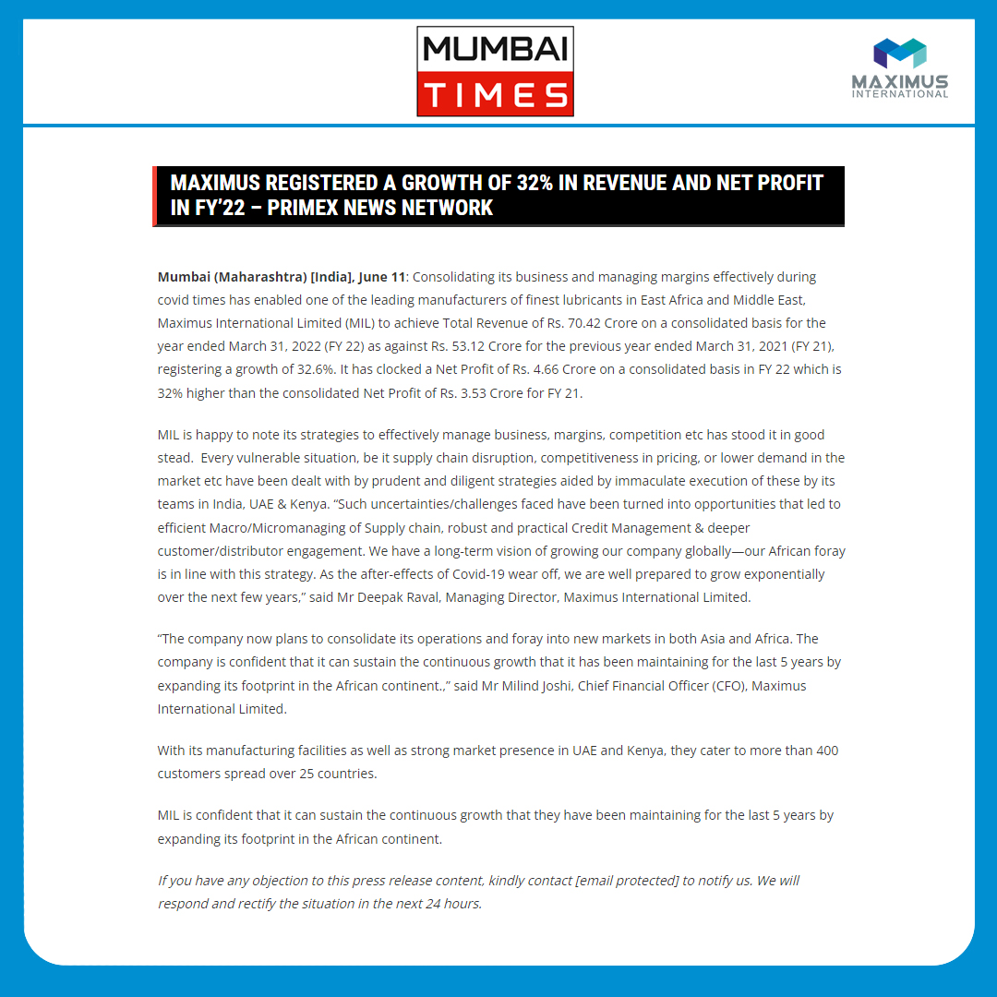
Notes:
https://mumbaitimes.online/maximus-registered-a-growth-of-32-in-revenue-and-net-profit-in-fy22-primex-news-network/

Slide 48
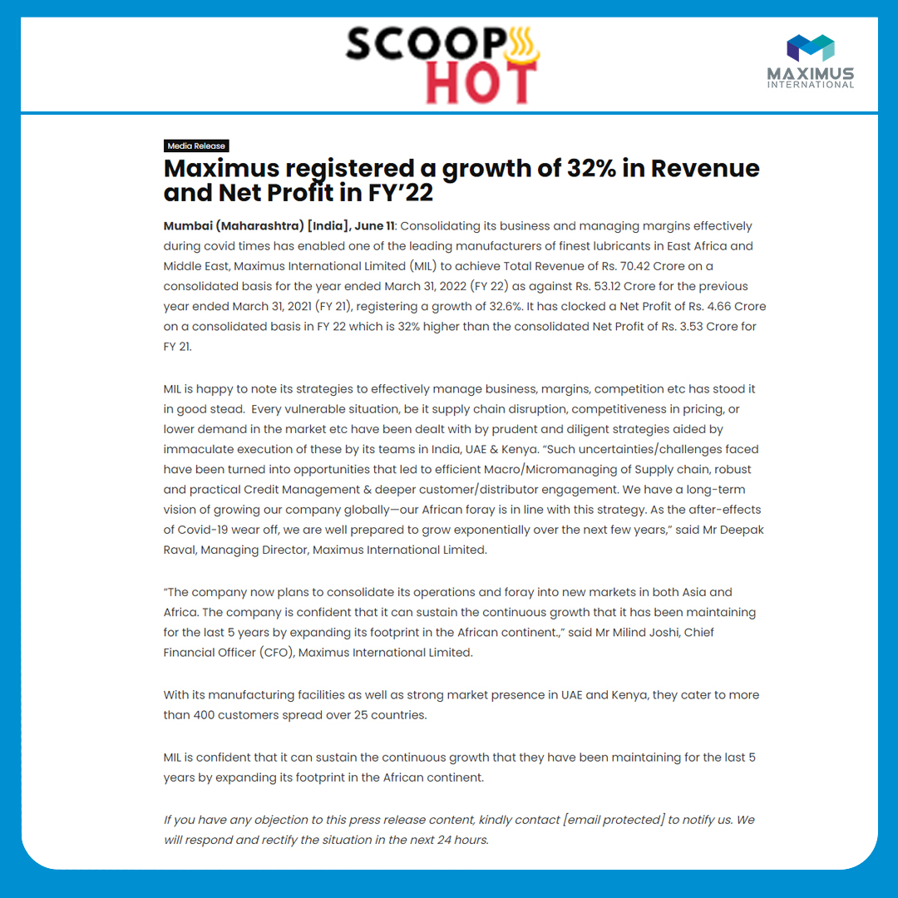
Notes:
https://www.scoophot.com/maximus-registered-a-growth-of-32-in-revenue-and-net-profit-in-fy22/

Slide 49

Notes:
https://www.illustrateddailynews.com/maximus-registered-a-growth-of-32-per-cent-in-revenue-and-net-profit-in-fy22/

Slide 50
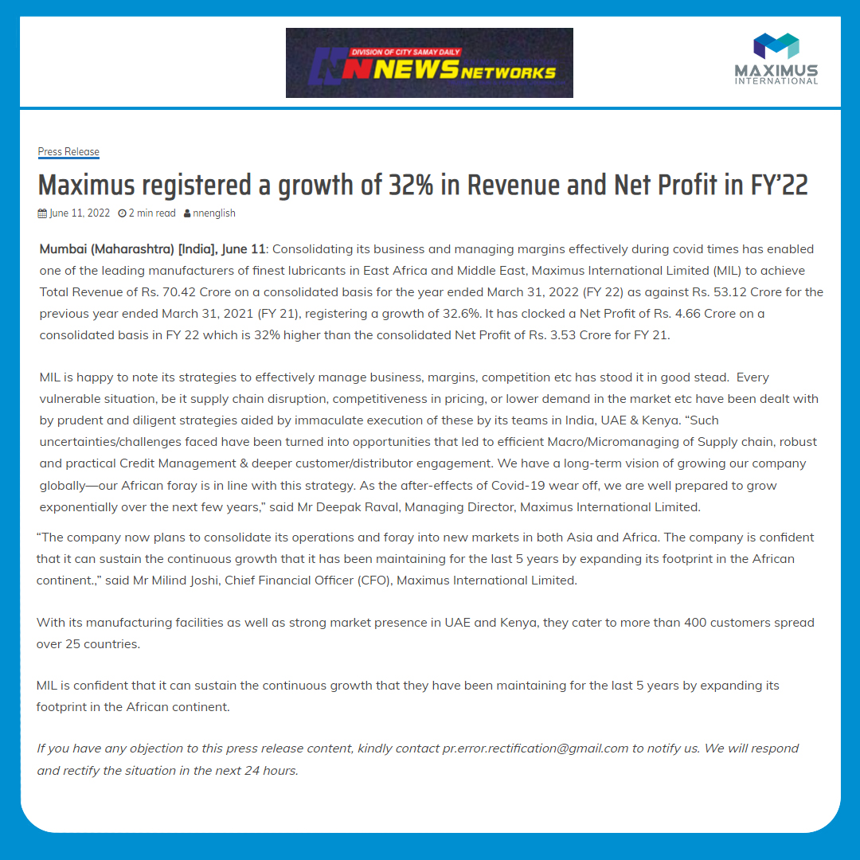
Notes:
https://newsnetworks.co.in/en/2022/06/11/maximus-registered-a-growth-of-32-in-revenue-and-net-profit-in-fy22/

Slide 51
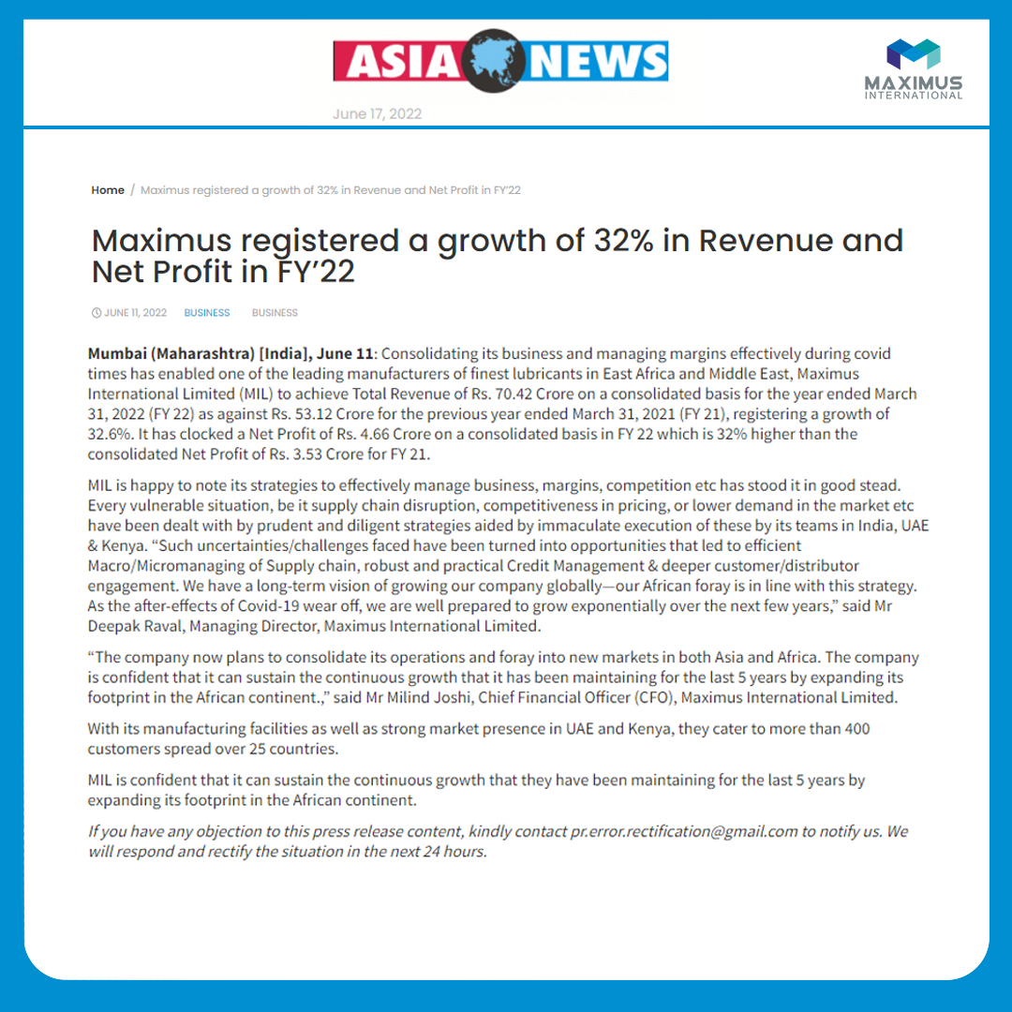
Notes:
https://assianews.com/maximus-registered-a-growth-of-32-in-revenue-and-net-profit-in-fy22/13855/

Slide 52
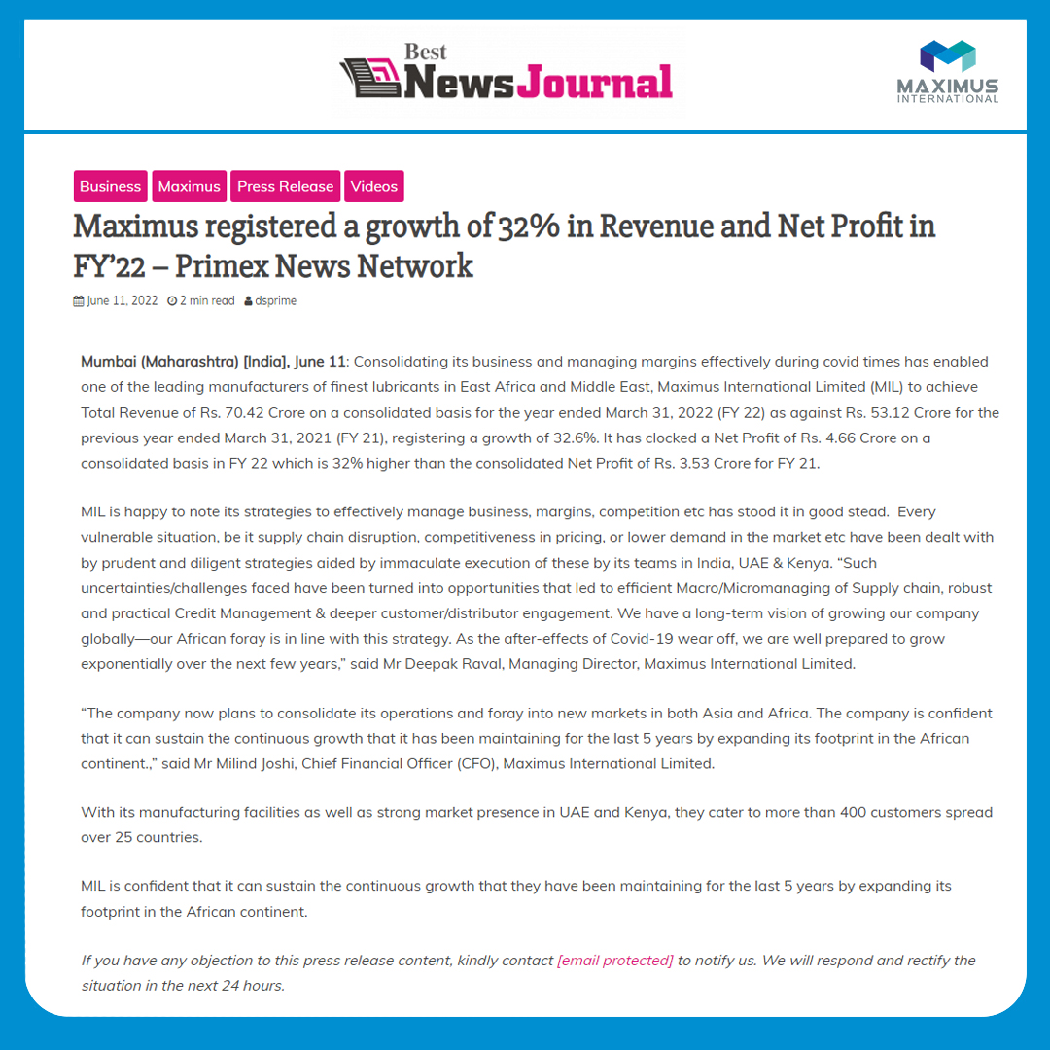
Notes:
https://bestnewsjournal.com/maximus-registered-a-growth-of-32-in-revenue-and-net-profit-in-fy22-primex-news-network/

Slide 53
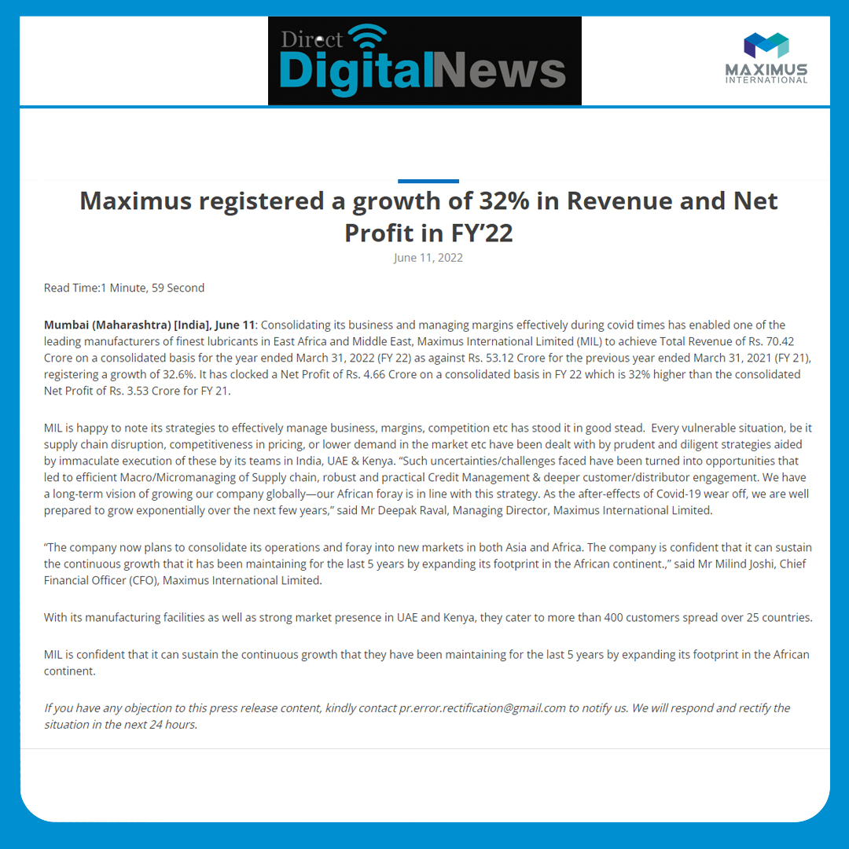
Notes:
https://directdigitalnews.com/maximus-registered-a-growth-of-32-in-revenue-and-net-profit-in-fy22/

Slide 54
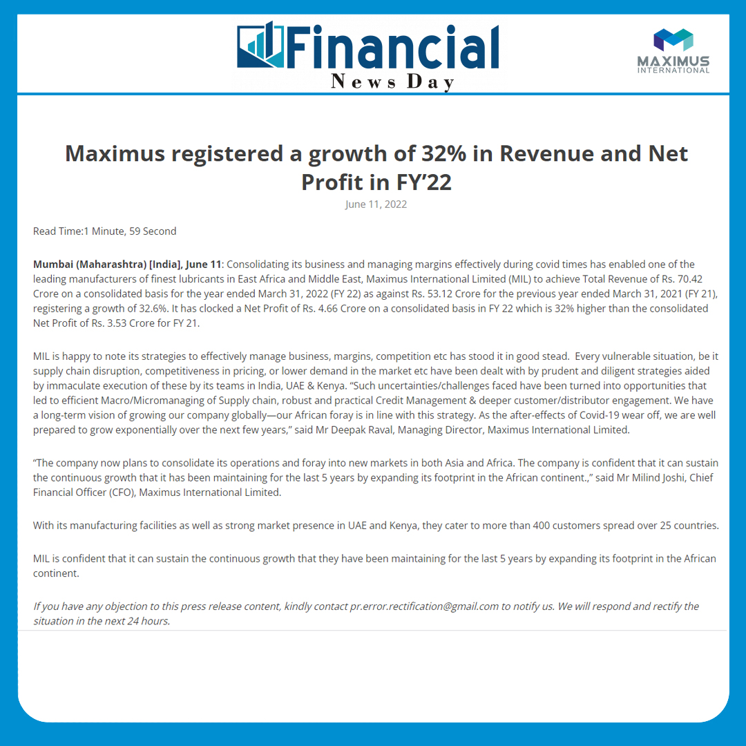
Notes:
https://financialnewsday.com/maximus-registered-a-growth-of-32-in-revenue-and-net-profit-in-fy22/

Slide 55
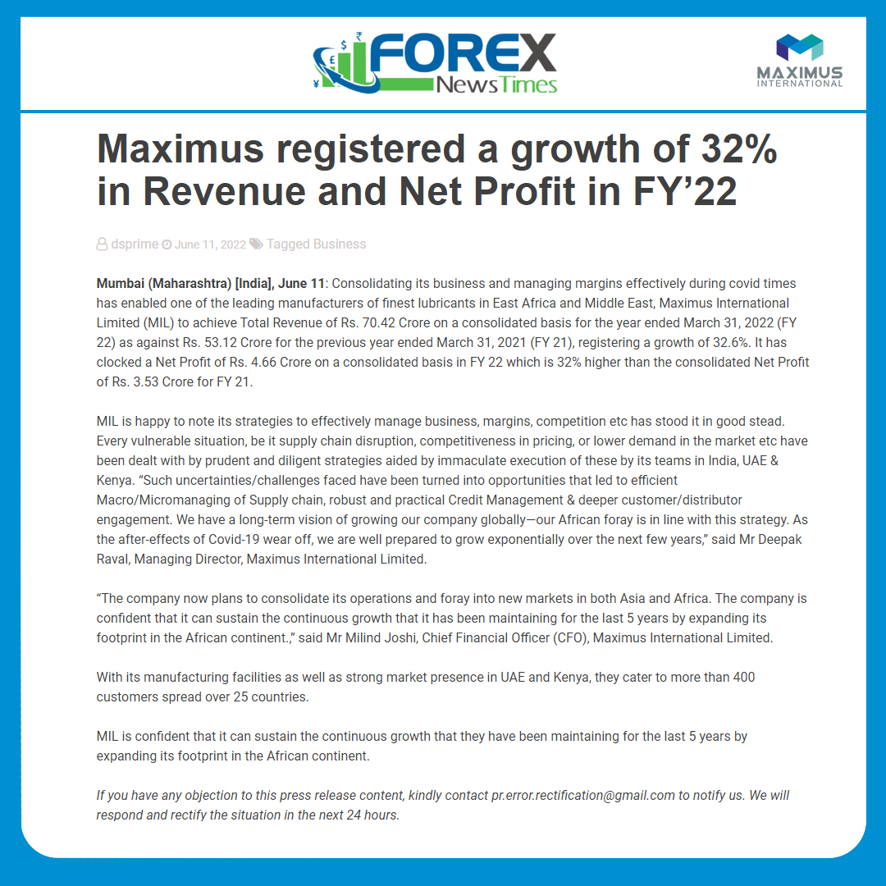
Notes:
https://forexnewstimes.com/maximus-registered-a-growth-of-32-in-revenue-and-net-profit-in-fy22/

Slide 56
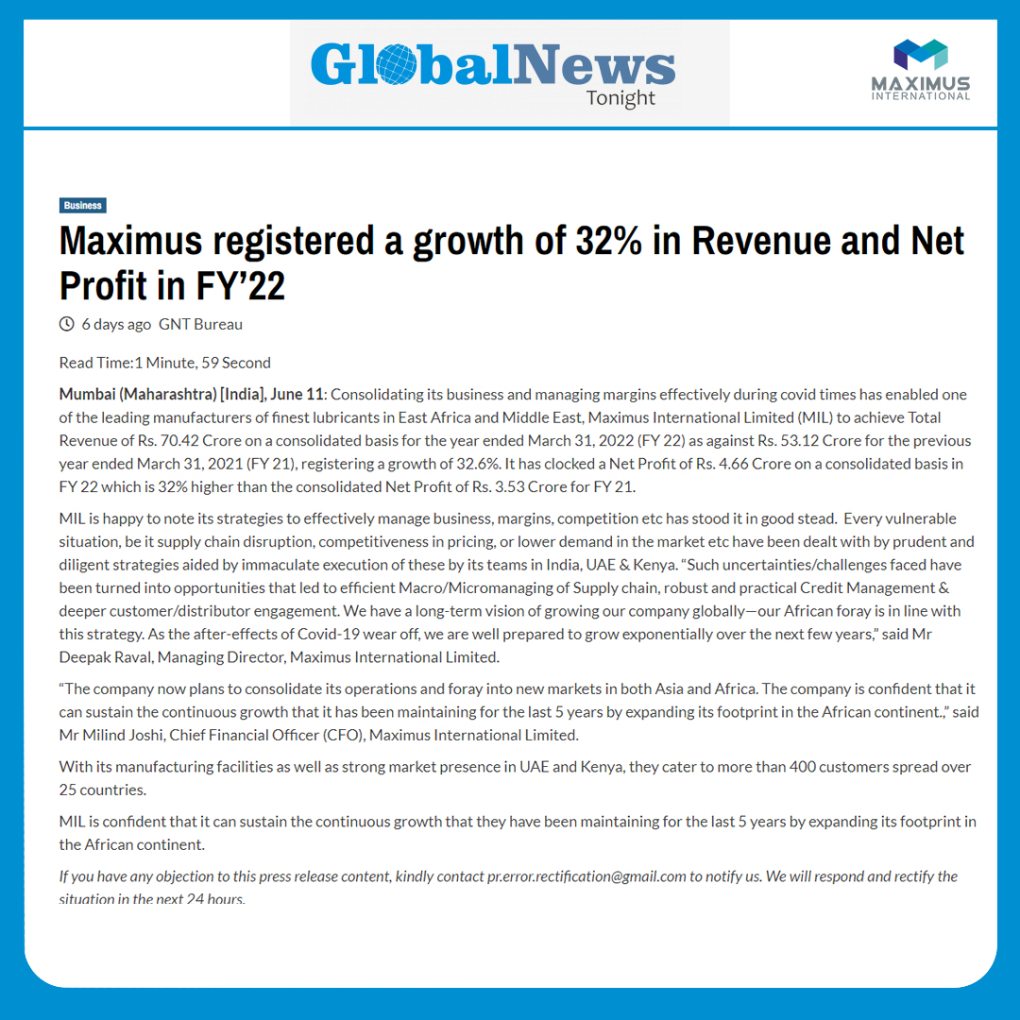
Notes:
https://globalnewstonight.com/index.php/2022/06/11/maximus-registered-a-growth-of-32-in-revenue-and-net-profit-in-fy22/

Slide 57

Notes:
https://inbusinesstimes.com/maximus-registered-a-growth-of-32-in-revenue-and-net-profit-in-fy22/

Slide 58
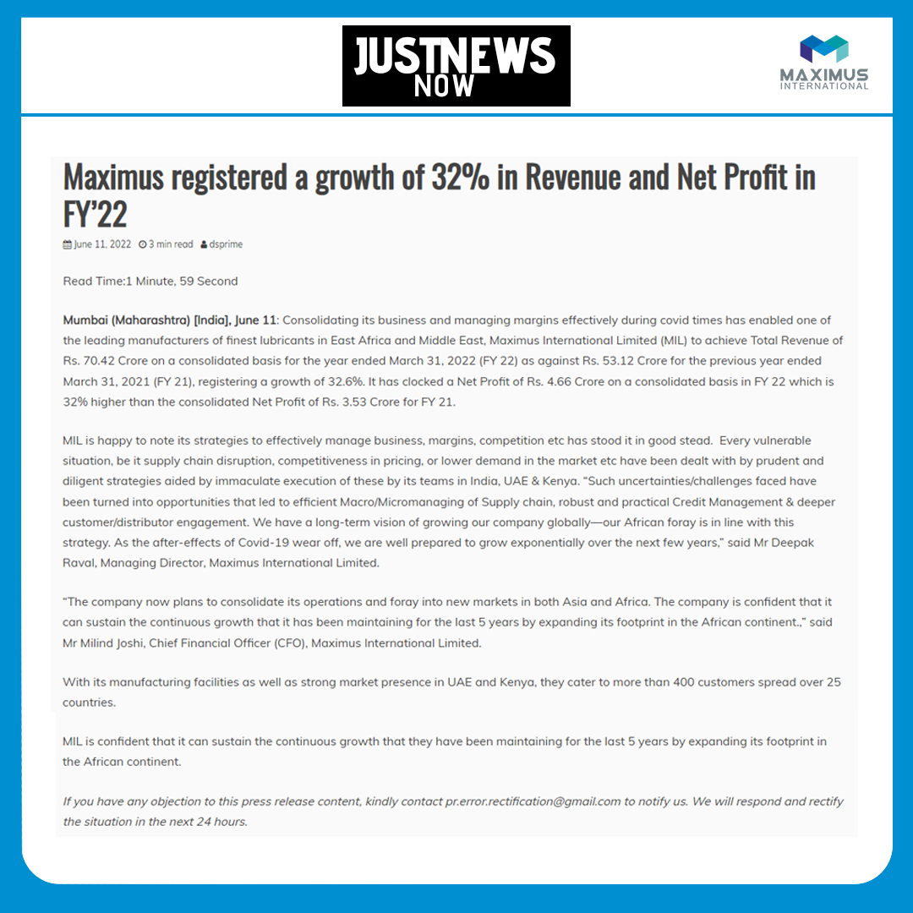
Notes:
https://justnewsnow.com/maximus-registered-a-growth-of-32-in-revenue-and-net-profit-in-fy22/

Slide 59

Notes:
https://latestgoldnews.com/index.php/2022/06/11/maximus-registered-a-growth-of-32-in-revenue-and-net-profit-in-fy22/

Slide 60

Notes:
https://newsecontent.com/maximus-registered-a-growth-of-32-in-revenue-and-net-profit-in-fy22/

Slide 61

Notes:
https://newsradian.com/index.php/2022/06/11/maximus-registered-a-growth-of-32-in-revenue-and-net-profit-in-fy22-2/

Slide 62

Notes:
https://newstrenddaily.com/index.php/2022/06/11/maximus-registered-a-growth-of-32-in-revenue-and-net-profit-in-fy22-2/

Slide 63

Notes:
https://primenewstv.com/index.php/2022/06/11/maximus-registered-a-growth-of-32-in-revenue-and-net-profit-in-fy22/

Slide 64

Notes:
https://punemetronews.com/maximus-registered-a-growth-of-32-in-revenue-and-net-profit-in-fy22/

Slide 65

Notes:
https://newswireindia.in/index.php/2022/06/11/maximus-registered-a-growth-of-32-in-revenue-and-net-profit-in-fy22/

Slide 66

Notes:
https://rtnews24.com/index.php/2022/06/11/maximus-registered-a-growth-of-32-in-revenue-and-net-profit-in-fy22/

Slide 67

Notes:
https://snbindianews.com/maximus-registered-a-growth-of-32-in-revenue-and-net-profit-in-fy22/

Slide 68

Notes:
https://starnewsline.com/index.php/2022/06/11/maximus-registered-a-growth-of-32-in-revenue-and-net-profit-in-fy22/

Slide 69

Notes:
https://urbannewsonline.com/index.php/2022/06/11/maximus-registered-a-growth-of-32-in-revenue-and-net-profit-in-fy22/

Slide 70

Notes:
https://worldnewsforall.com/index.php/2022/06/11/maximus-registered-a-growth-of-32-in-revenue-and-net-profit-in-fy22/

Slide 71

Notes:
https://atulyahindustan.in/maximus-registered-a-growth-of-32-in-revenue-and-net-profit-in-fy22/

Slide 72

Notes:
https://biznewss.in/index.php/2022/06/11/maximus-registered-a-growth-of-32-in-revenue-and-net-profit-in-fy22/

Slide 73

Notes:
https://bniindia.in/?p=13377

Slide 74

Notes:
https://businessvoicenow.com/?p=13334

Slide 75

Notes:
https://city-lights.in/index.php/2022/06/11/maximus-registered-a-growth-of-32-in-revenue-and-net-profit-in-fy22/

Slide 76

Notes:
https://cityreporters.in/index.php/2022/06/11/maximus-registered-a-growth-of-32-in-revenue-and-net-profit-in-fy22/

Slide 77

Notes:
https://companyvoice.in/?p=17130

Slide 78

Notes:
https://dailybulletin.co.in/index.php/2022/06/11/maximus-registered-a-growth-of-32-in-revenue-and-net-profit-in-fy22/

Slide 79

Notes:
https://dailybulletin.co.in/index.php/2022/06/11/maximus-registered-a-growth-of-32-in-revenue-and-net-profit-in-fy22/

Slide 80

Notes:
https://economicindia.co.in/business/maximus-registered-a-growth-of-32-in-revenue-and-net-profit-in-fy22/

Slide 81

Notes:
https://financialpost.co.in/index.php/2022/06/11/maximus-registered-a-growth-of-32-in-revenue-and-net-profit-in-fy22/

Slide 82

Notes:
https://financialtelegraph.in/index.php/2022/06/11/maximus-registered-a-growth-of-32-in-revenue-and-net-profit-in-fy22/

Slide 83

Notes:
https://higujarat.com/index.php/2022/06/11/maximus-registered-a-growth-of-32-in-revenue-and-net-profit-in-fy22/

Slide 84

Notes:
https://newswiregoa.com/index.php/2022/06/11/maximus-registered-a-growth-of-32-in-revenue-and-net-profit-in-fy22/

Slide 85

Notes:
https://indiafirstnews.in/index.php/2022/06/11/maximus-registered-a-growth-of-32-in-revenue-and-net-profit-in-fy22/96. https://indiaheadline.in/?p=13394

Slide 86

Notes:
https://indianbusinessline.com/index.php/2022/06/11/maximus-registered-a-growth-of-32-in-revenue-and-net-profit-in-fy22/

Slide 87

Notes:
https://indiannewsmaker.com/index.php/2022/06/11/maximus-registered-a-growth-of-32-in-revenue-and-net-profit-in-fy22/

Slide 88

Notes:
https://indianweekend.com/index.php/2022/06/11/maximus-registered-a-growth-of-32-in-revenue-and-net-profit-in-fy22/

Slide 89

Notes:
https://mycountry.co.in/index.php/2022/06/11/maximus-registered-a-growth-of-32-in-revenue-and-net-profit-in-fy22/

Slide 90

Notes:
https://newindiaherald.com/index.php/2022/06/11/maximus-registered-a-growth-of-32-in-revenue-and-net-profit-in-fy22/

Slide 91

Notes:
https://news-scoop.in/index.php/2022/06/11/maximus-registered-a-growth-of-32-in-revenue-and-net-profit-in-fy22/

Slide 92

Notes:
https://news21.co.in/index.php/2022/06/11/maximus-registered-a-growth-of-32-in-revenue-and-net-profit-in-fy22/

Slide 93

Notes:
https://newswiredelhi.com/index.php/2022/06/11/maximus-registered-a-growth-of-32-in-revenue-and-net-profit-in-fy22/

Slide 94

Notes:
https://newswirepunjab.com/index.php/2022/06/11/maximus-registered-a-growth-of-32-in-revenue-and-net-profit-in-fy22/

Slide 95

Notes:
https://primexnewsinternational.com/2022/06/11/maximus-registered-a-growth-of-32-in-revenue-and-net-profit-in-fy22/

Slide 96

Notes:
https://real-news.co.in/index.php/2022/06/11/maximus-registered-a-growth-of-32-in-revenue-and-net-profit-in-fy22/

Slide 97

Notes:
https://republic21.in/index.php/2022/06/11/maximus-registered-a-growth-of-32-in-revenue-and-net-profit-in-fy22/

Slide 98

Notes:
https://storywriter.co.in/index.php/2022/06/11/maximus-registered-a-growth-of-32-in-revenue-and-net-profit-in-fy22/

Slide 99

Notes:
https://thebigindia.co.in/index.php/2022/06/11/maximus-registered-a-growth-of-32-in-revenue-and-net-profit-in-fy22/

Slide 100

Notes:
https://thegrandmedia.in/index.php/2022/06/11/maximus-registered-a-growth-of-32-in-revenue-and-net-profit-in-fy22/

Slide 101

Notes:
https://theindianjournal.in/index.php/2022/06/11/maximus-registered-a-growth-of-32-in-revenue-and-net-profit-in-fy22/

Slide 102

Notes:
https://themsmenews.com/index.php/2022/06/11/maximus-registered-a-growth-of-32-in-revenue-and-net-profit-in-fy22/

Slide 103

Notes:
https://thenationtimes.co.in/index.php/2022/06/11/maximus-registered-a-growth-of-32-in-revenue-and-net-profit-in-fy22/

Slide 104

Notes:
https://newswirekarnataka.com/index.php/2022/06/11/maximus-registered-a-growth-of-32-in-revenue-and-net-profit-in-fy22/

Slide 105

Notes:
https://thenewsbharti.com/index.php/2022/06/11/maximus-registered-a-growth-of-32-in-revenue-and-net-profit-in-fy22/

Slide 106

Notes:
https://theprimeindia.in/index.php/2022/06/11/maximus-registered-a-growth-of-32-in-revenue-and-net-profit-in-fy22/

Slide 107

Notes:
https://thesamay.co.in/index.php/2022/06/11/maximus-registered-a-growth-of-32-in-revenue-and-net-profit-in-fy22/

Slide 108

Notes:
https://thestartupstory.co.in/index.php/2022/06/11/maximus-registered-a-growth-of-32-in-revenue-and-net-profit-in-fy22/

Slide 109

Notes:
. https://thetimes24.in/index.php/2022/06/11/maximus-registered-a-growth-of-32-in-revenue-and-net-profit-in-fy22/

Slide 110

Notes:
https://theudyog.in/maximus-registered-a-growth-of-32-in-revenue-and-net-profit-in-fy22/

Slide 111

Notes:
https://truestoryindia.com/index.php/2022/06/11/maximus-registered-a-growth-of-32-in-revenue-and-net-profit-in-fy22/

Slide 112

Notes:
https://theoneindia.in/index.php/2022/06/11/maximus-registered-a-growth-of-32-in-revenue-and-net-profit-in-fy22/

Slide 113

Notes:
https://up18news.com/maximus-registered-a-growth-of-32-in-revenue-and-net-profit-in-fy22/

Slide 114

Notes:
https://www.indiainfoline.com/article/news-top-story/maximus-international-hits-new-high-after-registering-32-yoy-growth-in-revenue-and-net-profit-in-fy22-122060900081_1.html

Slide 115

Notes:
https://jionews.com/home/article/10/1593333233/Maximus-registered-a-growth-of-32-per-cent-in-revenue-and-net-profit-in-FY%E2%80%9922

Slide 116

Notes:
https://www.newyorkdespatch.com/news/maximus-registered-a-growth-of-32-per-cent-in-revenue-and-net-profit-in-fy2220220611172635/

Slide 117

Notes:
https://news.google.com/search?q=Maximus%20registered%20a%20growth%20of%2032%20per%20cent%20in%20revenue%20and%20net%20profit%20in%20FY%2722&hl=en-IN&gl=IN&ceid=IN%3Aen

Slide 118

Notes:
https://newsroombuzz.com/maximus-registered-a-growth-of-32-in-revenue-and-net-profit-in-fy22/

Slide 119

Notes:
https://newssupplydaily.com/index.php/2022/06/11/maximus-registered-a-growth-of-32-in-revenue-and-net-profit-in-fy22/

Slide 120

https://venturecompanynews.com/maximus-registered-a-growth-of-32-in-revenue-and-net-profit-in-fy22/
Notes:
https://venturecompanynews.com/maximus-registered-a-growth-of-32-in-revenue-and-net-profit-in-fy22/

Slide 121


Slide 122


Slide 123


Slide 124


Slide 125


Slide 126


Slide 127


Slide 128


Slide 129


Slide 130


Slide 131


Slide 132


Slide 133


