Slide 1

Maximus Press Release

Slide 2

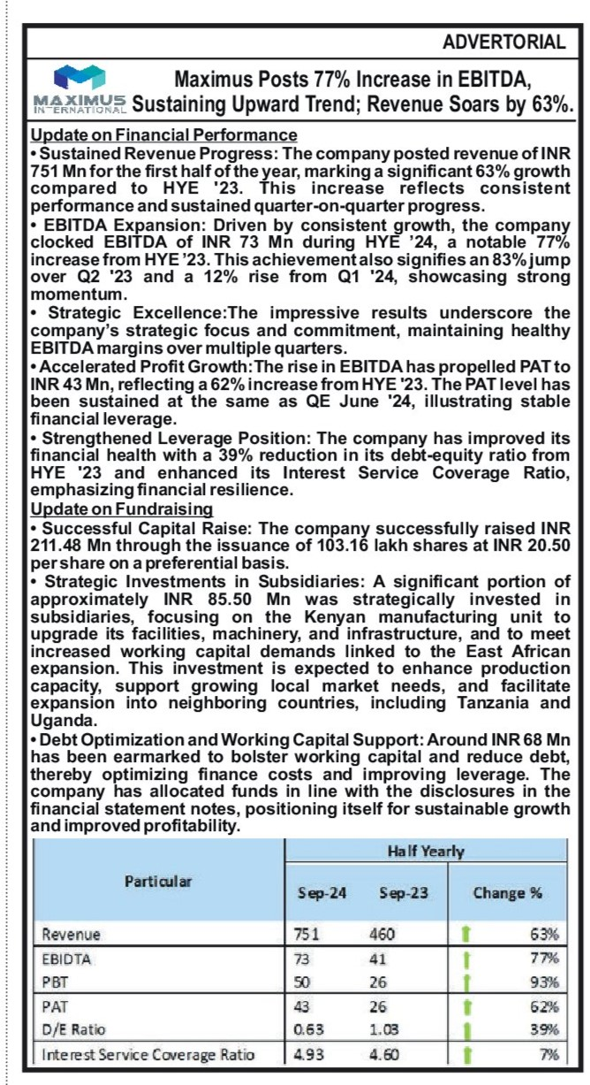
Business Standard, Date:-27-11-24, Page no.20

Slide 3

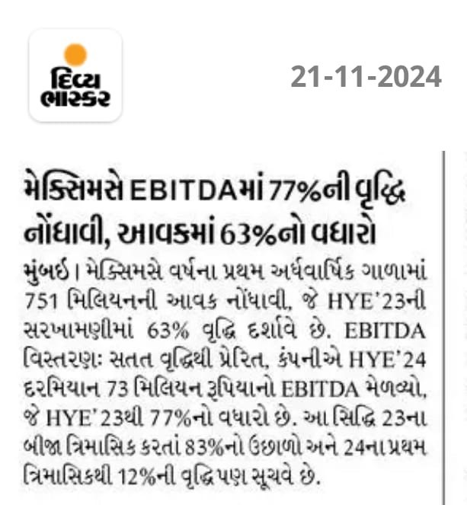




Divya Bhaskar, Date:-21-11-2024

Slide 4
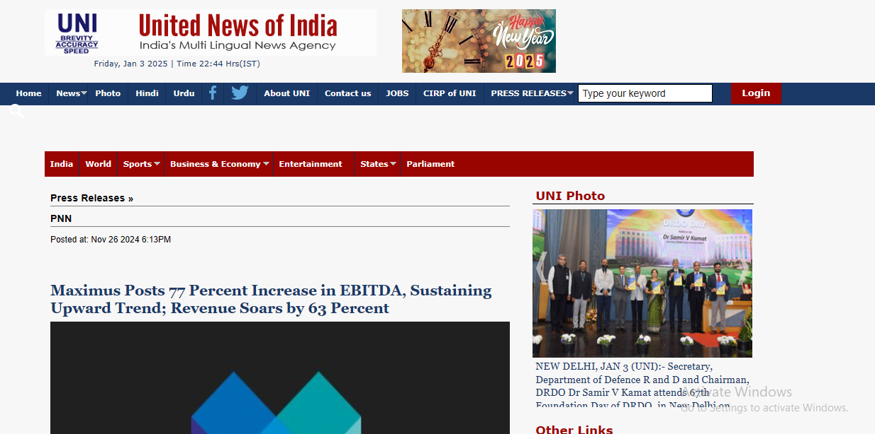
https://www.uniindia.com/maximus-posts-77-percent-increase-in-ebitda-sustaining-upward-trend-revenue-soars-by-63-percent/pnn/news/3333203.html

Slide 5

https://m.dailyhunt.in/news/india/english/attention+india-epaper-dh70afb931d2334d9fbcf878fa57765042/maximus+posts+77+percent+increase+in+ebitda+sustaining+upward+trend+revenue+soars+by+63+percent-newsid-dh70afb931d2334d9fbcf878fa57765042_9710afe0ac0211ef979b9ed855e7f3a0?sm=Y

Slide 6

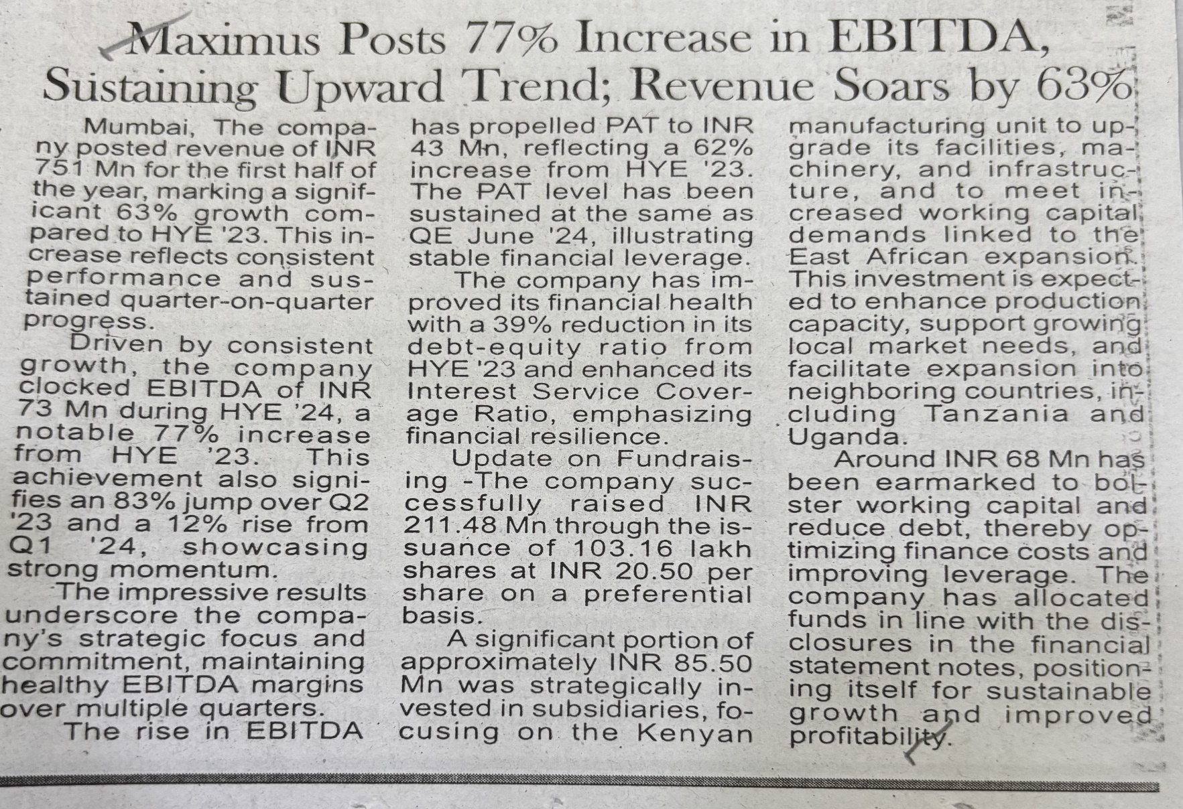
Western Times (Eng) :- Ahmedabad, Date:-27-11-24, Page no.06

Slide 7
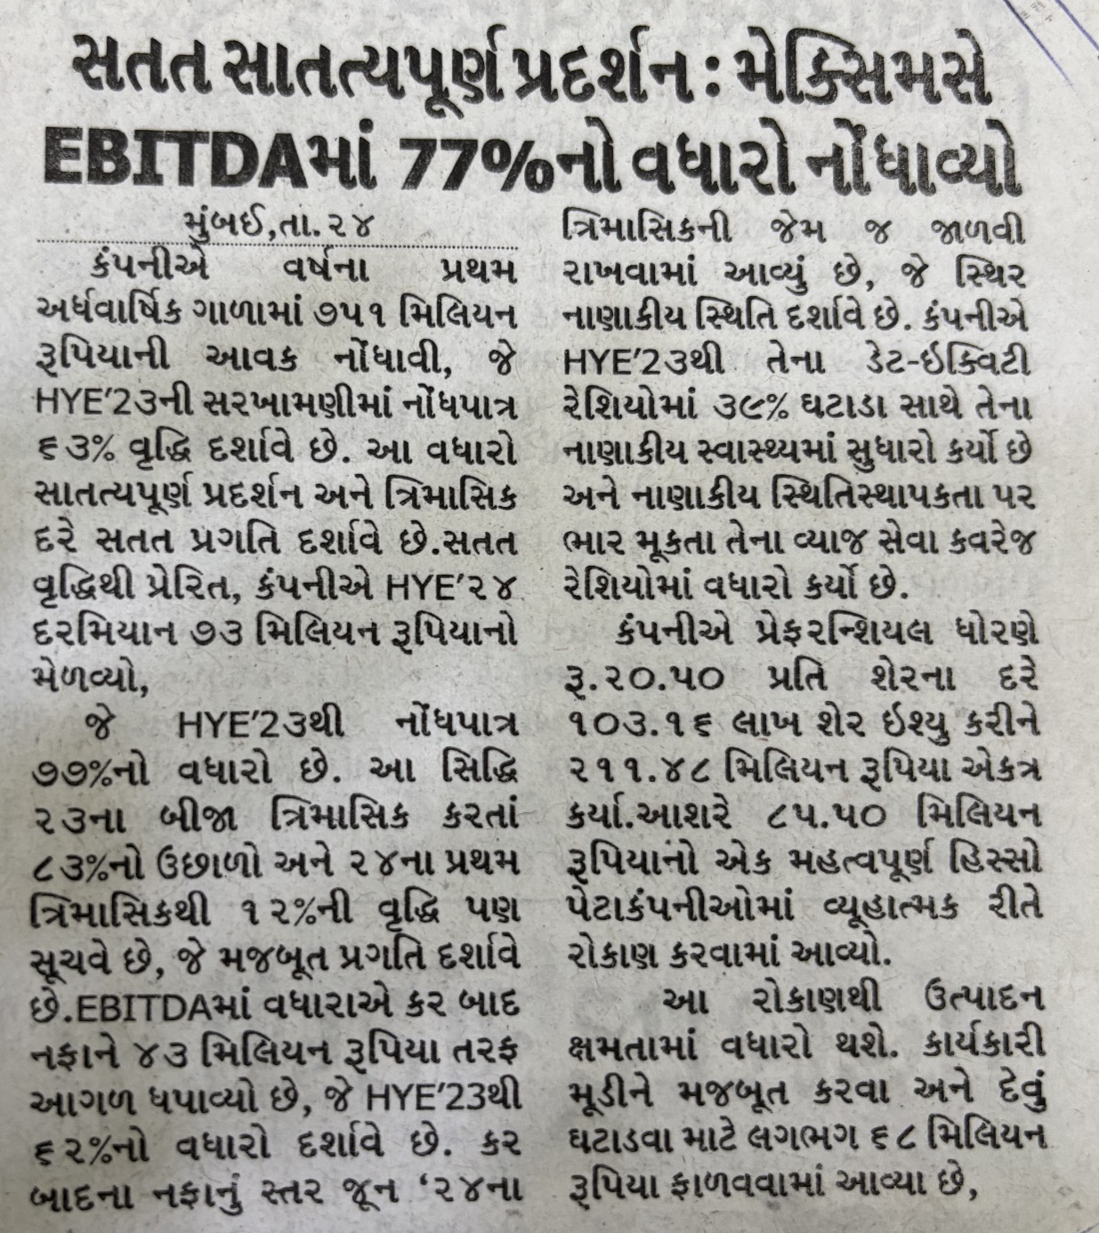
Loksatta Jansatta, Vadodara, Date:-25-11-2024, Page No- 9

Slide 8
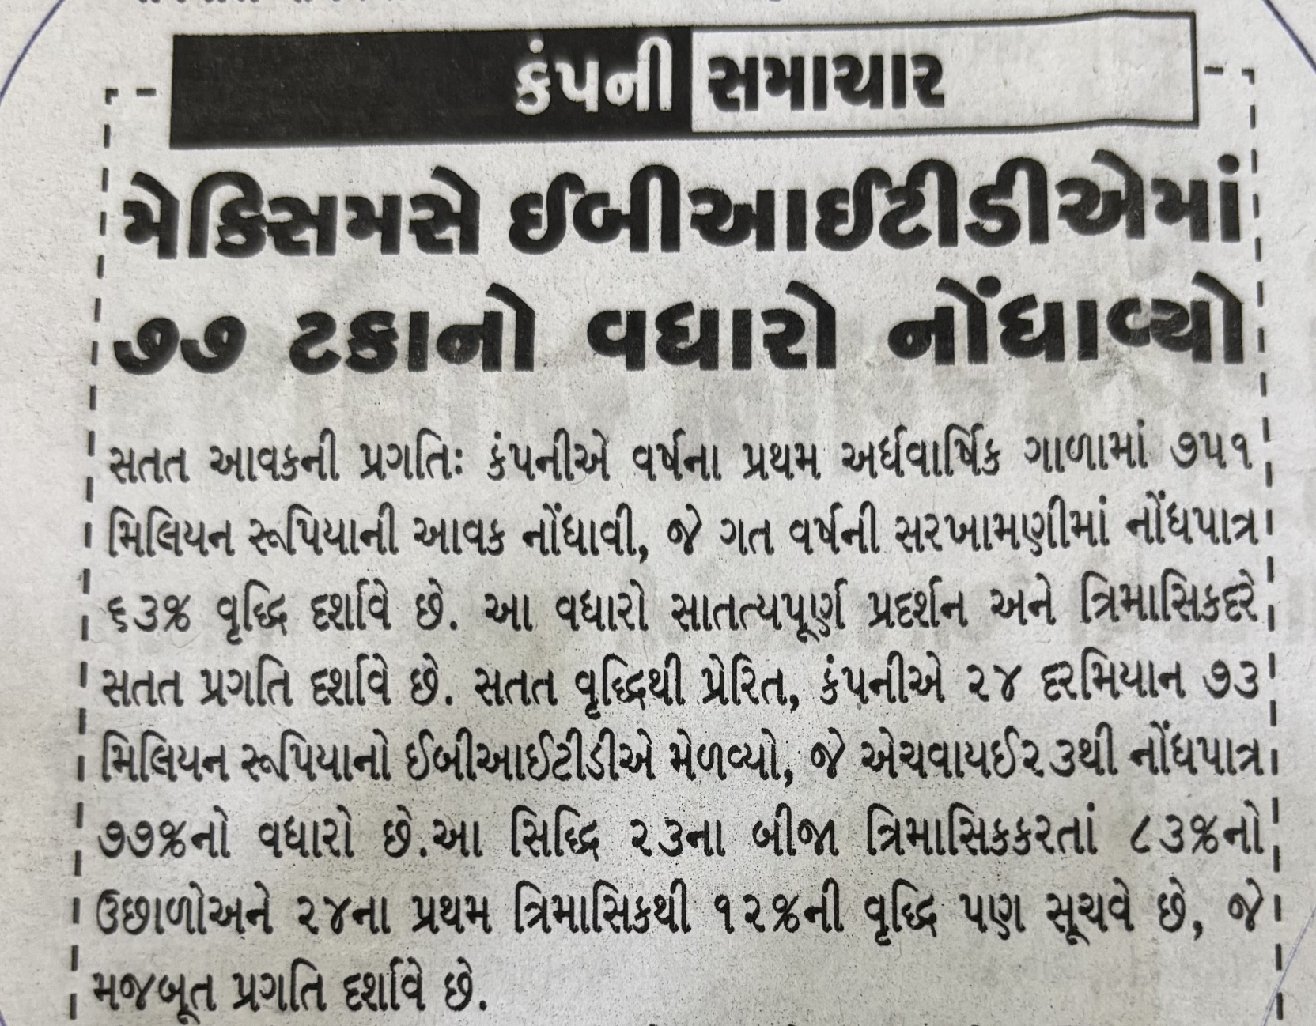
Aaj Kal (Guj) :- Rajkot, Date:-20-11-24, Page no. 10

Slide 9
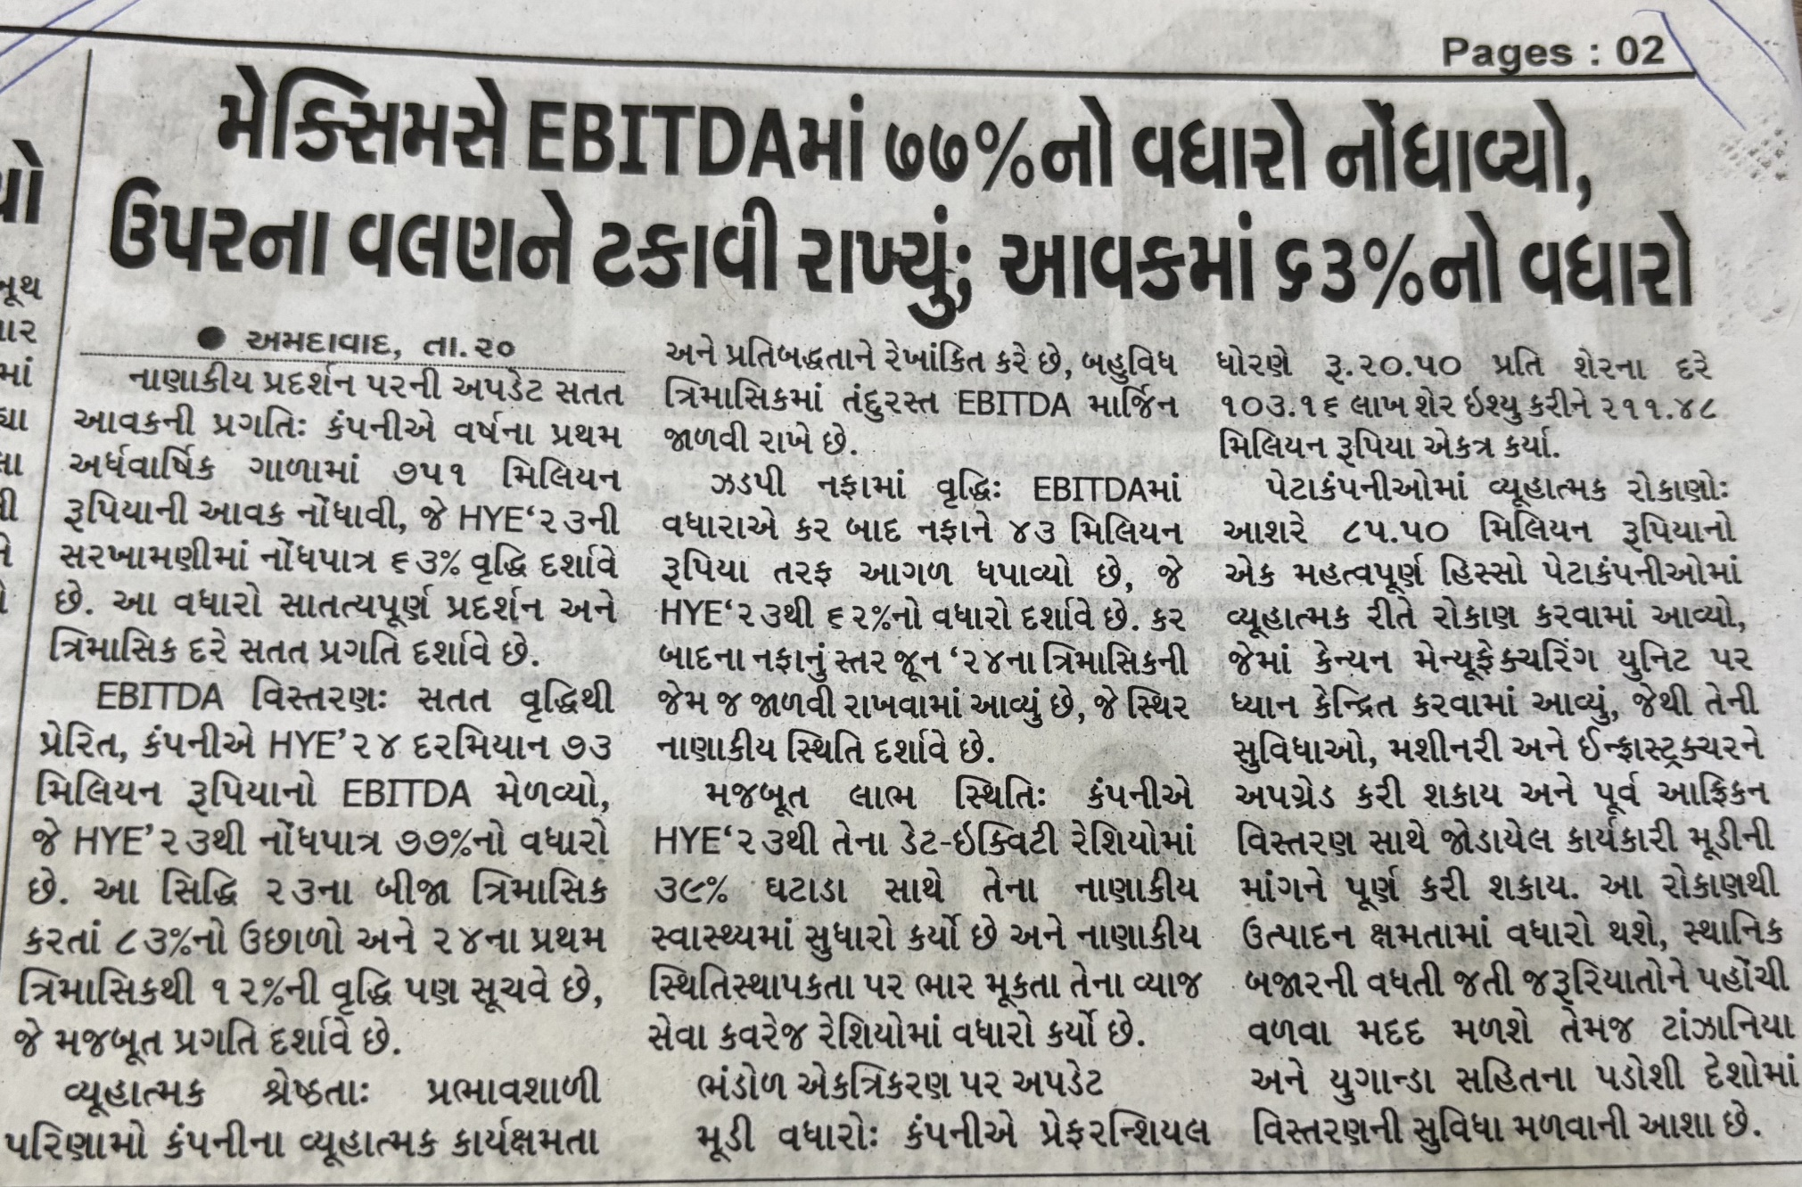
Vadodara Samachar, Date:-21-11-24, Page no. 2

Slide 10
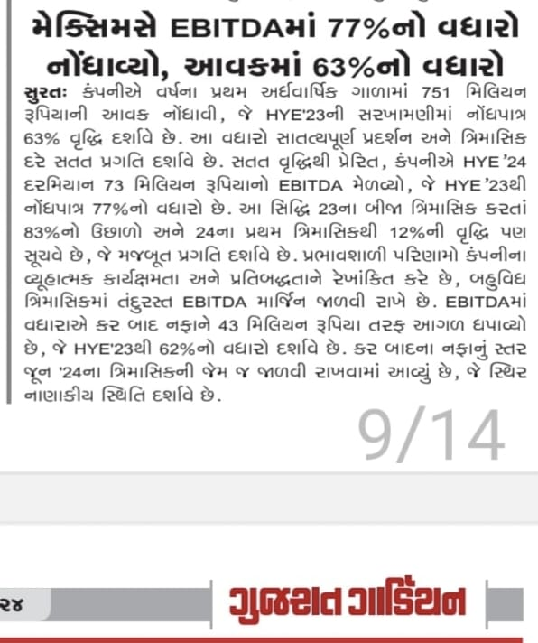
Gujarat Guardian

Slide 11
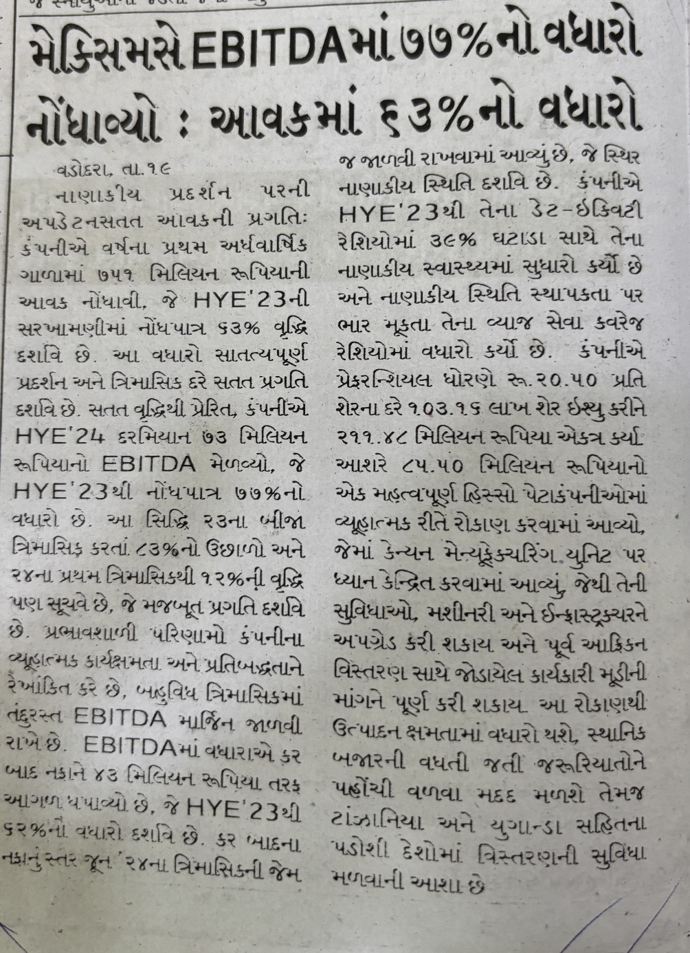
Yugprabhav_Vadodara, Date:-19-11-24, Page no.2

Slide 12
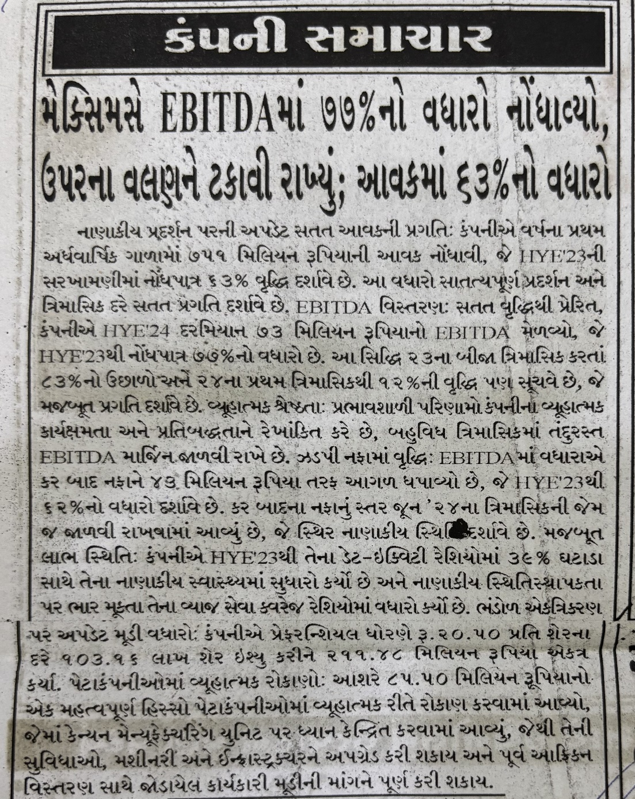
Vadprad Today, Date:-20-11-24, Page no. 2

Slide 13
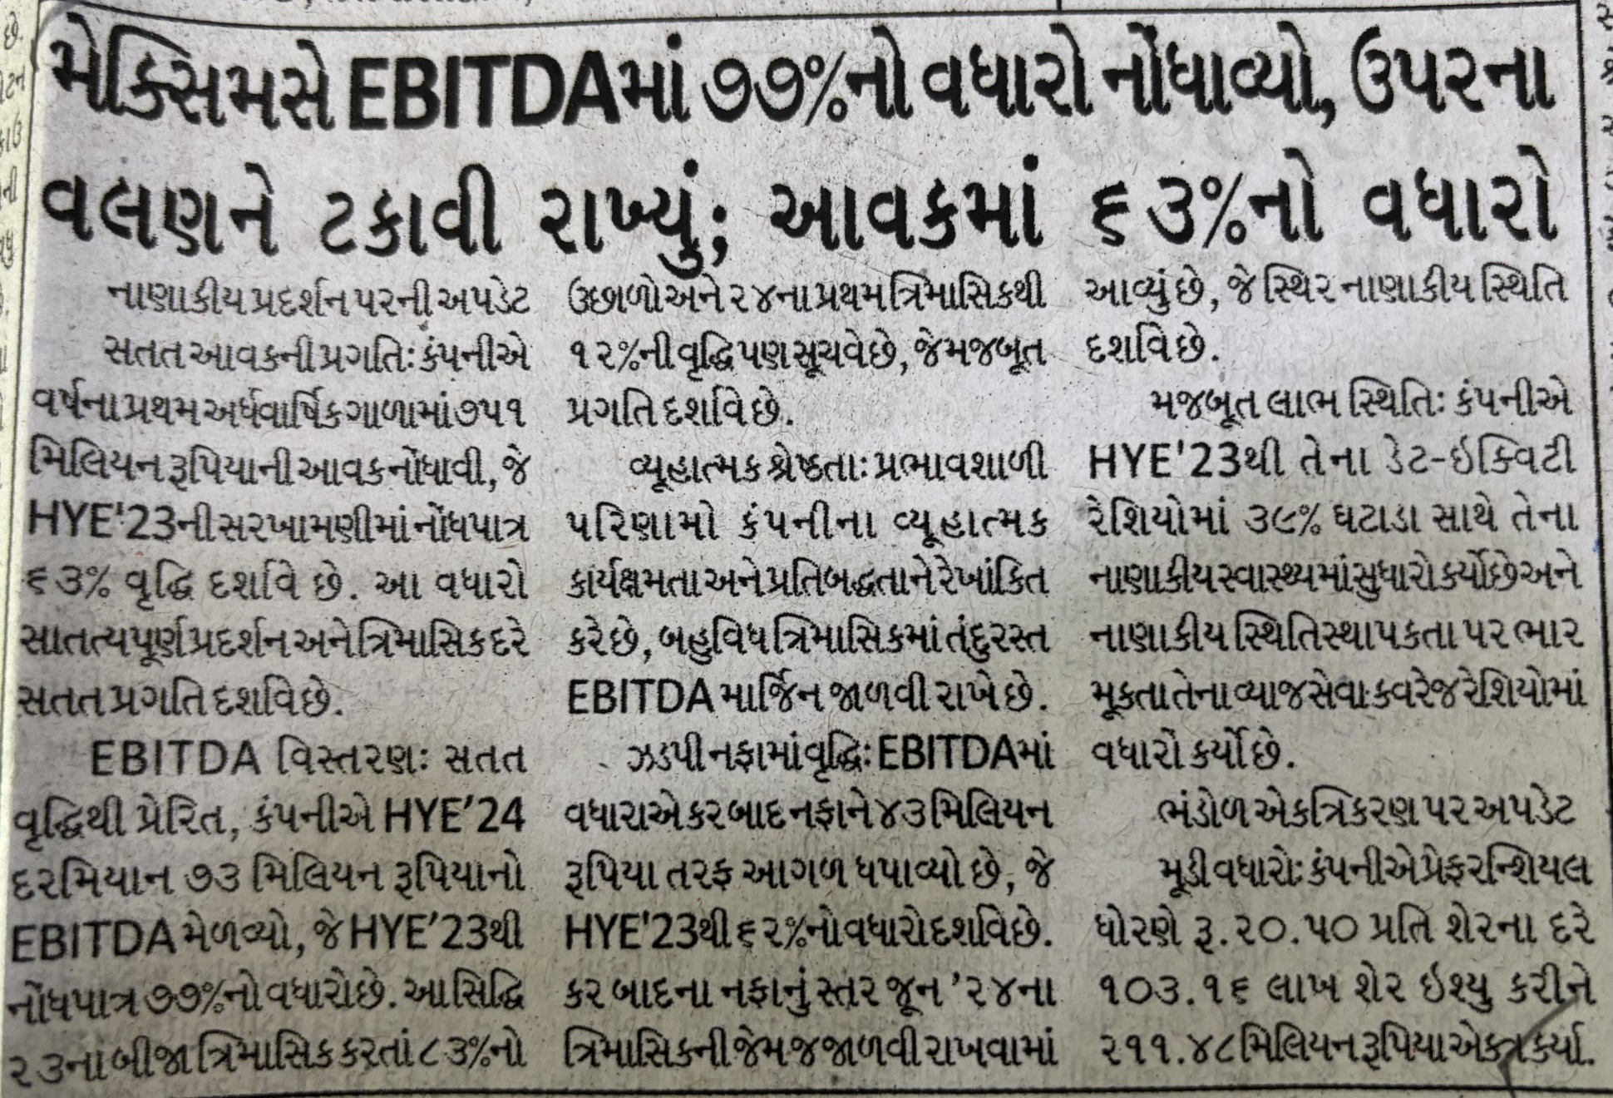
Prabhat-Ahmedabad, Date:-22-11-24, Page No: 2

Slide 14
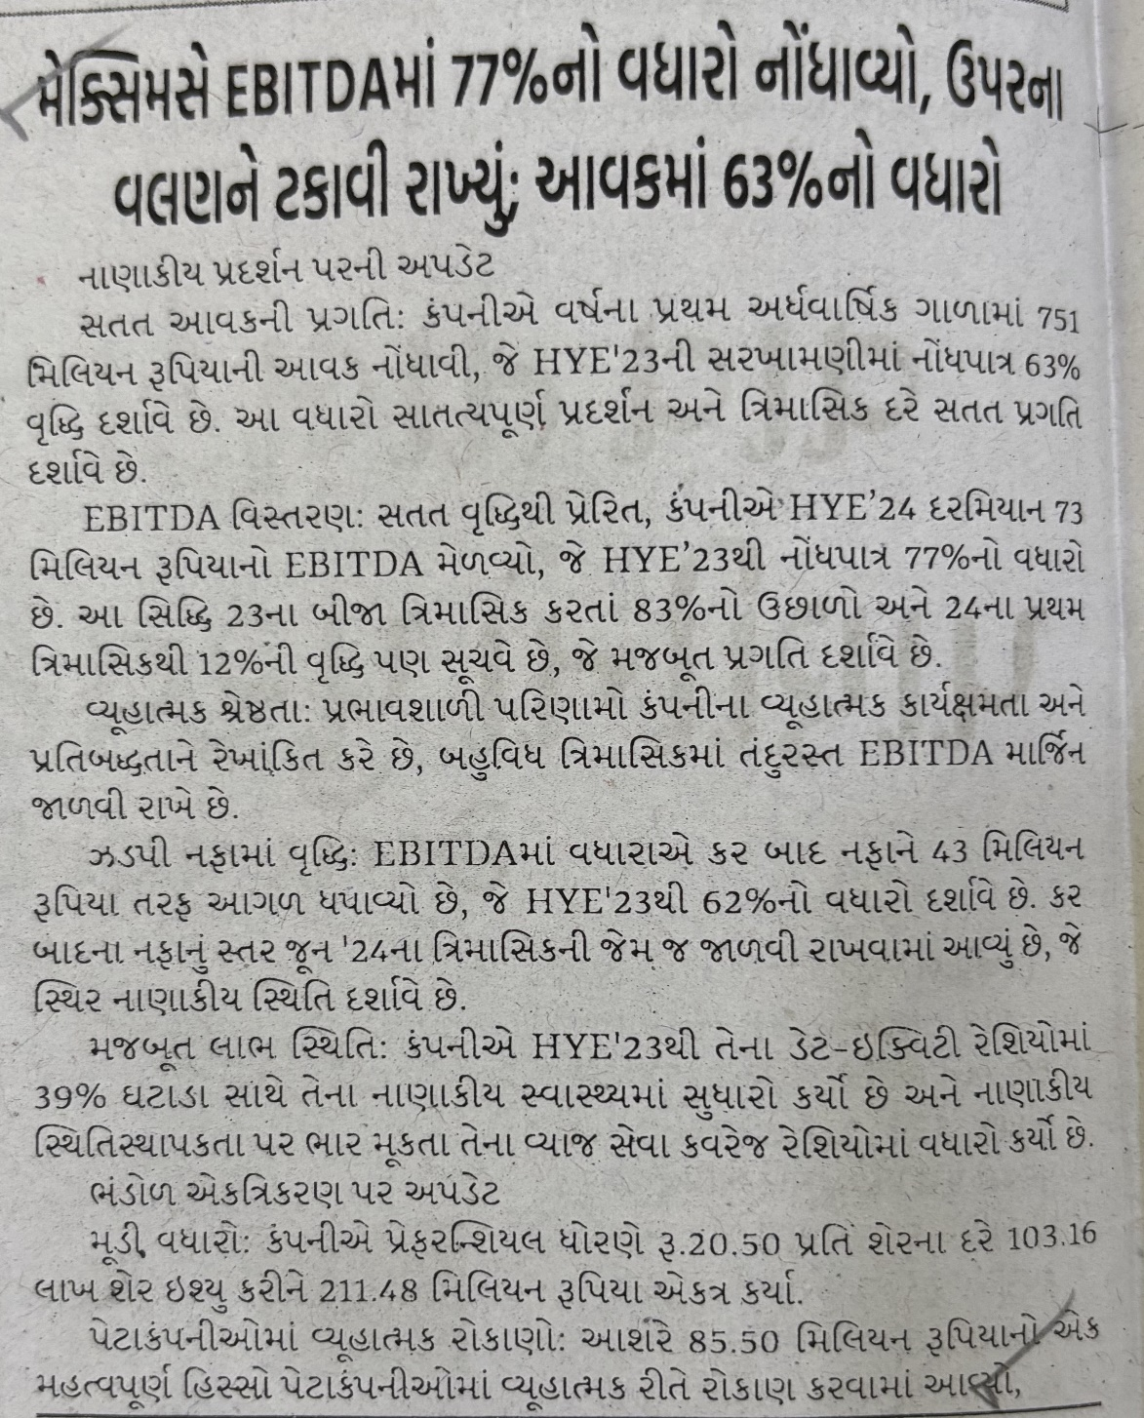
Rakhewal, Date:-21-11-2024, Page No: 4

Slide 15
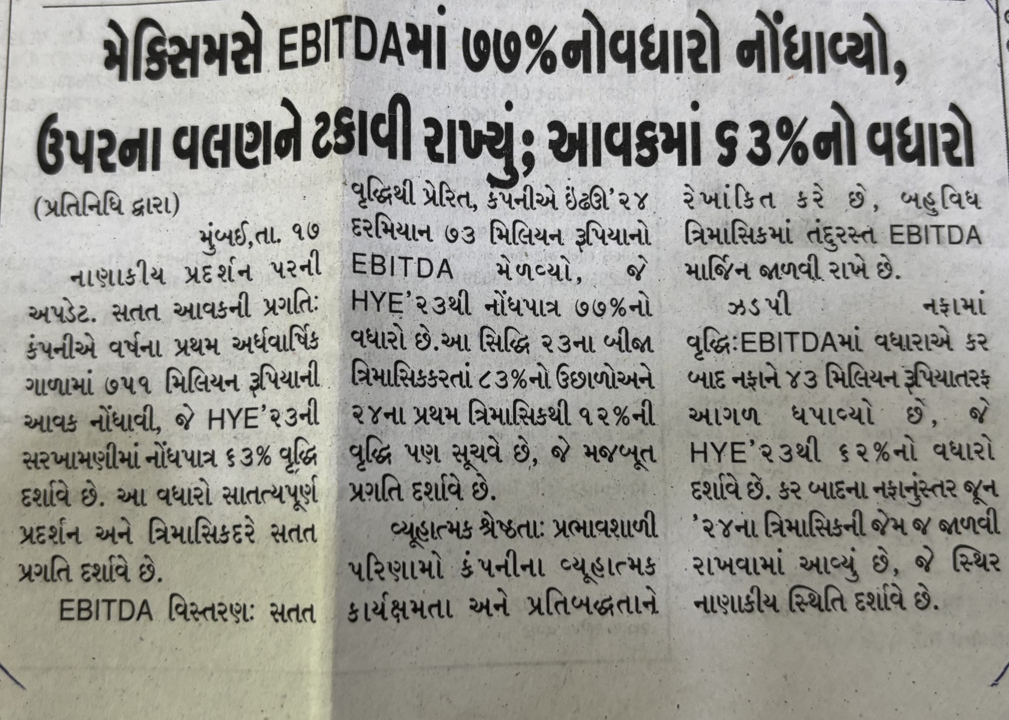
Jai Hind, Page No: 10

Slide 16
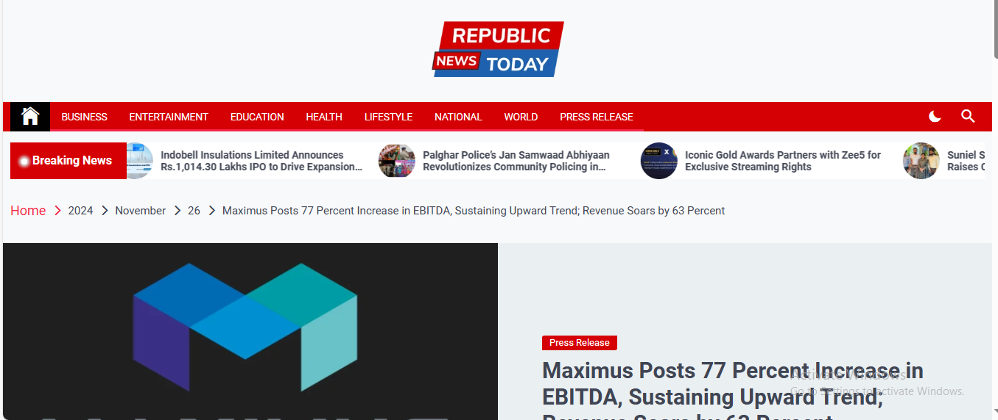
https://republicnewstoday.com/index.php/2024/11/26/maximus-posts-77-percent-increase-in-ebitda-sustaining-upward-trend-revenue-soars-by-63-percent/

Slide 17
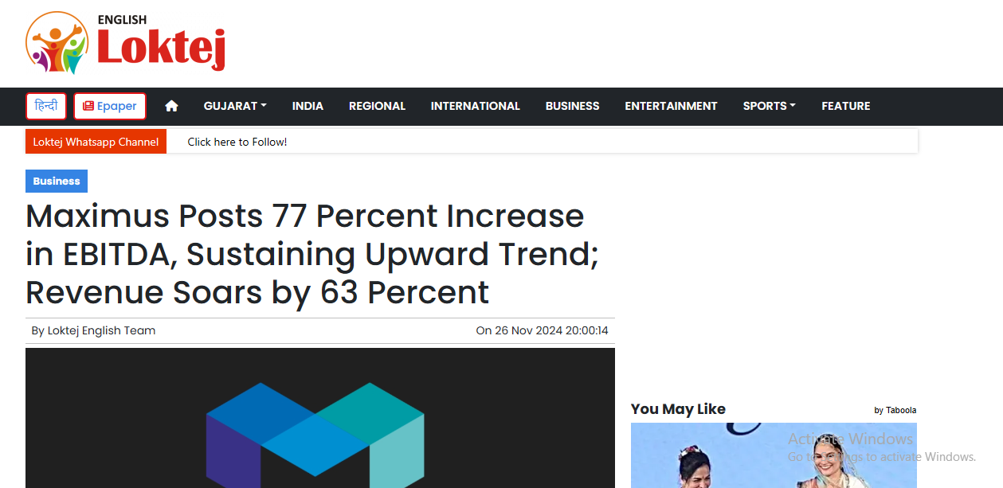
Maximus Posts 77 Percent Increase in EBITDA, Sustaining Upward Trend; Revenue Soars by 63 Percent | Loktej Business News - Loktej English

Slide 18
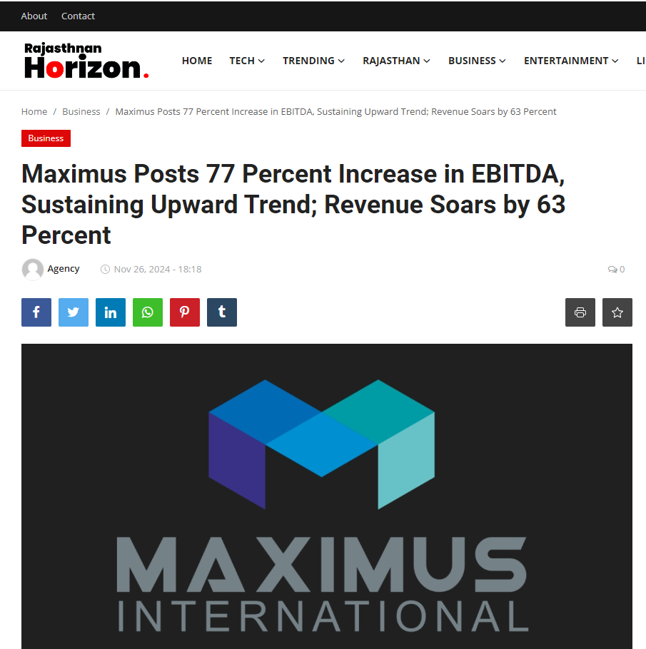
https://www.rajasthanhorizon.com/maximus-posts-77-percent-increase-in-ebitda-sustaining-upward-trend-revenue-soars-by-63-percent

Slide 19
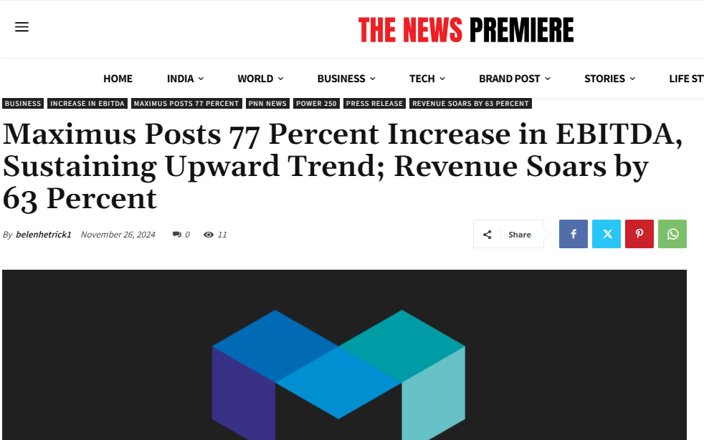
https://thenewspremiere.com/maximus-posts-77-percent-increase-in-ebitda-sustaining-upward-trend-revenue-soars-by-63-percent/

Slide 20
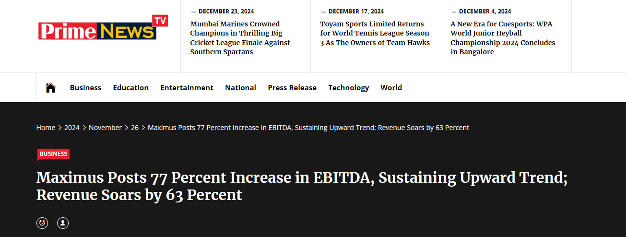
https://primenewstv.com/index.php/2024/11/26/maximus-posts-77-percent-increase-in-ebitda-sustaining-upward-trend-revenue-soars-by-63-percent/

Slide 21
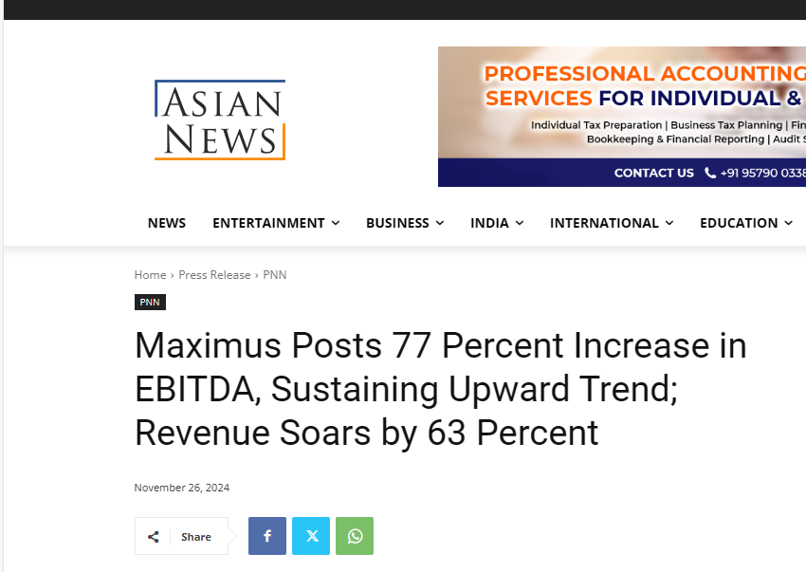
https://asiannews.in/maximus-posts-77-percent-increase-in-ebitda-sustaining-upward-trend-revenue-soars-by-63-percent/

Slide 22
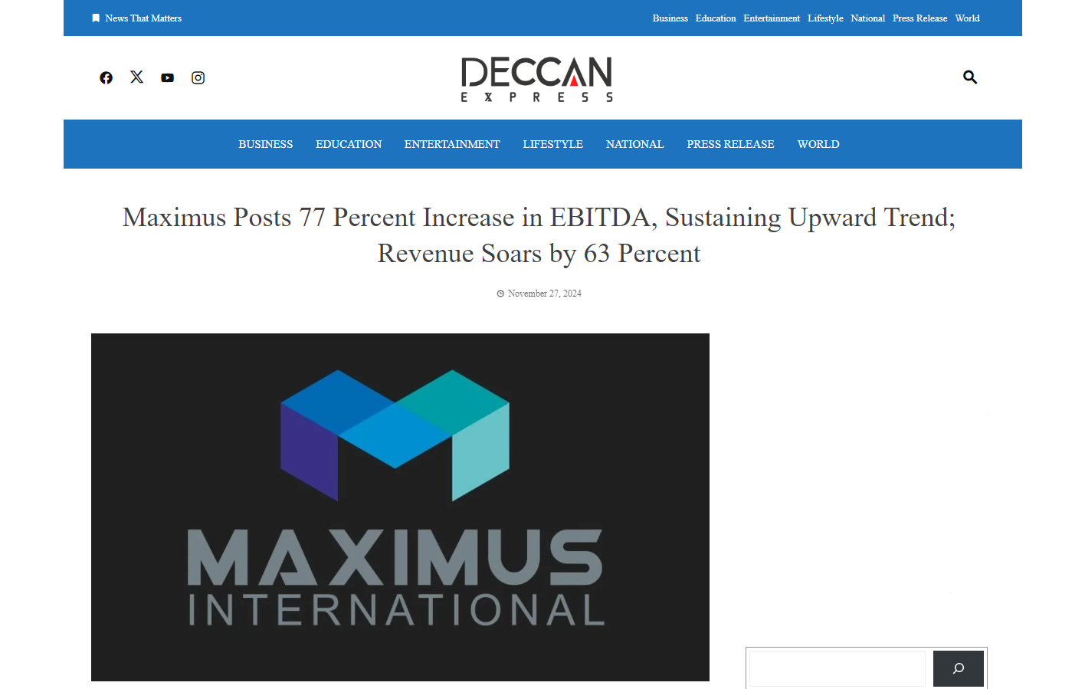
https://deccanexpress.co.in/index.php/press-release/maximus-posts-77-percent-increase-in-ebitda-sustaining-upward-trend-revenue-soars-by-63-percent/

Slide 23
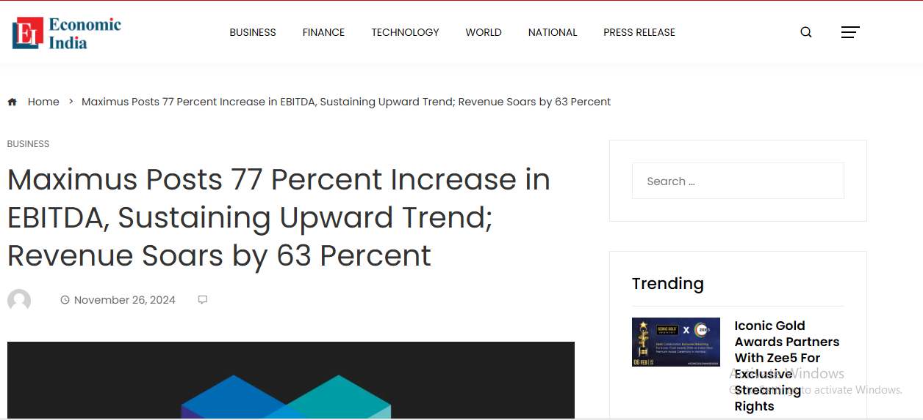
https://economicindia.co.in/business/maximus-posts-77-percent-increase-in-ebitda-sustaining-upward-trend-revenue-soars-by-63-percent/

Slide 24

https://ncr-chronicle.com/press-release/maximus-posts-77-percent-increase-in-ebitda-sustaining-upward-trend-revenue-soars-by-63-percent/

Slide 25
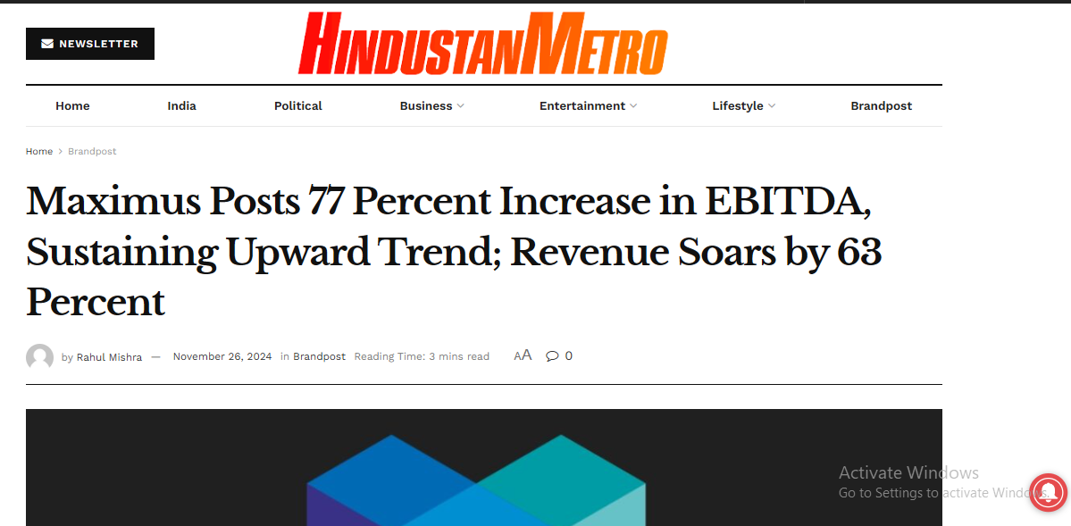
https://hindustanmetro.com/maximus-posts-77-percent-increase-in-ebitda-sustaining-upward-trend-revenue-soars-by-63-percent/

Slide 26

https://financialpost.co.in/index.php/maximus-posts-77-percent-increase-in-ebitda-sustaining-upward-trend-revenue-soars-by-63-percent/

Slide 27
Other Links

Slide 28
https://attentionindia.com/maximus-posts-77-percent-increase-in-ebitda-sustaining-upward-trend-revenue-soars-by-63-percent
https://www.sangritoday.com/spotlight/maximus-posts-77-percent-increase-in-ebitda-sustaining-upward-trend-revenue-soars-by-63-percent
https://thecapitalnews.in/index.php/press-release/maximus-posts-77-percent-increase-in-ebitda-sustaining-upward-trend-revenue-soars-by-63-percent/
https://startupbabu.in/maximus-posts-77-percent-increase-in-ebitda-sustaining-upward-trend-revenue-soars-by-63-percent
https://up18news.com/maximus-posts-77-percent-increase-in-ebitda-sustaining-upward-trend-revenue-soars-by-63-percent/
https://en.samacharsansaar.com/maximus-posts-77-percent-increase-in-ebitda-sustaining-upward-trend-revenue-soars-by-63-percent/

Slide 29
https://newsradian.com/index.php/2024/11/26/maximus-posts-77-percent-increase-in-ebitda-sustaining-upward-trend-revenue-soars-by-63-percent/
https://m.dailyhunt.in/news/india/english/loktej+english-epaper-loktejen/maximus+posts+77+percent+increase+in+ebitda+sustaining+upward+trend+revenue+soars+by+63+percent-newsid-n640907046?sm=Y
https://thenewscartel.com/maximus-posts-77-percent-increase-in-ebitda-sustaining-upward-trend-revenue-soars-by-63-percent/
https://news.google.com/search?q=Maximus%20Posts&amp;amp;hl=en-IN&amp;amp;gl=IN&amp;amp;ceid=IN%3Aen
https://kbktimes.com/maximus-posts-77-percent-increase-in-ebitda-sustaining-upward-trend-revenue-soars-by-63-percent/
https://theeasternage.com/maximus-posts-77-percent-increase-in-ebitda-sustaining-upward-trend-revenue-soars-by-63-percent/
https://independantexpress.com/maximus-posts-77-percent-increase-in-ebitda-sustaining-upward-trend-revenue-soars-by-63-percent/

Slide 30
https://ufonews.in/maximus-posts-77-percent-increase-in-ebitda-sustaining-upward-trend-revenue-soars-by-63-percent/
https://321journal.com/maximus-posts-77-percent-increase-in-ebitda-sustaining-upward-trend-revenue-soars-by-63-percent/
https://dailylatestnews.in/maximus-posts-77-percent-increase-in-ebitda-sustaining-upward-trend-revenue-soars-by-63-percent/
https://flipboard.com/@TheFilmyCharcha/-maximus-posts-77-percent-increase-in-eb/a-Ruhp8Y03RKeGuLQcztOebQ%3Aa%3A3961411955-23971d9ee6%2Fattentionindia.com
https://attentionindianews.substack.com/p/maximus-posts-77-percent-increase?r=2n9p33&amp;amp;utm_campaign=post&amp;amp;utm_medium=web&amp;amp;triedRedirect=true
https://medium.com/@thefilmycharcha/maximus-posts-77-percent-increase-in-ebitda-sustaining-upward-trend-revenue-soars-by-63-percent-0d7d49d4fd5a

Slide 31
https://attentionpedia.com/agency-news/maximus-posts-77-percent-increase-in-ebitda-sustaining-upward-trend-revenue-soars-by-63-percent/
https://yoursvia.com/maximus-posts-77-percent-increase-in-ebitda-sustaining-upward-trend-revenue-soars-by-63-percent
https://logicalindia.in/maximus-posts-77-percent-increase-in-ebitda-sustaining-upward-trend-revenue-soars-by-63-percent
https://theviralindia.com/maximus-posts-77-percent-increase-in-ebitda-sustaining-upward-trend-revenue-soars-by-63-percent
https://theviralbytes.in/maximus-posts-77-percent-increase-in-ebitda-sustaining-upward-trend-revenue-soars-by-63-percent
https://tptv.in/maximus-posts-77-percent-increase-in-ebitda-sustaining-upward-trend-revenue-soars-by-63-percent
https://instastory.in/maximus-posts-77-percent-increase-in-ebitda-sustaining-upward-trend-revenue-soars-by-63-percent

Slide 32
https://fazilkatimes.in/maximus-posts-77-percent-increase-in-ebitda-sustaining-upward-trend-revenue-soars-by-63-percent
https://attentionworlds.com/maximus-posts-77-percent-increase-in-ebitda-sustaining-upward-trend-revenue-soars-by-63-percent
https://entrepreneurworlds.com/maximus-posts-77-percent-increase-in-ebitda-sustaining-upward-trend-revenue-soars-by-63-percent
https://www.jaipur-mirror.com/maximus-posts-77-percent-increase-in-ebitda-sustaining-upward-trend-revenue-soars-by-63-percent
https://www.sangritv.com/maximus-posts-77-percent-increase-in-ebitda-sustaining-upward-trend-revenue-soars-by-63-percent
https://www.sanchoretoday.com/maximus-posts-77-percent-increase-in-ebitda-sustaining-upward-trend-revenue-soars-by-63-percent
https://www.talkpedia.in/maximus-posts-77-percent-increase-in-ebitda-sustaining-upward-trend-revenue-soars-by-63-percent

Slide 33
https://www.marudharbharti.com/en/maximus-posts-77-percent-increase-in-ebitda-sustaining-upward-trend-revenue-soars-by-63-percent
https://www.famousinsider.com/maximus-posts-77-percent-increase-in-ebitda-sustaining-upward-trend-revenue-soars-by-63-percent
https://www.famousnow.in/maximus-posts-77-percent-increase-in-ebitda-sustaining-upward-trend-revenue-soars-by-63-percent
https://www.agrnews.co.in/maximus-posts-77-percent-increase-in-ebitda-sustaining-upward-trend-revenue-soars-by-63-percent
https://www.financetak.com/maximus-posts-77-percent-increase-in-ebitda-sustaining-upward-trend-revenue-soars-by-63-percent
https://indianweekend.in/index.php/2024/11/26/maximus-posts-77-percent-increase-in-ebitda-sustaining-upward-trend-revenue-soars-by-63-percent/
https://en.barmerbulletin.com/maximus-posts-77-percent-increase-in-ebitda-sustaining-upward-trend-revenue-soars-by-63-percent

Slide 34
https://en.nagaurtoday.com/maximus-posts-77-percent-increase-in-ebitda-sustaining-upward-trend-revenue-soars-by-63-percent
https://www.indiadazzle.com/spotlight/maximus-posts-77-percent-increase-in-ebitda-sustaining-upward-trend-revenue-soars-by-63-percent
https://www.sangriexpress.in/maximus-posts-77-percent-increase-in-ebitda-sustaining-upward-trend-revenue-soars-by-63-percent
https://www.mbi24news.com/maximus-posts-77-percent-increase-in-ebitda-sustaining-upward-trend-revenue-soars-by-63-percent
https://www.sptimes.in/maximus-posts-77-percent-increase-in-ebitda-sustaining-upward-trend-revenue-soars-by-63-percent
https://www.ekaainabharat.com/en/maximus-posts-77-percent-increase-in-ebitda-sustaining-upward-trend-revenue-soars-by-63-percent
https://www.shubh24.com/maximus-posts-77-percent-increase-in-ebitda-sustaining-upward-trend-revenue-soars-by-63-percent

Slide 35
https://en.newsbolt.in/maximus-posts-77-percent-increase-in-ebitda-sustaining-upward-trend-revenue-soars-by-63-percent
https://en.jaipurtimes.org/maximus-posts-77-percent-increase-in-ebitda-sustaining-upward-trend-revenue-soars-by-63-percent
https://www.nationrepubliq.com/maximus-posts-77-percent-increase-in-ebitda-sustaining-upward-trend-revenue-soars-by-63-percent
https://en.sangritimes.com/maximus-posts-77-percent-increase-in-ebitda-sustaining-upward-trend-revenue-soars-by-63-percent
https://www.jaipurkiran.com/2024/11/maximus-posts-77-percent-increase-in.html
https://www.educationdaddy.in/maximus-posts-77-percent-increase-in-ebitda-sustaining-upward-trend-revenue-soars-by-63-percent
https://en.marudharaaina.com/2024/11/maximus-posts-77-percent-increase-in.html
https://expresstimesjournal.com/maximus-posts-77-percent-increase-in-ebitda-sustaining-upward-trend-revenue-soars-by-63-percent/

Slide 36
https://thebulletinmirror.com/2024/11/26/maximus-posts-77-percent-increase-in-ebitda-sustaining-upward-trend-revenue-soars-by-63-percent/
https://en.marudharabharti.com/maximus-posts-77-percent-increase-in-ebitda-sustaining-upward-trend-revenue-soars-by-63-percent
https://theoutlookmirror.com/maximus-posts-77-percent-increase-in-ebitda-sustaining-upward-trend-revenue-soars-by-63-percent/
https://en.jalorelive.com/maximus-posts-77-percent-increase-in-ebitda-sustaining-upward-trend-revenue-soars-by-63-percent
https://newsfortune.in/maximus-posts-77-percent-increase-in-ebitda-sustaining-upward-trend-revenue-soars-by-63-percent/
https://newsbliss.in/maximus-posts-77-percent-increase-in-ebitda-sustaining-upward-trend-revenue-soars-by-63-percent/
https://dailysentinel24.com/maximus-posts-77-percent-increase-in-ebitda-sustaining-upward-trend-revenue-soars-by-63-percent/

Slide 37
https://www.thebizzstories.com/maximus-posts-77-percent-increase-in-ebitda-sustaining-upward-trend-revenue-soars-by-63-percent
https://heraldnewstribune.com/maximus-posts-77-percent-increase-in-ebitda-sustaining-upward-trend-revenue-soars-by-63-percent/
https://rockynews.in/maximus-posts-77-percent-increase-in-ebitda-sustaining-upward-trend-revenue-soars-by-63-percent/
https://sohamnews.com/maximus-posts-77-percent-increase-in-ebitda-sustaining-upward-trend-revenue-soars-by-63-percent/
https://bmetanews.com/maximus-posts-77-percent-increase-in-ebitda-sustaining-upward-trend-revenue-soars-by-63-percent/
https://dispatchjounral.com/maximus-posts-77-percent-increase-in-ebitda-sustaining-upward-trend-revenue-soars-by-63-percent/
https://thepulsetribune.com/maximus-posts-77-percent-increase-in-ebitda-sustaining-upward-trend-revenue-soars-by-63-percent/

Slide 38
https://newslancer.in/maximus-posts-77-percent-increase-in-ebitda-sustaining-upward-trend-revenue-soars-by-63-percent/
https://tradeyarrnews.com/maximus-posts-77-percent-increase-in-ebitda-sustaining-upward-trend-revenue-soars-by-63-percent/
https://newsguidepost.com/maximus-posts-77-percent-increase-in-ebitda-sustaining-upward-trend-revenue-soars-by-63-percent/
https://1xstartupnews.com/maximus-posts-77-percent-increase-in-ebitda-sustaining-upward-trend-revenue-soars-by-63-percent/
https://mumbaitimes.online/maximus-posts-77-percent-increase-in-ebitda-sustaining-upward-trend-revenue-soars-by-63-percent/
https://bharatscoops.com/business/maximus-posts-77-percent-increase-in-ebitda-sustaining-upward-trend-revenue-soars-by-63-percent/
https://bhurabhai.com/maximus-posts-77-percent-increase-in-ebitda-sustaining-upward-trend-revenue-soars-by-63-percent/

Slide 39
https://iambhojpuriya.com/maximus-posts-77-percent-increase-in-ebitda-sustaining-upward-trend-revenue-soars-by-63-percent/
https://khabarebharat.com/maximus-posts-77-percent-increase-in-ebitda-sustaining-upward-trend-revenue-soars-by-63-percent/
https://thebharatjournal.com/index.php/2024/11/26/maximus-posts-77-percent-increase-in-ebitda-sustaining-upward-trend-revenue-soars-by-63-percent/
https://wowentrepreneurs.in/index.php/2024/11/26/maximus-posts-77-percent-increase-in-ebitda-sustaining-upward-trend-revenue-soars-by-63-percent/
https://kamalnewsindia.com/maximus-posts-77-percent-increase-in-ebitda-sustaining-upward-trend-revenue-soars-by-63-percent/
https://zambianewstoday.com/index.php/2024/11/26/maximus-posts-77-percent-increase-in-ebitda-sustaining-upward-trend-revenue-soars-by-63-percent/
https://privilegednews.com/index.php/2024/11/26/maximus-posts-77-percent-increase-in-ebitda-sustaining-upward-trend-revenue-soars-by-63-percent/

Slide 40
https://khabreindia.com/index.php/2024/11/26/maximus-posts-77-percent-increase-in-ebitda-sustaining-upward-trend-revenue-soars-by-63-percent/
https://dailyhindu.in/index.php/2024/11/26/maximus-posts-77-percent-increase-in-ebitda-sustaining-upward-trend-revenue-soars-by-63-percent/
https://a2znewspaper.com/maximus-posts-77-percent-increase-in-ebitda-sustaining-upward-trend-revenue-soars-by-63-percent/ https://assianews.com/index.php/maximus-posts-77-percent-increase-in-ebitda-sustaining-upward-trend-revenue-soars-by-63-percent/
https://bestnewsjournal.com/maximus-posts-77-percent-increase-in-ebitda-sustaining-upward-trend-revenue-soars-by-63-percent/
https://financialnewsday.com/maximus-posts-77-percent-increase-in-ebitda-sustaining-upward-trend-revenue-soars-by-63-percent/
https://forexnewstimes.com/index.php/maximus-posts-77-percent-increase-in-ebitda-sustaining-upward-trend-revenue-soars-by-63-percent/

Slide 41
https://globalnewstonight.com/index.php/2024/11/26/maximus-posts-77-percent-increase-in-ebitda-sustaining-upward-trend-revenue-soars-by-63-percent/
https://inbusinesstimes.com/maximus-posts-77-percent-increase-in-ebitda-sustaining-upward-trend-revenue-soars-by-63-percent/
https://justnewsnow.com/index.php/maximus-posts-77-percent-increase-in-ebitda-sustaining-upward-trend-revenue-soars-by-63-percent/
https://latestgoldnews.com/index.php/2024/11/26/maximus-posts-77-percent-increase-in-ebitda-sustaining-upward-trend-revenue-soars-by-63-percent/
https://newsecontent.com/maximus-posts-77-percent-increase-in-ebitda-sustaining-upward-trend-revenue-soars-by-63-percent/
https://newsroombuzz.com/index.php/maximus-posts-77-percent-increase-in-ebitda-sustaining-upward-trend-revenue-soars-by-63-percent/
https://newssupplydaily.com/index.php/2024/11/26/maximus-posts-77-percent-increase-in-ebitda-sustaining-upward-trend-revenue-soars-by-63-percent/

Slide 42
https://newstrenddaily.com/index.php/2024/11/26/maximus-posts-77-percent-increase-in-ebitda-sustaining-upward-trend-revenue-soars-by-63-percent/
https://punemetronews.com/index.php/maximus-posts-77-percent-increase-in-ebitda-sustaining-upward-trend-revenue-soars-by-63-percent/
https://newswireindia.in/index.php/2024/11/26/maximus-posts-77-percent-increase-in-ebitda-sustaining-upward-trend-revenue-soars-by-63-percent/
https://rtnews24.com/index.php/maximus-posts-77-percent-increase-in-ebitda-sustaining-upward-trend-revenue-soars-by-63-percent/
https://snbindianews.com/maximus-posts-77-percent-increase-in-ebitda-sustaining-upward-trend-revenue-soars-by-63-percent/
https://starnewsline.com/index.php/maximus-posts-77-percent-increase-in-ebitda-sustaining-upward-trend-revenue-soars-by-63-percent/
https://urbannewsonline.com/index.php/maximus-posts-77-percent-increase-in-ebitda-sustaining-upward-trend-revenue-soars-by-63-percent/

Slide 43
https://venturecompanynews.com/index.php/maximus-posts-77-percent-increase-in-ebitda-sustaining-upward-trend-revenue-soars-by-63-percent/
https://worldnewsforall.com/index.php/maximus-posts-77-percent-increase-in-ebitda-sustaining-upward-trend-revenue-soars-by-63-percent/
https://atulyahindustan.in/index.php/maximus-posts-77-percent-increase-in-ebitda-sustaining-upward-trend-revenue-soars-by-63-percent/
https://biznewss.in/index.php/maximus-posts-77-percent-increase-in-ebitda-sustaining-upward-trend-revenue-soars-by-63-percent/
https://city-lights.in/index.php/2024/11/26/maximus-posts-77-percent-increase-in-ebitda-sustaining-upward-trend-revenue-soars-by-63-percent
https://cityreporters.in/index.php/2024/11/26/maximus-posts-77-percent-increase-in-ebitda-sustaining-upward-trend-revenue-soars-by-63-percent
https://dailybulletin.co.in/index.php/business/maximus-posts-77-percent-increase-in-ebitda-sustaining-upward-trend-revenue-soars-by-63-percent/

Slide 44
https://dailynewsindia.co.in/index.php/maximus-posts-77-percent-increase-in-ebitda-sustaining-upward-trend-revenue-soars-by-63-percent/
https://financialtelegraph.in/index.php/maximus-posts-77-percent-increase-in-ebitda-sustaining-upward-trend-revenue-soars-by-63-percent/
https://higujarat.com/index.php/2024/11/26/maximus-posts-77-percent-increase-in-ebitda-sustaining-upward-trend-revenue-soars-by-63-percent/
https://indiafirstnews.in/index.php/2024/11/26/maximus-posts-77-percent-increase-in-ebitda-sustaining-upward-trend-revenue-soars-by-63-percent/
https://indianbusinessline.com/index.php/2024/11/26/maximus-posts-77-percent-increase-in-ebitda-sustaining-upward-trend-revenue-soars-by-63-percent/
https://indiannewsmaker.com/index.php/2024/11/26/maximus-posts-77-percent-increase-in-ebitda-sustaining-upward-trend-revenue-soars-by-63-percent/
https://mycountry.co.in/index.php/2024/11/26/maximus-posts-77-percent-increase-in-ebitda-sustaining-upward-trend-revenue-soars-by-63-percent/

Slide 45
https://newindiaherald.com/index.php/2024/11/26/maximus-posts-77-percent-increase-in-ebitda-sustaining-upward-trend-revenue-soars-by-63-percent/
https://news-scoop.in/index.php/2024/11/26/maximus-posts-77-percent-increase-in-ebitda-sustaining-upward-trend-revenue-soars-by-63-percent/
https://news21.co.in/index.php/maximus-posts-77-percent-increase-in-ebitda-sustaining-upward-trend-revenue-soars-by-63-percent/
https://primexnewsinternational.com/index.php/maximus-posts-77-percent-increase-in-ebitda-sustaining-upward-trend-revenue-soars-by-63-percent/
https://real-news.co.in/index.php/maximus-posts-77-percent-increase-in-ebitda-sustaining-upward-trend-revenue-soars-by-63-percent/
https://republic21.in/index.php/maximus-posts-77-percent-increase-in-ebitda-sustaining-upward-trend-revenue-soars-by-63-percent/
https://storywriter.co.in/index.php/2024/11/26/maximus-posts-77-percent-increase-in-ebitda-sustaining-upward-trend-revenue-soars-by-63-percent/

Slide 46
https://the24nation.com/index.php/maximus-posts-77-percent-increase-in-ebitda-sustaining-upward-trend-revenue-soars-by-63-percent/
https://thebigindia.co.in/index.php/2024/11/26/maximus-posts-77-percent-increase-in-ebitda-sustaining-upward-trend-revenue-soars-by-63-percent/
https://thegrandmedia.in/index.php/2024/11/26/maximus-posts-77-percent-increase-in-ebitda-sustaining-upward-trend-revenue-soars-by-63-percent/
https://theindianjournal.in/index.php/2024/11/26/maximus-posts-77-percent-increase-in-ebitda-sustaining-upward-trend-revenue-soars-by-63-percent/
https://themsmenews.com/index.php/2024/11/26/maximus-posts-77-percent-increase-in-ebitda-sustaining-upward-trend-revenue-soars-by-63-percent/
https://thenationalage.com/index.php/2024/11/26/maximus-posts-77-percent-increase-in-ebitda-sustaining-upward-trend-revenue-soars-by-63-percent/
https://thenationaldaily.in/index.php/2024/11/26/maximus-posts-77-percent-increase-in-ebitda-sustaining-upward-trend-revenue-soars-by-63-percent/

Slide 47
https://thenationtimes.co.in/index.php/2024/11/26/maximus-posts-77-percent-increase-in-ebitda-sustaining-upward-trend-revenue-soars-by-63-percent/
https://thenewsbharti.com/index.php/2024/11/26/maximus-posts-77-percent-increase-in-ebitda-sustaining-upward-trend-revenue-soars-by-63-percent/
https://theprimeindia.in/index.php/2024/11/26/maximus-posts-77-percent-increase-in-ebitda-sustaining-upward-trend-revenue-soars-by-63-percent/
https://thesamay.co.in/index.php/2024/11/26/maximus-posts-77-percent-increase-in-ebitda-sustaining-upward-trend-revenue-soars-by-63-percent/
https://thestartupstory.co.in/index.php/2024/11/26/maximus-posts-77-percent-increase-in-ebitda-sustaining-upward-trend-revenue-soars-by-63-percent/
https://thetimes24.in/index.php/2024/11/26/maximus-posts-77-percent-increase-in-ebitda-sustaining-upward-trend-revenue-soars-by-63-percent/
https://theudyog.in/index.php/2024/11/26/maximus-posts-77-percent-increase-in-ebitda-sustaining-upward-trend-revenue-soars-by-63-percent/

Slide 48
https://sahityahindustan.com/index.php/2024/11/26/maximus-posts-77-percent-increase-in-ebitda-sustaining-upward-trend-revenue-soars-by-63-percent/
https://gvblnews.com/maximus-posts-77-percent-increase-in-ebitda-sustaining-upward-trend-revenue-soars-by-63-percent/
https://newswiredelhi.com/index.php/maximus-posts-77-percent-increase-in-ebitda-sustaining-upward-trend-revenue-soars-by-63-percent/
https://arizonianweekly.com/maximus-posts-77-percent-increase-in-ebitda-sustaining-upward-trend-revenue-soars-by-63-percent/
https://haywardsentinel.com/business/maximus-posts-77-percent-increase-in-ebitda-sustaining-upward-trend-revenue-soars-by-63-percent/
https://thealabamajournal.com/maximus-posts-77-percent-increase-in-ebitda-sustaining-upward-trend-revenue-soars-by-63-percent/
https://bniindia.in/?p=44780
https://businessvoicenow.com/?p=37037

Slide 49
https://companyvoice.in/?p=46387
https://indiaheadline.in/?p=43030
https://republic-india.com/?p=46838
https://prevalentindia.in/index.php/press-release/maximus-posts-77-percent-increase-in-ebitda-sustaining-upward-trend-revenue-soars-by-63-percent/
https://lucnkowdigital.com/press-release/maximus-posts-77-percent-increase-in-ebitda-sustaining-upward-trend-revenue-soars-by-63-percent/
https://rajasthanjournal.com/press-release/maximus-posts-77-percent-increase-in-ebitda-sustaining-upward-trend-revenue-soars-by-63-percent/
https://maharashtra24x7.com/press-release/maximus-posts-77-percent-increase-in-ebitda-sustaining-upward-trend-revenue-soars-by-63-percent/
https://up-patrika.com/press-release/maximus-posts-77-percent-increase-in-ebitda-sustaining-upward-trend-revenue-soars-by-63-percent/

Slide 50
https://kanpurlive.in/press-release/maximus-posts-77-percent-increase-in-ebitda-sustaining-upward-trend-revenue-soars-by-63-percent/
https://livejabalpur.com/press-release/maximus-posts-77-percent-increase-in-ebitda-sustaining-upward-trend-revenue-soars-by-63-percent/
https://rajasthanmirror.com/press-release/maximus-posts-77-percent-increase-in-ebitda-sustaining-upward-trend-revenue-soars-by-63-percent/
https://northwestnewstimes.com/index.php/press-release/maximus-posts-77-percent-increase-in-ebitda-sustaining-upward-trend-revenue-soars-by-63-percent/
https://mpnewsline.com/press-release/maximus-posts-77-percent-increase-in-ebitda-sustaining-upward-trend-revenue-soars-by-63-percent/
https://delhinewsnow.com/index.php/2024/11/27/maximus-posts-77-percent-increase-in-ebitda-sustaining-upward-trend-revenue-soars-by-63-percent/
https://delhimorningtribune.com/press-release/maximus-posts-77-percent-increase-in-ebitda-sustaining-upward-trend-revenue-soars-by-63-percent/

Slide 51
https://theeveningpost.in/index.php/press-release/maximus-posts-77-percent-increase-in-ebitda-sustaining-upward-trend-revenue-soars-by-63-percent/
https://bhopalsuntimes.com/press-release/maximus-posts-77-percent-increase-in-ebitda-sustaining-upward-trend-revenue-soars-by-63-percent/
https://mpguardian.com/index.php/2024/11/27/maximus-posts-77-percent-increase-in-ebitda-sustaining-upward-trend-revenue-soars-by-63-percent/
https://udaipurdispatch.com/2024/11/27/maximus-posts-77-percent-increase-in-ebitda-sustaining-upward-trend-revenue-soars-by-63-percent/
https://jodhpurreporter.com/index.php/2024/11/27/maximus-posts-77-percent-increase-in-ebitda-sustaining-upward-trend-revenue-soars-by-63-percent/
https://nashik24.com/index.php/2024/11/27/maximus-posts-77-percent-increase-in-ebitda-sustaining-upward-trend-revenue-soars-by-63-percent/
https://bizzsight.com/index.php/2024/11/27/maximus-posts-77-percent-increase-in-ebitda-sustaining-upward-trend-revenue-soars-by-63-percent/

Slide 52
https://nationalinsight.in/index.php/press-release/maximus-posts-77-percent-increase-in-ebitda-sustaining-upward-trend-revenue-soars-by-63-percent/
https://pinkcitynow.com/index.php/2024/11/27/maximus-posts-77-percent-increase-in-ebitda-sustaining-upward-trend-revenue-soars-by-63-percent/
https://khabarerajasthan.com/index.php/2024/11/27/maximus-posts-77-percent-increase-in-ebitda-sustaining-upward-trend-revenue-soars-by-63-percent/
https://holamumbai.com/press-release/maximus-posts-77-percent-increase-in-ebitda-sustaining-upward-trend-revenue-soars-by-63-percent/
https://prakharjagaran.com/maximus-posts-77-percent-increase-in-ebitda-sustaining-upward-trend-revenue-soars-by-63-percent/
https://sattaexpress.co.in/index.php/2024/11/27/maximus-posts-77-percent-increase-in-ebitda-sustaining-upward-trend-revenue-soars-by-63-percent/
https://rajasthanexpress.in/index.php/2024/11/27/maximus-posts-77-percent-increase-in-ebitda-sustaining-upward-trend-revenue-soars-by-63-percent/

Slide 53
https://businesspoint.co.in/index.php/press-release/maximus-posts-77-percent-increase-in-ebitda-sustaining-upward-trend-revenue-soars-by-63-percent/
https://nagpurnewstoday.com/index.php/2024/11/27/maximus-posts-77-percent-increase-in-ebitda-sustaining-upward-trend-revenue-soars-by-63-percent/
https://delhinewswatch.com/index.php/2024/11/27/maximus-posts-77-percent-increase-in-ebitda-sustaining-upward-trend-revenue-soars-by-63-percent/
https://indorepioneer.com/index.php/press-release/maximus-posts-77-percent-increase-in-ebitda-sustaining-upward-trend-revenue-soars-by-63-percent/
https://gwaliorbuzz.com/index.php/2024/11/27/maximus-posts-77-percent-increase-in-ebitda-sustaining-upward-trend-revenue-soars-by-63-percent/
https://newstrackbhopal.com/index.php/2024/11/27/maximus-posts-77-percent-increase-in-ebitda-sustaining-upward-trend-revenue-soars-by-63-percent/
https://madhyapradeshherald.com/press-release/maximus-posts-77-percent-increase-in-ebitda-sustaining-upward-trend-revenue-soars-by-63-percent/

Slide 54
https://risingentrepreneurs.in/index.php/press-release/maximus-posts-77-percent-increase-in-ebitda-sustaining-upward-trend-revenue-soars-by-63-percent/
https://newsdaddy.co.in/index.php/press-release/maximus-posts-77-percent-increase-in-ebitda-sustaining-upward-trend-revenue-soars-by-63-percent/
https://mint-money.in/index.php/press-release/maximus-posts-77-percent-increase-in-ebitda-sustaining-upward-trend-revenue-soars-by-63-percent/

